Slide 1
4G

Slide 2

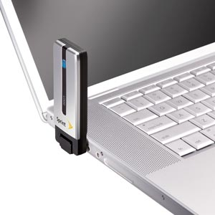
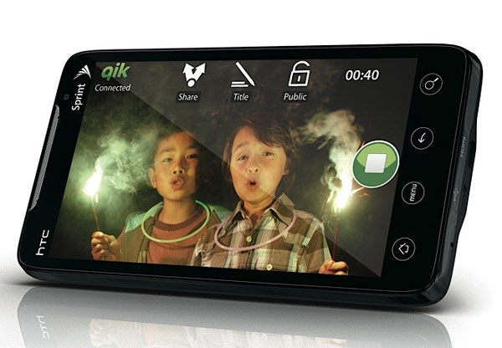
HYPE – 10 MBPS
Reality – 2 MBPAS
Watch TV or Video on Your handheld Device
No Hotspot Required
It is 2X to 3X faster than 3G
Nice improvement for Cell Phones

Slide 3
IPAD

Slide 4
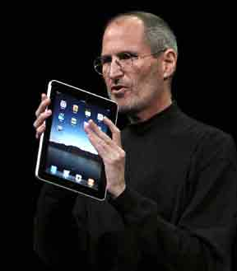
IPAD
$649 to $1,249
Really Just a Big iTouch
I Like the iTouch
Easier to Read Than iTouch
Far Too Big To be Handheld
Not as Powerful as Laptop
Costs More Than A Laptop
Heavier than eReaders
Fingerprints
Accidental Menus
Carlton’s Advice, Get a Laptop – less Money, Does More, More Powerful

Slide 5
Iphone 4

Slide 6
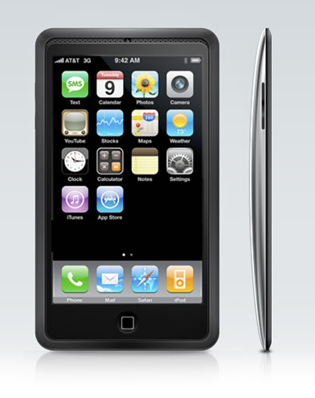
iPhone4
$199 to $299
Really Just a iTouch w/ Phone
I Like the iTouch
Easier to Read Than iTouch
Far Too Big To be Handheld
Not as Powerful as Laptop
Costs More Than A Laptop
Heavier than eReaders
Fingerprints
Accidental Menus

Slide 7
Blu-Ray

Slide 8


Blu-Ray
$ = Varies
Blue Laser Beams Are 1/10th The Size of Red Laser Beams
Thus Blu-Ray Disks can Squeeze Ten Times the Information Than a Standard DVD
Which Allows for HD DVDs

Slide 9
GoogleTV

Slide 10

Google TV
Web & TV Merge
SlingBox to Android Phones

Slide 11
Dell Streak

Slide 12
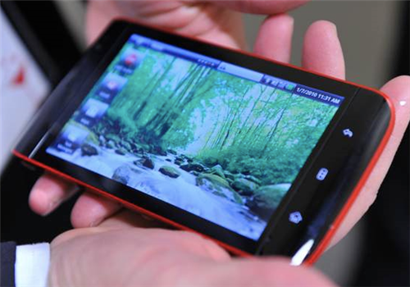
Dell Streak
$299
Dell’s Answer to iTouch
Google Maps w/ Navigation

Slide 13
Dell’s Looking Glass

Slide 14
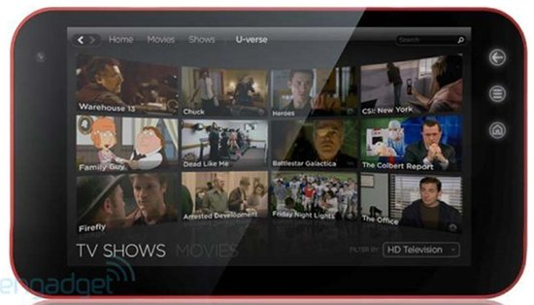
Dell Looking Glass
$399
Dell’s Answer to iPad
Just a Bigger Streak
Google Maps w/ Navigation

Slide 15
Data Inherit

Slide 16
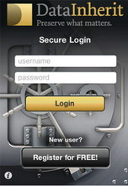
Swiss Company
$16.50/Month
Stores all of you Passwords
And 25 GBs of Data
Passes to your loved one’s when you die
Sign of the times
What about your electronic data when you die?
Erase it? All of it? Save it? Who owns it? Is there value? Is there embarrassment?

Slide 17
Flavors.Me

Slide 18

Flavors.me
$20 a Year
Create dynamic website using your personal web content.
http://flavors.me/carltoncollins

Slide 19
Canoe Lake

Slide 20
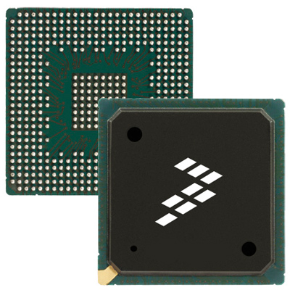
Intel’s Canoe Lake Atom Chips
Lower Cost (<$199)
Smaller
Promises 8 Hour Battery Life
Only supports Linux
Chip Makers Targeting Cell Phone and Netbook Markets
http://en.wikipedia.org/wiki/Intel_Atom

Slide 21
Tab Napping

Slide 22

Coming Soon! – “Tab Napping”
Sneaky Virus replaces legitimate open tabbed browsers with fake browsers, and then asks you to reenter your login information
http://www.pcworld.com/article/197299/how_to_foil_web_browser_tabnapping.html

Slide 23
Spector Pro

Slide 24


Spector Pro
$99
Records every detail of what your kids or employees do on their computer.
Chats, instant messages, emails, the web sites they visit, what they search for, what they do on MySpace and Facebook, the pictures they post and look at, the keystrokes they type.
Office Wide Version Too – SpectorPro 360.
http://www.spectorsoft.com/

Slide 25
Sprint Overdrive

Slide 26
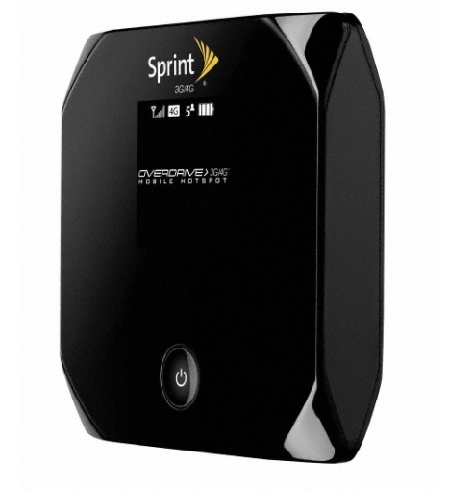
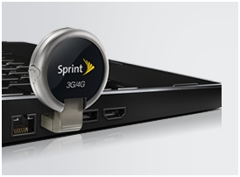
Sprint Overdrive
$100 + $60/Month
4G Portable Hotspot for 5 Users
Fits in Shirt Pocket
Defaults to 3G and 2G when 4G is not available
http://mobilebusiness.sprint.com/broadband/index.html?pid=4&id9=vanity:overdrive?id9=SEM_Google_C_Sprint_Mobile_Broadband

Slide 27
Green Slim

Slide 28
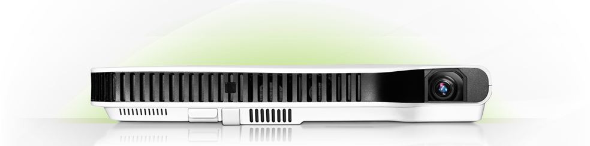
Casio Green Slim Projector
$849
2,500 Lumens
20,000 Hour Bulb
Mercury Free
Wireless Communication
5 Pounds
1.7"H x 11.7"W x 8.3"D
http://www.superslimprojector.com/home

Slide 29
Solid State Drives

Slide 30

Solid State Drives
$25 to $26,287
50GB to 480GB
PCI, USB, SATA
Example - 50 GB OCZ for $170
http://computers.pricegrabber.com/hard-drives/p/11/st=sort/popup7[]=100:1052/sortby=priceA

Slide 31
Readers

Slide 32
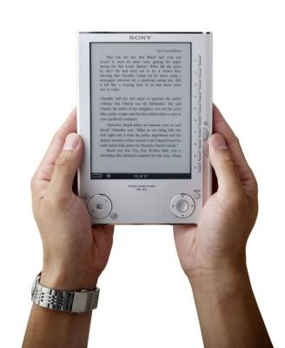
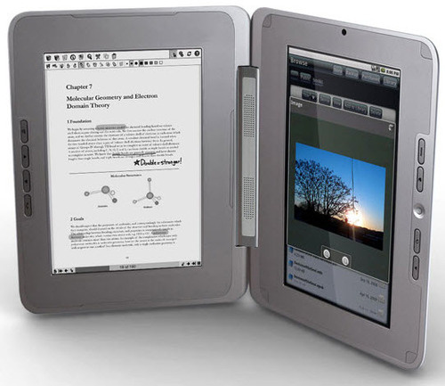
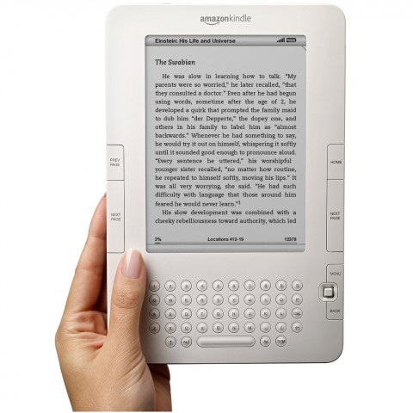
Readers
Entourage $499
Amazon Kindle $269
Sony $148
http://electronics.pricegrabber.com/dictionaries-readers/reader/p/1981/form_keyword=reader/st=query/sv=search_top/rd=1

Slide 33
BouneBack

Slide 34

BounceBack
$49 to $79
Creates a complete clone of your computer’s primary hard drive and enables you to start your Windows operating system from an external USB hard drive.
http://www.cmsproducts.com/products/backup_software/bounceback/default.html

Slide 35
Bose

Slide 36
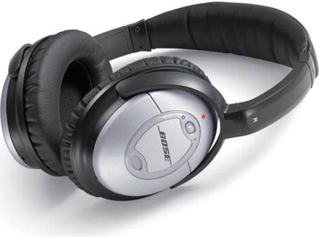

Bose
Noise Cancelling Head Set
$299

Slide 37
Pocket CamCorders

Slide 38
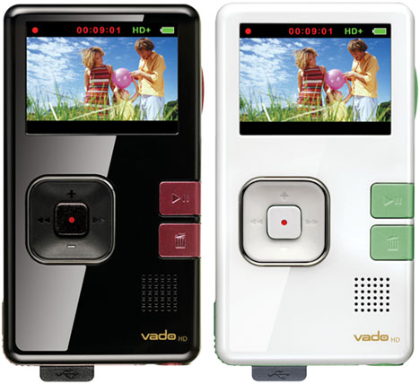
Pocket Camcorders - Many Brands
Creative Vado - $180
$130 to $280

Slide 39
Patriot Bolt

Slide 40
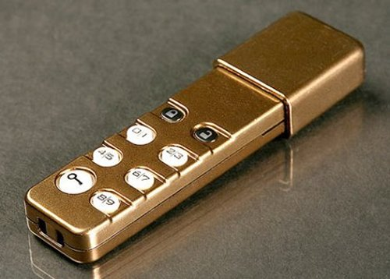
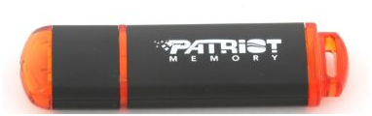
$18 to $259
8 GB to 64 GB
Encrypted
Patriot Bolt
8GB
$25
CHDT Corp
Personal Pocket Safe USB
4GB, $48
http://www.newegg.com/Product/ProductList.aspx?Submit=ENE&N=100007960%20600038374&IsNodeId=1&name=256bit%20AES%20Encryption

Slide 41
Key Coded
Door Locks

Slide 42
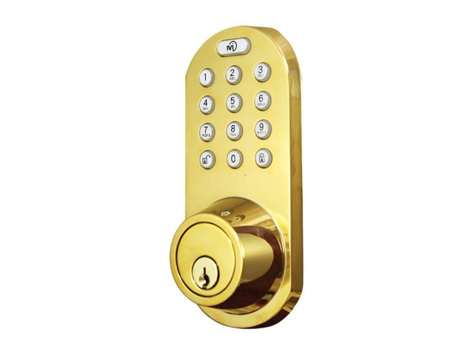
Key Coded Door Locks

Slide 43
InkJet Multifunction

Slide 44
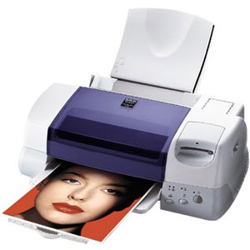
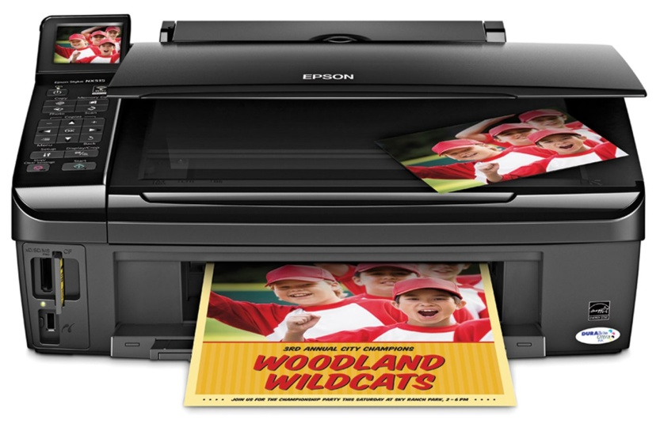
Epson Stylus NX515
$130
Color printer, Scanner
36 PPM
5760 x 1440 optimized dpi
EPSON RULES!

Slide 45
Jabra
Cruiser

Slide 46
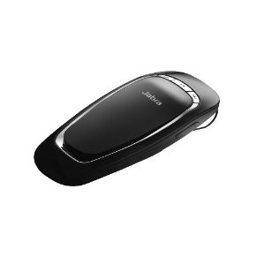
JABRA CRUISER
$47
Hands Free Speaker Phone
Auto-pairing makes for easy set-up
14 hours talk-time and 13 days standby time
Multipoint allows you to simultaneously connect to two devices

Slide 47
SMART PHONES

Slide 48
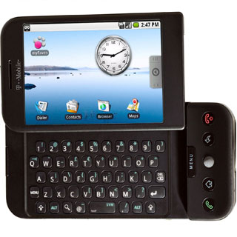
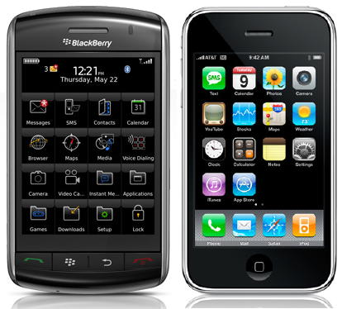
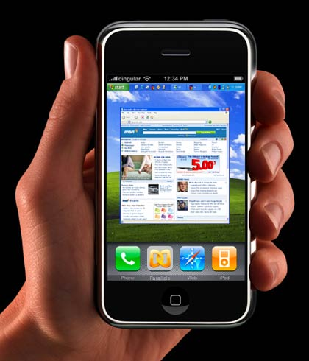
Smart Phones
Google Android
(T-Mobile)
BlackBerry RIM
Storm/Pearl
(AT&T, Verizon)
Apple Iphone
(AT&T)

Slide 49
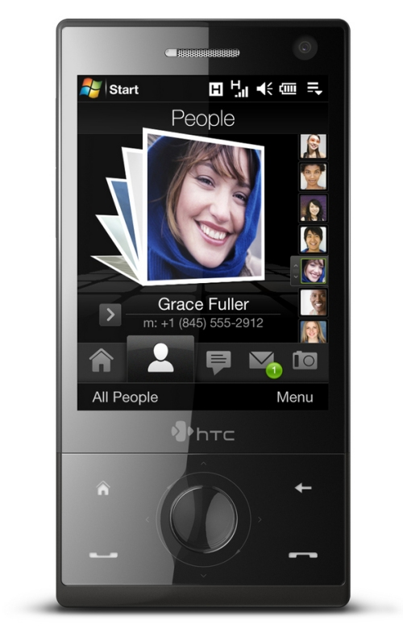
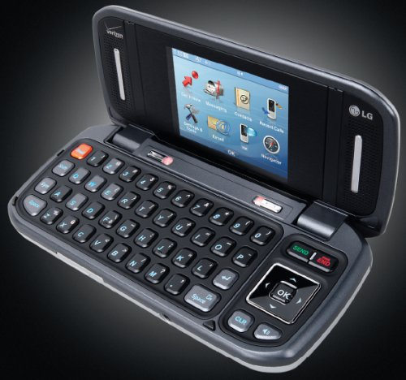
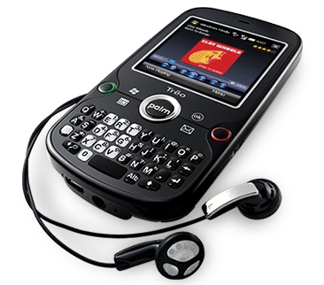
Smart Phones
LG VX9900
Palm Treo
(Verizon, Sprint)
HTC Touch Diamond
(All 3G Networks)

Slide 50
Smart Phones:
Five Operating Systems to Choose From:
  Google Droid O/S
  BlackBerry O/S
  Apple O/S
  Palm O/S
  Microsoft Windows O/S
Key is to Select the Best Cellular Provider in Your Area:
  Verizon
  AT&T
  Sprint
  T-Mobile

Slide 51
Smart Phones:
Are for people who don’t always have a laptop with them
And want to check/send e-mails
And have their contacts/calendar/To Do with them
If You Always carry A LapTop, Then a Smart Phone is not Very Necessary
You can Forward E-Mails to a Regular Phone via MMS

Slide 53
The CHUBBY

Slide 54
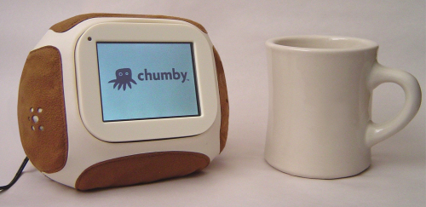
CHUBBY
$179
A Bean Bag Computer/Alarm Clock/Photo Viewer
No, I Don’t Know Why

Slide 55
NetBooks

Slide 56
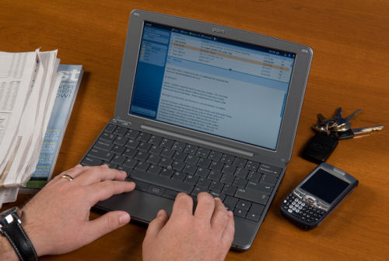
NetBooks
$300 Computers
Small, Light Weight, Cheap, Easier to Use than a Handheld, Browser, Not As Powerful
Works In A Pinch, But I prefer a LapTop

Slide 57
SKYPE TV

Slide 58
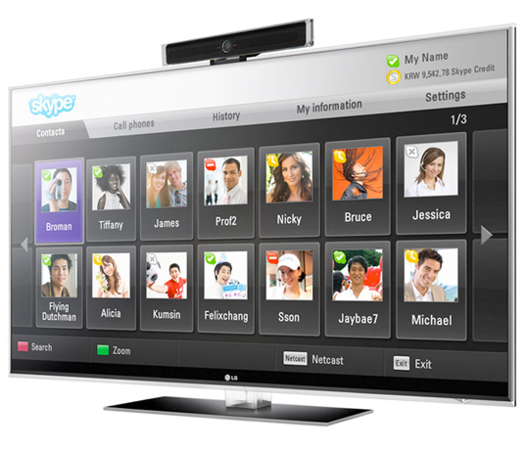

SKYPE TV
Video Conference Via your TV
http://www.skype.com/intl/en-us/get-skype/on-your-tv/

Slide 59
KEEP VID

Slide 60

KEEP VID
Save YouTube Video Clips to Your Computer As Self Running Files
http://www.youtube.com/watch?v=k2KfxdjjvDE&NR=1
www.keepvid.com

Slide 61
Power Patrol

Slide 62
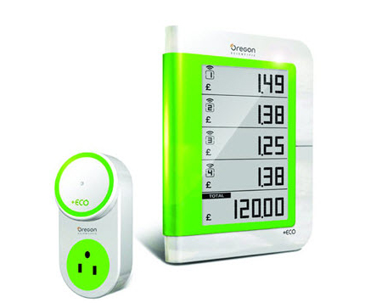
Oregon Scientific
$30
Monitor power consumption, carbon emissions, and real-time costs for up to eight appliances
http://www.earthtechling.com/2010/01/upcoming-oregon-scientific-devices-track-appliance-energy-usage/

Slide 63
10X ZOOM

Slide 64
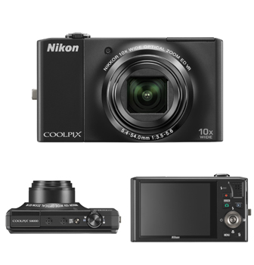
NIKON COOLPIX
$300
The thinnest camera^{*1} in its class
Wide-angle 10x zoom
Macro shooting as close as 0.4 inch
14.2 Megapixels
http://www.earthtechling.com/2010/01/upcoming-oregon-scientific-devices-track-appliance-energy-usage/

Slide 65
2010 Tech Update for CPAs
By J. Carlton Collins

