Slide 1
The Tech Savvy CPA
Southeastern Accounting Show
J. Carlton Collins

Slide 2
Journal of Accountancy Article – June 2009
Main Point:
Not that You should USE…
Rather, that you should BE AWARE…

Slide 3
Technology
is Not Perfect

Slide 4
Nonetheless,
Having Technology beats not having Technology
Hammer vs Nail Gun
Writing a letter vs Word processing
Postal Service vs E-Mail
Land line vs Cell phone
Hand Crank Windows & Manual door locks vs Anti-lock brakes & Air bags
IRS forms vs Tax Prep software
Manual accounting system vs Computerized accounting system
14 column ledger paper vs Electronic spreadsheet

Slide 5
“Technology is only useful if it saves time, saves money or provides a better product”
- Stuart Cashin, CPA, 1986

Slide 6
Justifying Technology
“Analysis Paralysis”
Automated Supply Chain
Paperless Systems
Warehouse Management

Slide 7
Justifying Technology
“As a whole –
I find that the cost of technology is always justified, Technology always pays for itself rather quickly”
J. Carlton Collins, CPA

Slide 8
Web Site

Slide 9

Securing a Domain Name
GoDaddy
Domain Name
AccountingSoftware2010
Hosting
Show Checkout Screen

Slide 10
Building a Web Page
FrontPage
Login
New Page, Titles, Text, Accounting Software
Content
Feedback Form
YouTube Clip
Embed YouTube Clip in Web Page
Demonstrate
Recording Camera Videos
Search, find picture, save
Crop picture
Insert Picture
Polygonal hotspots

Slide 11
Submitting URL

Slide 12
Submitting Your Domain Name
Submit your URL to Google
Algorithm for scoring high
  Phrase in URL
  Phrase in Title
  Phrase in Keywords
  Phrase on Home Page
  Phrase on Sub-Pages
  People link to you with that phrase
Bing
1 Point
1 Point
1 Point
1 Point
1 Point
Many Points

Slide 13
Filtering Searches

Slide 14
Filtering Searches
Filtering Google
Employee Internet Use Contracts

Slide 15
Wikipedia

Slide 16
Google Alerts

Slide 17
Google Maps

Slide 18
Google Maps
Street view
Driving Directions
Re-route
Add multiple stops
Traffic
Map Views

Slide 19
Pivot Tables

Slide 20
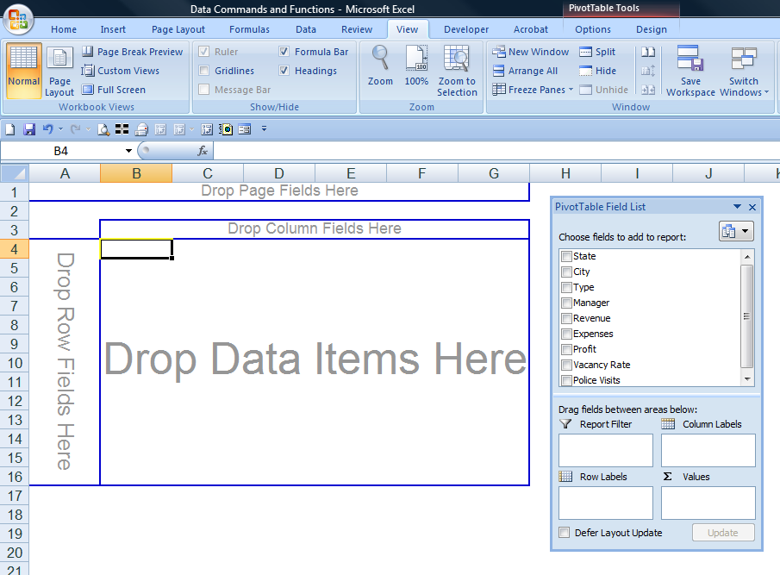
PivotTables

Slide 21
Pivot Tables
Quick & Dirty Pivot Table – Just Drag & Drop
Create Many
Pivot Charts
Pivot Them
Filter Them
Drill Them
Why most CPAs have trouble learning Pivot Tables

Slide 22
Excel Queries

Slide 23
Excel Queries
Query Stock Prices
Query any Web Page
Query your Accounting System

Slide 24
Card Scan

Slide 25
Card Scan
Business Card to Computer
Computer to Outlook
Outlook to your cell phone (or anywhere)

Slide 26
Text to Speech

Slide 27
Read to Me
Excel Speaks
Verbose – copy to clipboard, CTRL, SHIFT, B
Cool Speaking
Many Others - http://www.google.com/search?hl=en&q=%22text+to+speech%22&aq=f&oq=&aqi=g10

Slide 28
Speech to Text

Slide 29
Speech to Text
In Office 2003
Not in Office 2007
Not in Windows XP
In Windows Vista
Boom microphone

Slide 30
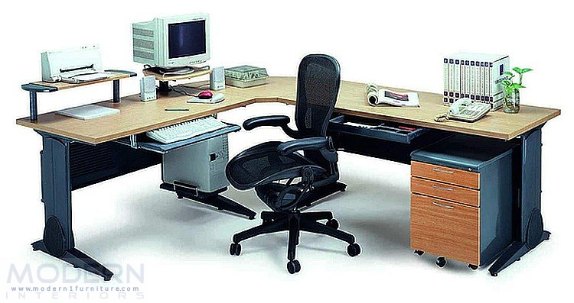
Well Organized Computer System

Slide 31
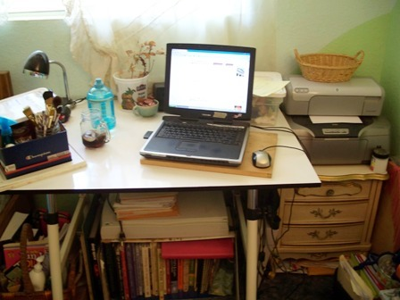
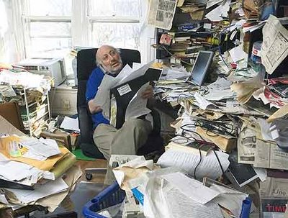
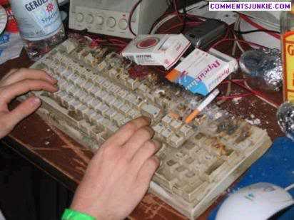
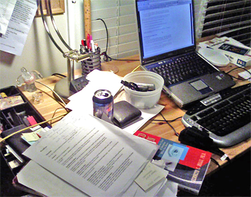

Slide 32
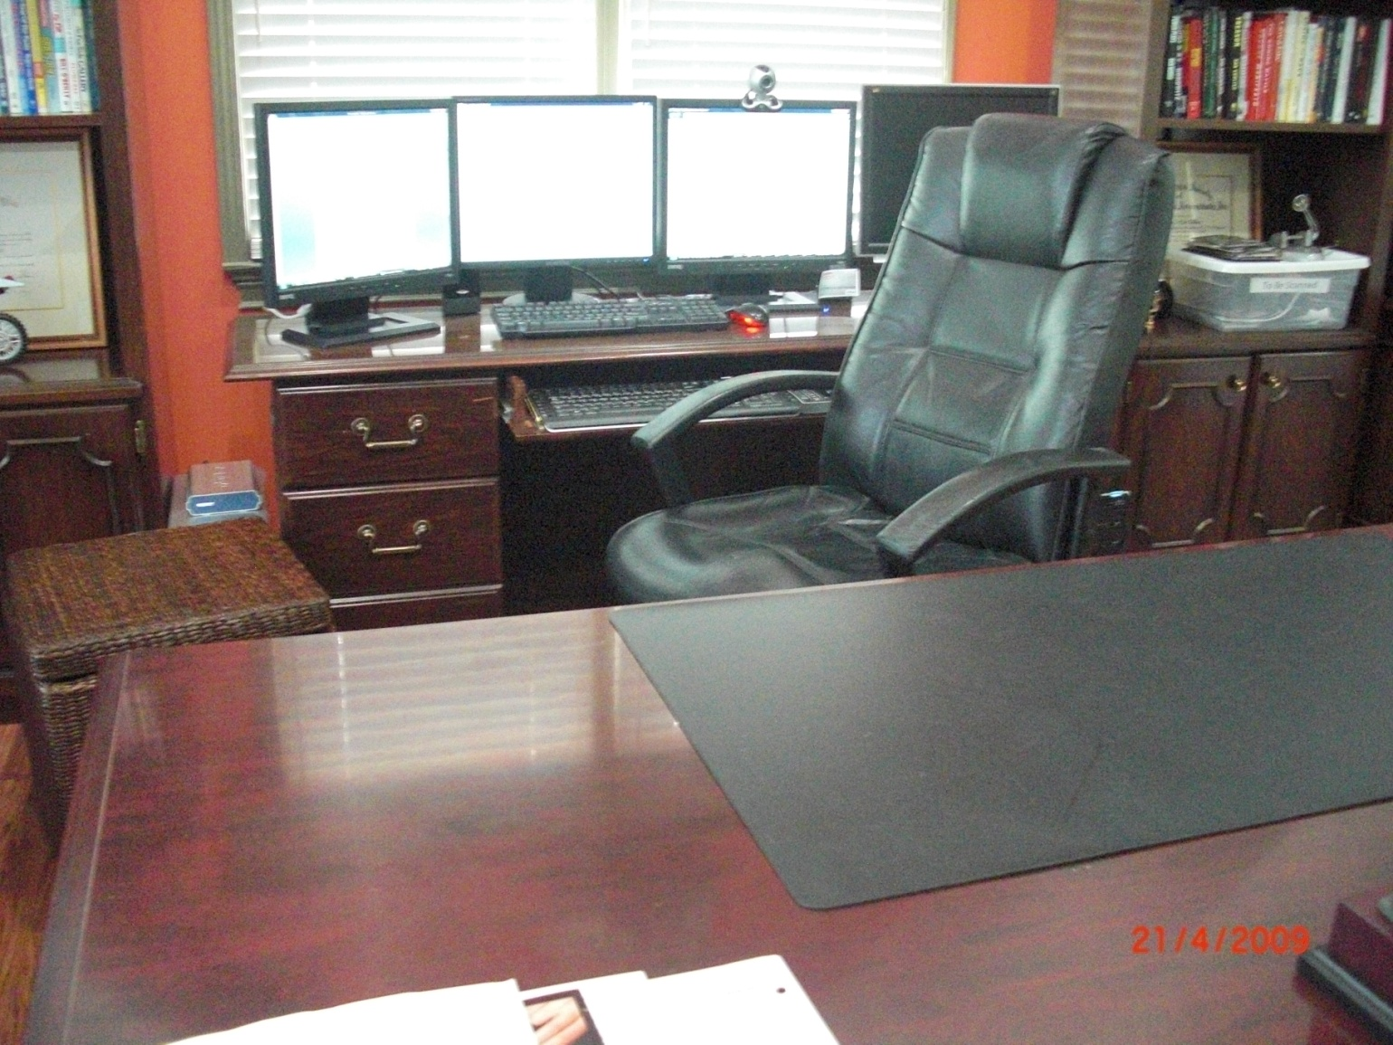
My Computer System

Slide 33
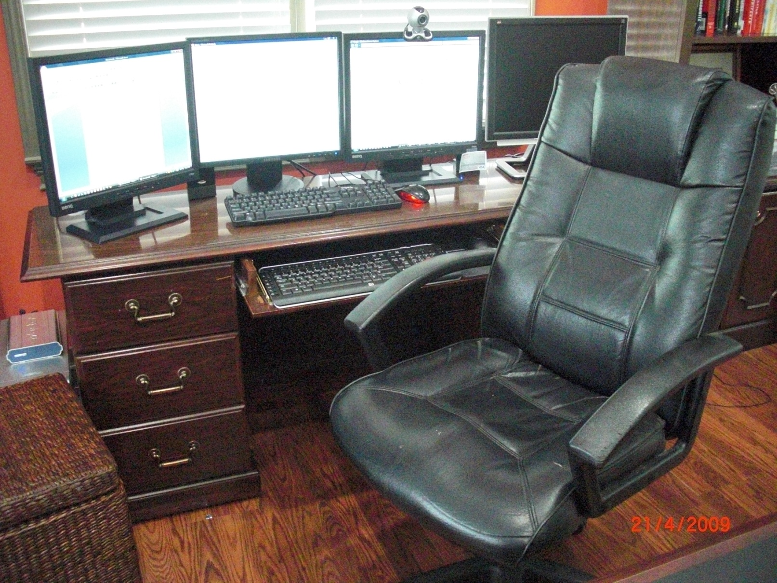
My Computer System

Slide 34
Full Sized Computer versus Laptop Computer

Slide 35
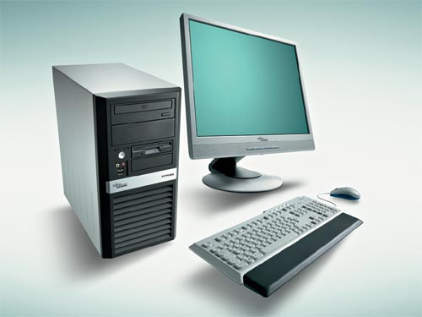
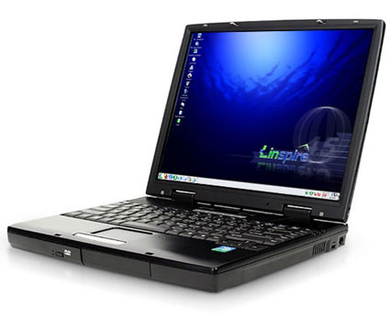
Full Sized Computer versus Laptop Computer

Slide 36
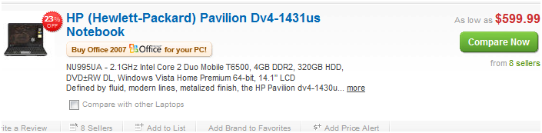
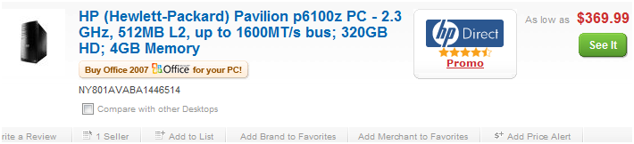
Desktops Cost Less than Laptops
Laptops cost more than Desktops – For Example:

Slide 37
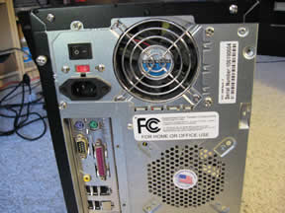
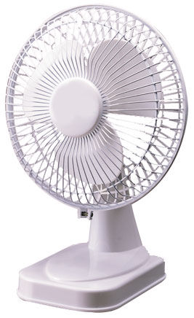
Desktops are Faster than Laptops
Desktops are faster than Laptops because they have fans – 2.2 Ghz versus 3.4 Ghz

Slide 38

Laptops are not Ergonomically Sound
Ouch
Ouch

Slide 39
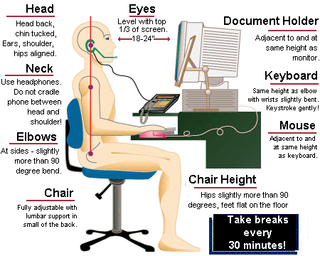

Slide 40
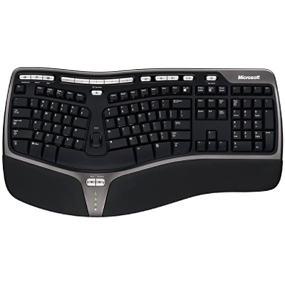

Slide 41
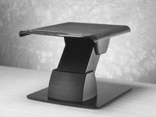
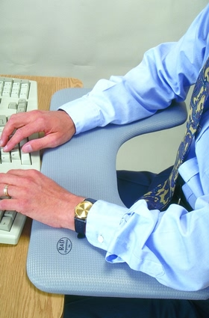
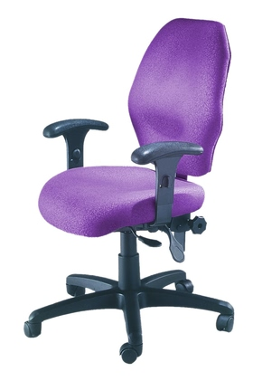
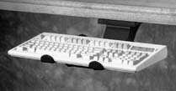

Slide 42
Flat Panel Monitor

Slide 43
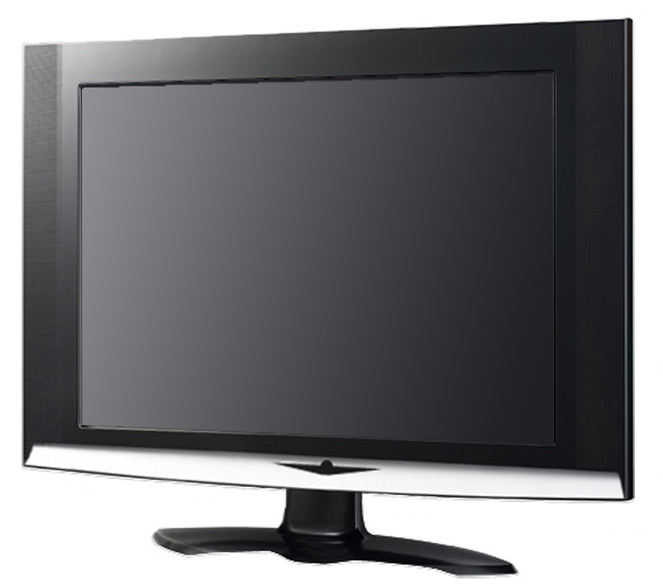
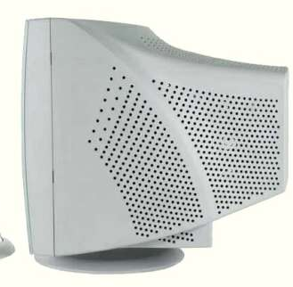
Flat Panel Monitor
Eye Fatigue

Slide 44
Multiple Monitors

Slide 45
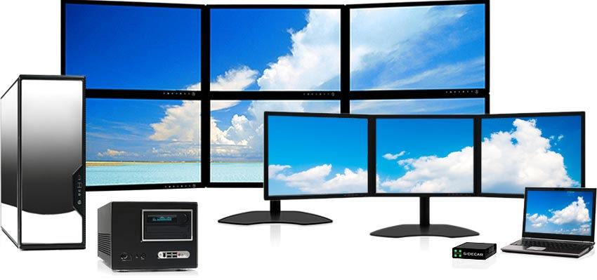
Multiple Monitors

Slide 46
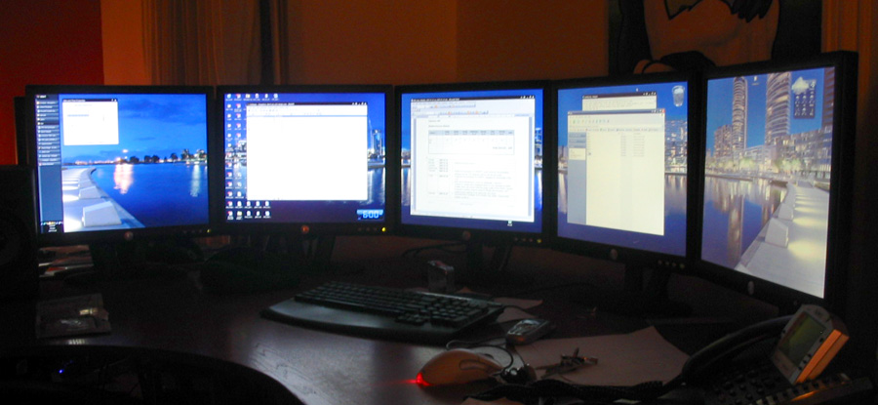
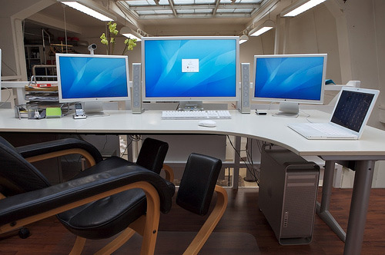

Slide 47
Duplexing Printer

Slide 48
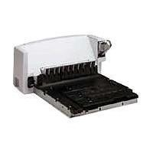
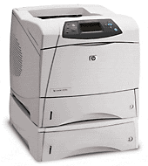
Duplexing Printer

Slide 49
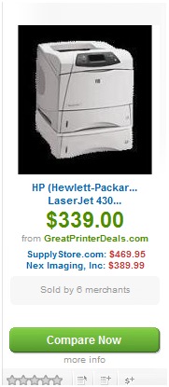
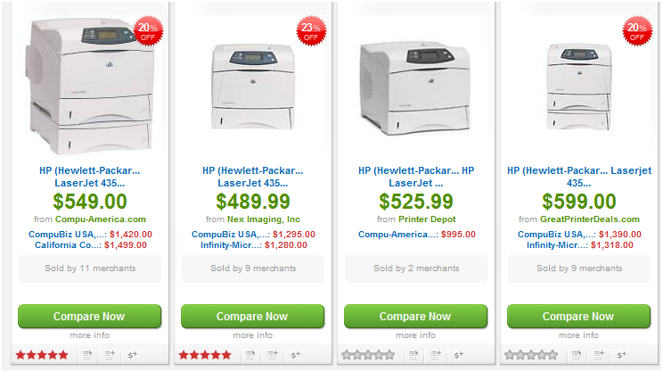
Printer Prices Falling in 2009 – HP 4350

Slide 50
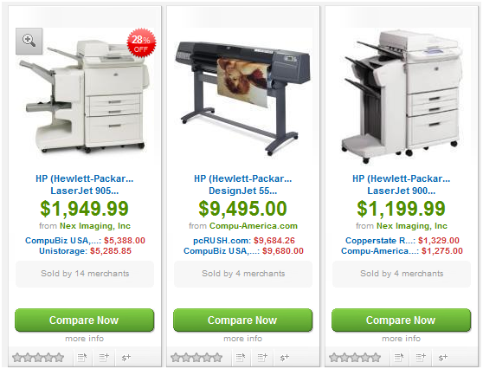
Printer Prices Falling in 2009 – HP 9050

Slide 51
Printer Hookup

Slide 52
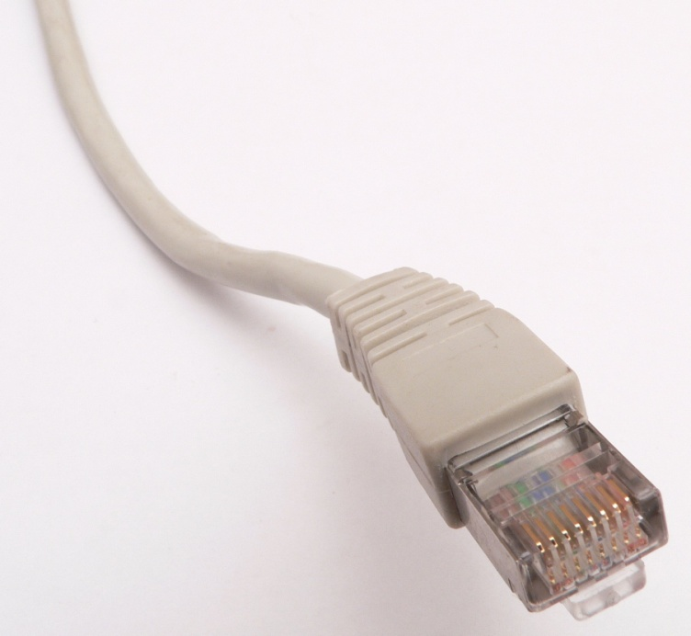
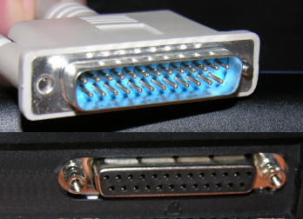
Printer Hook Up

Slide 53
Vista Instant Search or Google Desktop

Slide 54
Windows Vista
Bad rap
      All applications needed tweaking
      Requires 3 GBs of RAM
Instant Search
3D Flip
Sees More RAM
Sees More Processors

Slide 55
Social Networking
Because Who You Know Matters – Right?

Slide 56
Social Networking
Linked-In
Plaxo
MySpace
FaceBook
Twitter

Slide 57
FaceBook
  330 million people
  I expected snot nosed brats
  Instead had huge impact on my life –
    Personally & professionally
    400+ Friends
  4 Minutes to set up, easy as checking your e-mail
  Pictures, videos, public conversation & cell phone

Slide 58
Twitter
  Twitter can be really stupid
  But the application of Technology is to be applauded
  “Use computers and the internet” without having “computers or the Internet”

Slide 59
Skype

Slide 60
Skype
  Free Video calls
  Demo searching for someone
  Demo a call
  Call land lines and cell phones too
  Demo
  Call multiple people
  Share desktop

Slide 61
QuickBooks Pro Advisor Program

Slide 62
QB Advisor
$449
Receive $2,000 in software
Receive unlimited support
Get Promoted

Slide 63
Photoshop

Slide 64
Rip & Burn

Slide 65
Domain Name
in E-Mail Address

Slide 66
One screams “Novice”, Guess Which One
Steve@AOL.com
Steve@ASAResearch.com

Slide 67
E-Mail Contains
Default Signature Block

Slide 68
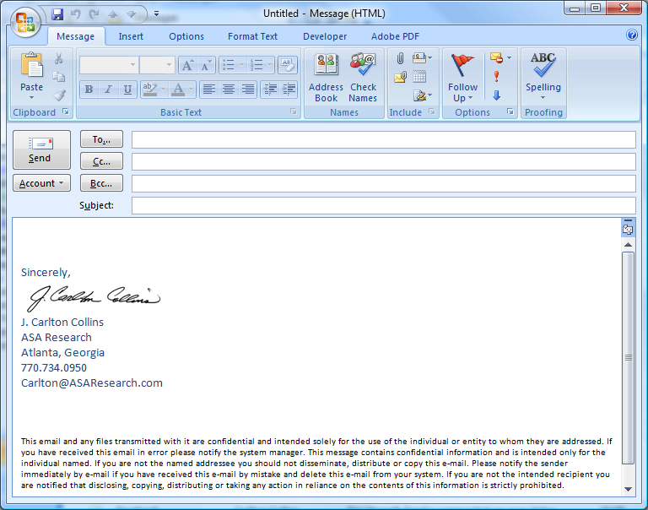
To Save Time
Complete Contact Info:
So I know your last name
So I can call you
So I can refer you
So I know your Time Zone
Include Legal Notice
Include Logo

Slide 69
E-Mail
Distribution Lists

Slide 70
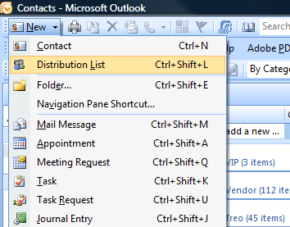
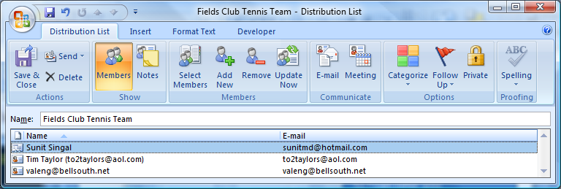
To Save Time

Slide 71
Leave E-Mail
Up & Running Always

Slide 72
Use More than
One E-Mail Address

Slide 73
Use Personally
Protects Your Business E-Mail Address
Free E-Mail Accounts:
HotMail – Microsoft
GMail – Google
Yahoo Mail – Yahoo
AIM – AOL
Others

Slide 74
Why You Should
Leave Your Computer
On Overnight

Slide 75
Many Benefits
Save 20 to 40 hours a year in rebooting time
Computer will last longer
Virus check at 2:00am
Spam check at 3:00am
Updates at 4:00 am
Back up at 5:00am
Computer Available via Remote Access
Voice Over IP – (Such as Skype or Magic Jack)
Sleeping your computer negates many of these benefits

Slide 76
Make Sure:
Password Protected Screen Saver Kicks in
Monitor & Printer Sleep After Specified Time
Green Comments:
Computer uses less electricity than 40 watt light bulb
Comparatively - Rebooting takes significant energy, boot three times and use more energy than leaving it on all day
Walk to work, wash clothes by hand, throw away power drills

Slide 77
Remote Control Access

Slide 78
Benefits of Remote Access:
Fast connection because only screens travel
Remote computer needs only a browser
All files and data always available to you
Work from home
Check E-mail on primary computer
Great for Remote training/troubleshooting
Print here or there
Provide access to satellite locations

Slide 79
Connect Wirelessly

Slide 80
Benefits of Wireless:
Hotspots are everywhere – Macdonald’s even
You just need a wireless network card in your Laptop, Netbook or iTouch
WiMAX is coming – (31 mile reach, but at that range, speed issues. Faster at shorter ranges)

Slide 81
Copy – Paste Link

Slide 82
E-Mail Merge

Slide 83
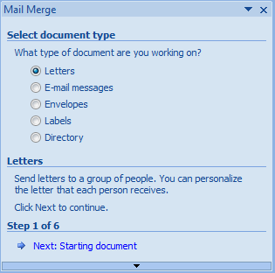
E-Mail Merge – Six Steps

Slide 84
Electronic Surveys

Slide 85
Many Benefits
InfoPath
Zoomerang
Survey Monkey
Many Others - http://www.google.com/search?hl=en&safe=off&rlz=1T4SKPB_enUS317US317&num=100&q=electronic+survey&aq=f&oq=&aqi=g7g-s1g2

Slide 86
High Speed Internet

Slide 87
Access Speeds
Dial Up - (56 Kbit/s)
3 Port Modem (Multi-Link) - (168 Kbit/s)
Satellite - (150 to 1,200 Kbit/s)
DSL - (192 Kbit/s to 1.5 Mbit/s)
T1 Line - (384 Kbit/s to 1.5 Mbit/s)
Cable / Broadband - (Up to 10 Mbit/s)
T3 Line - (44.7 Mbit/s)

Slide 88
25. Computer Checks

Slide 89
Read on the Internet

Slide 90
Published Page to the Internet

Slide 91
More than One
Processor Chip

Slide 92
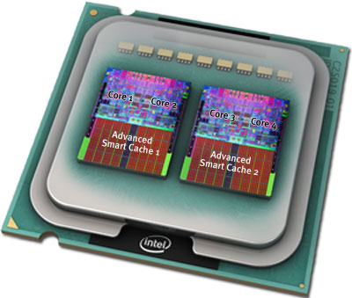
Increasing Clock Speed
Chips Melting
Dual Core Processors
Quad Core Processors
Cray Super Computer

Slide 93
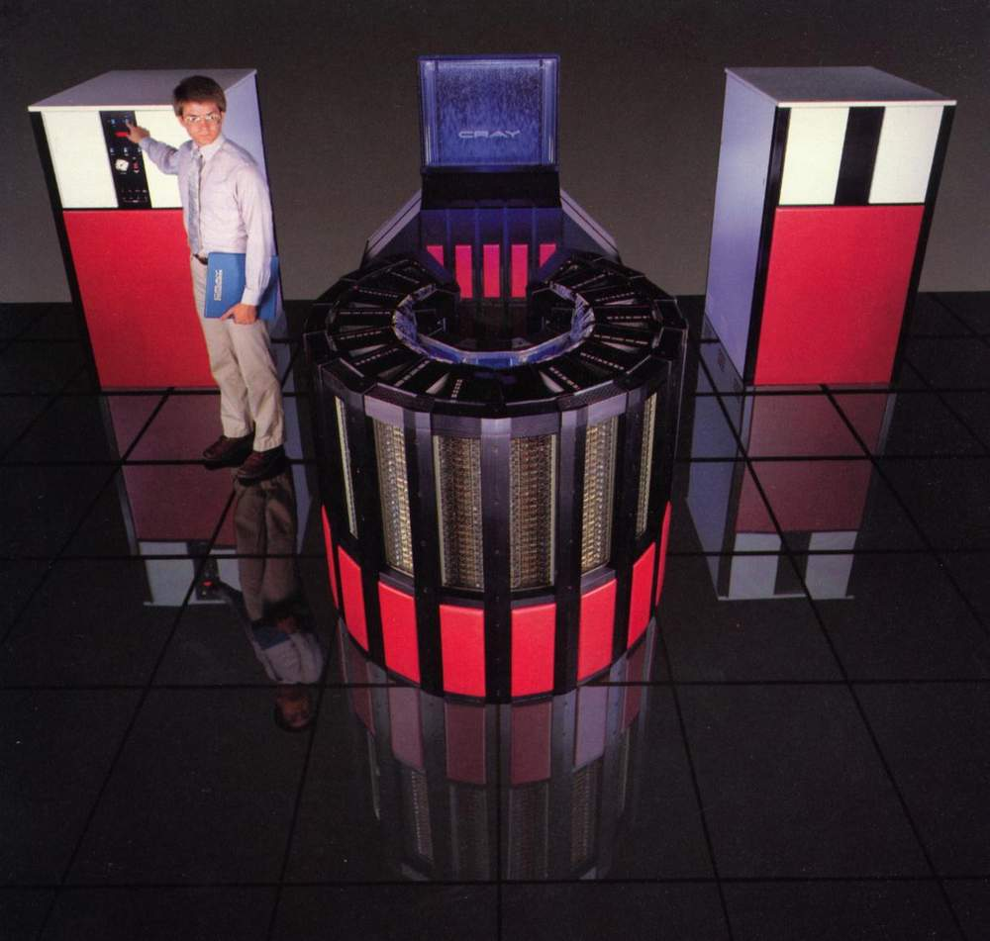
Cray Super Computer
Same components
More Core Processor Chips
Chilling Towers

Slide 94
More than 3 GBs
of RAM

Slide 95
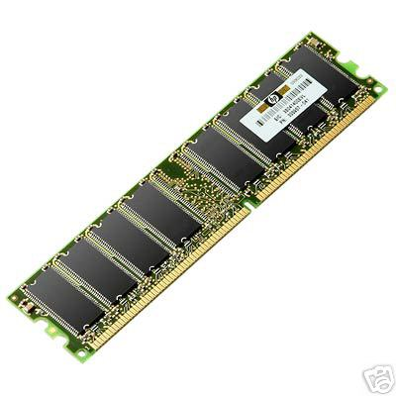
Vista Needs At least 3 GBs
My Laptop has 4
My Desktop has 8

Slide 96
64 Bit Operating
System?

Slide 97
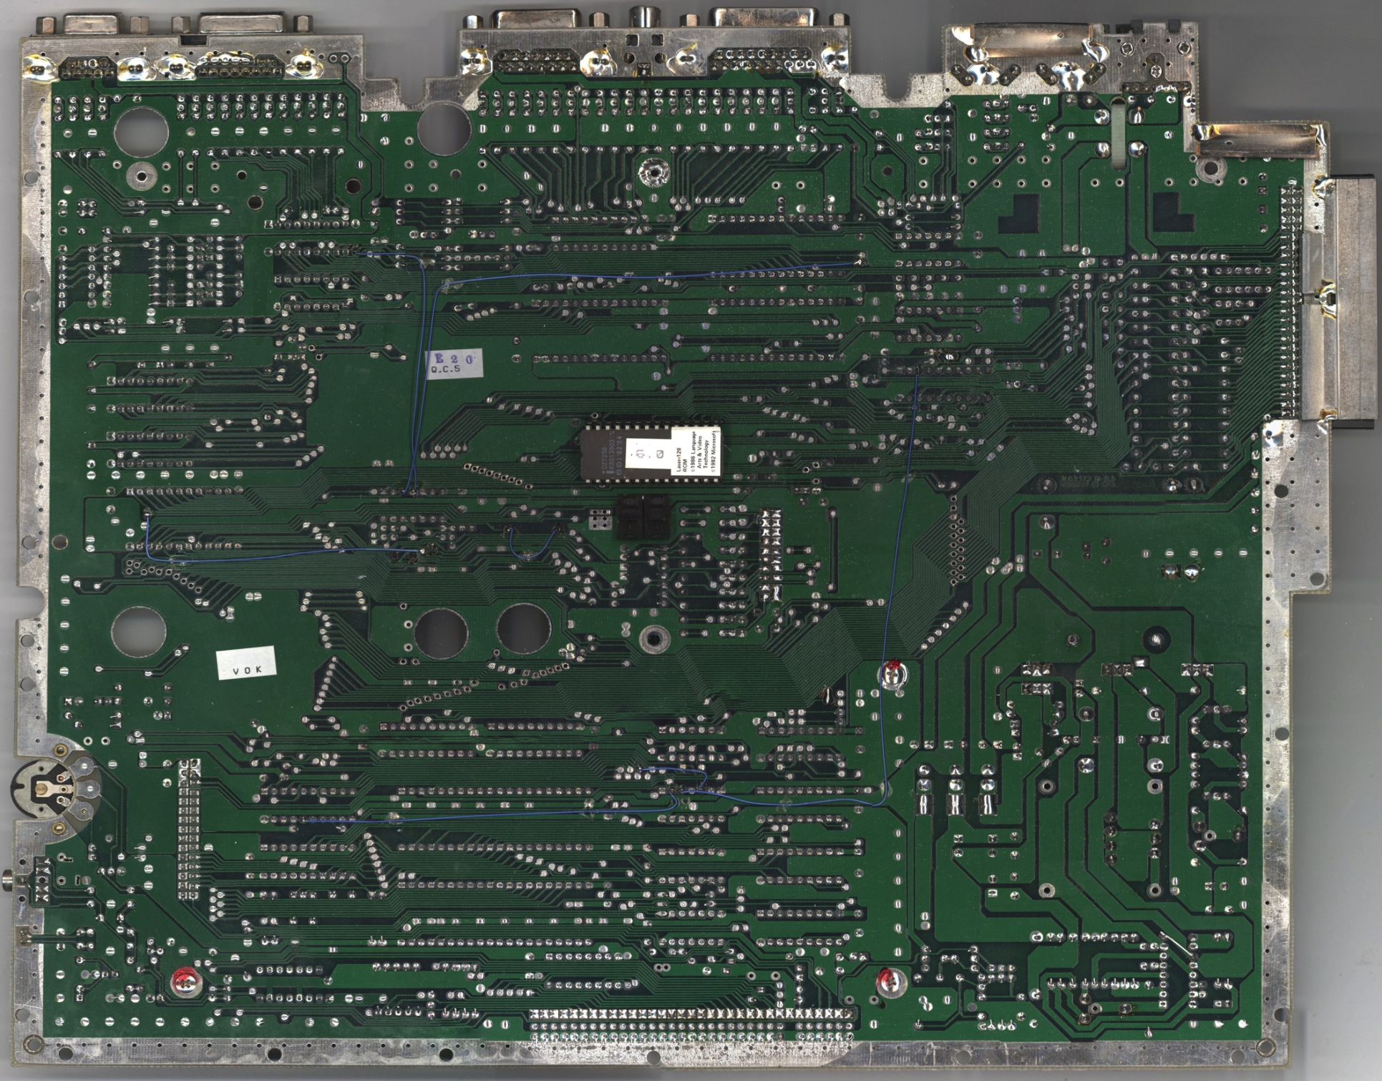
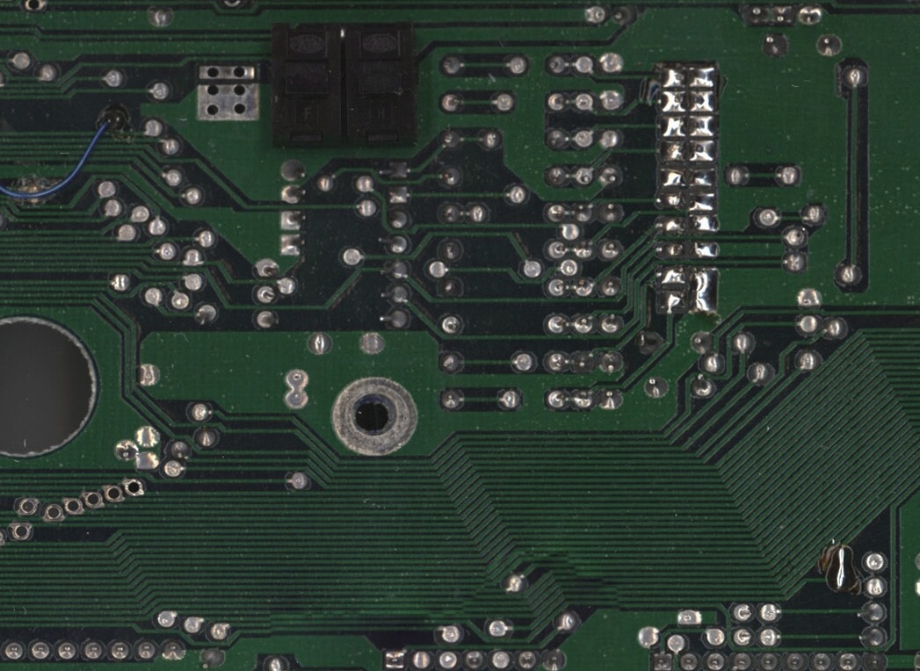
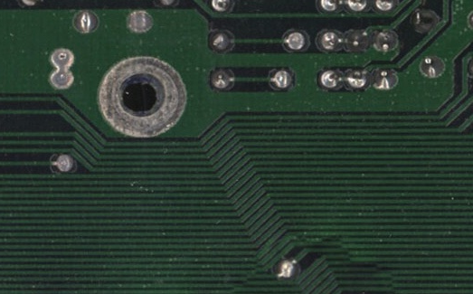
64 Bit Motherboard has 64 Lanes of Traffic embedded

Slide 98
64 Bit Points
32 bit = Personal computer
64 bit = Mini computer (IBM AS/400)
128 Bit = Mainframe computer
All computers 64 bit since 1994
Most still use 32 bit operating system
Windows XP and Vista come in 32 or 64 bits
64 Bit is faster
Applications must be tweaked to run on 64 bit

