Slide 1
Information Security for CPAs
Southeastern Accounting Show
J. Carlton Collins

Slide 2
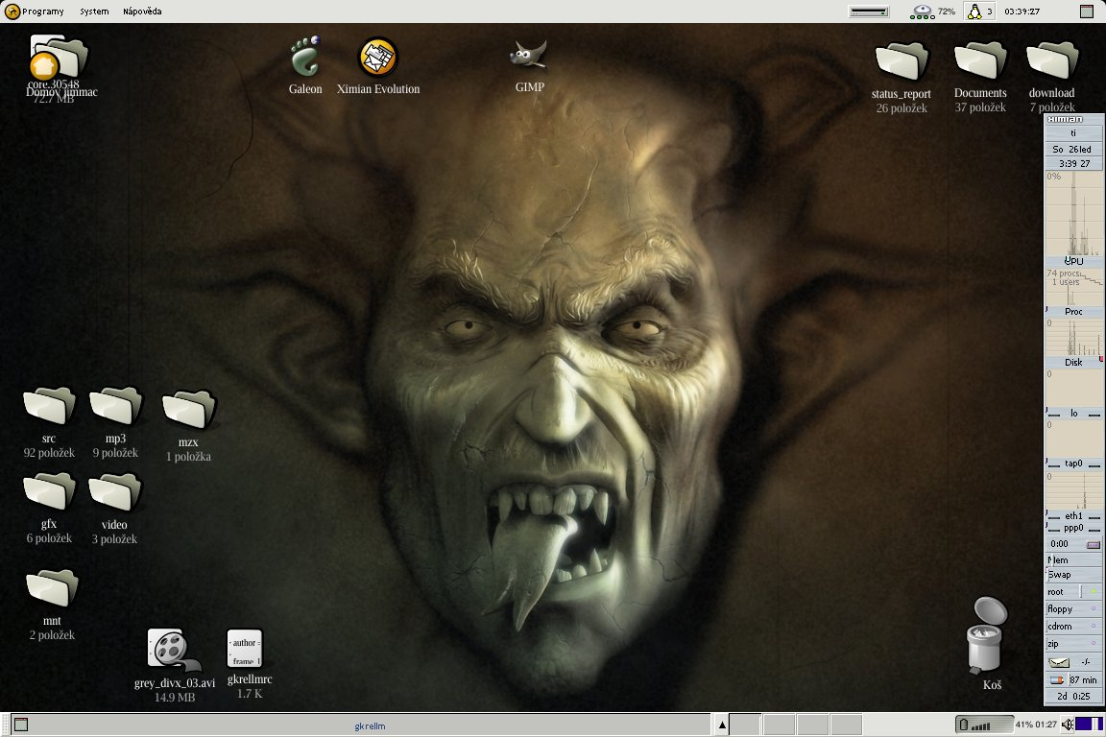
Information Security for CPAs
J. Carlton Collins, CPA

Slide 3
1. Virus Protection

Slide 4
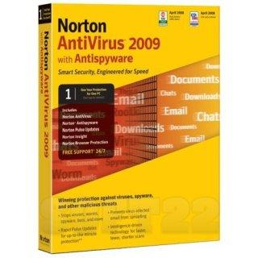
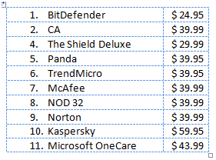

Top Virus Protection Products

Slide 5
2. Patches & Updates

Slide 6
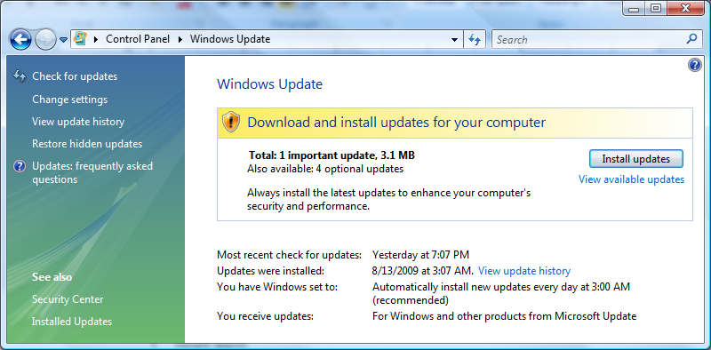
Windows Updates

Slide 7
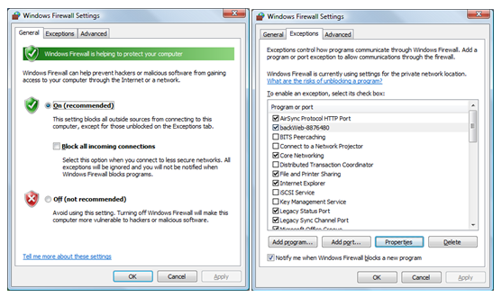
Windows XP & Windows Vista Firewalls

Slide 8
3. Password Protected Screen Saver

Slide 9
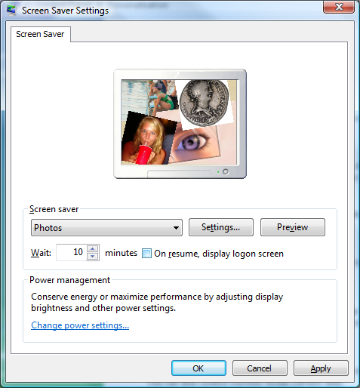

Slide 10
4. Firewall

Slide 11
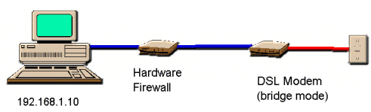

Slide 12
5. Configure Your
Wireless Routers

Slide 13
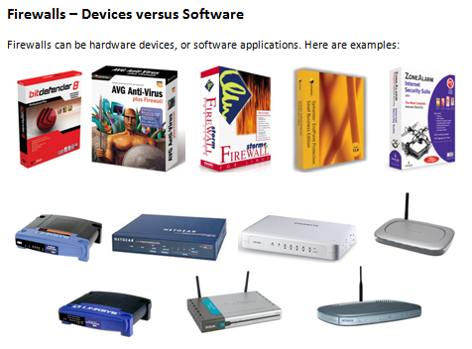

Slide 14
Firewall Settings
  Reset password
  Turn on Encryption
  Broadcast different name (SSID)

Slide 15
6. Encryption Primer

Slide 16



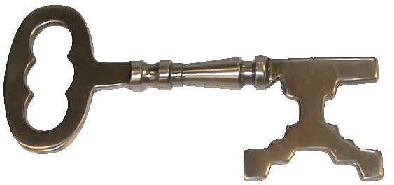
Encrypting Word and Excel Files

Slide 17
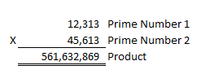
Encryption Primer Page 17
All encryption is based
on two prime numbers:

Slide 18
About Bits Page 17
It takes 8 Bits to Form a Single Number
40 Bit | 12313 | 1 second
56 Bit | 1234513 | 19 hours
64 Bit | 12345613 | 7 months
128 Bit | 1234567891234513 | 4.3 quadrillion years
4,300,000,000,000,000
4,594,972,986,357,220,000,000,000,000,000,000,000,000,000,000,000

Slide 19
7. Encrypt Your Data Files, Folders & Hard Drives

Slide 20
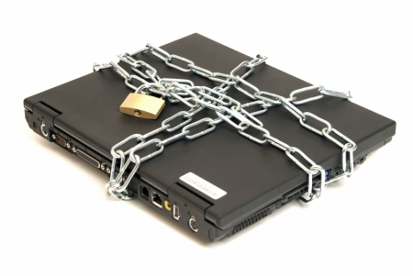
Protecting Your Hard Drive

Slide 21
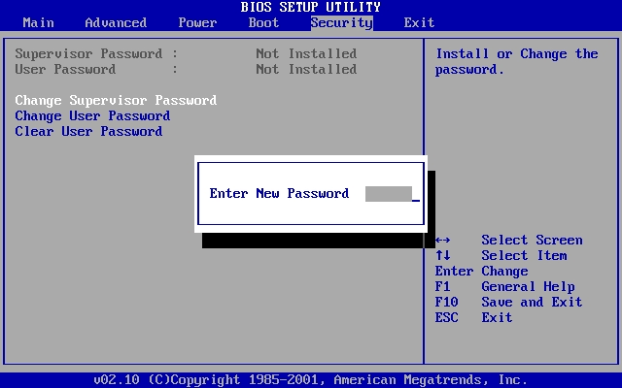
1. BIOS Password

Slide 22
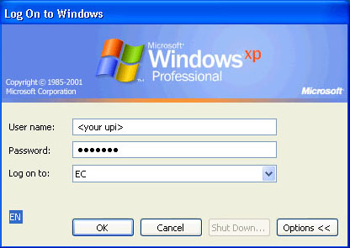
2. Windows Password
Carlton Collins

Slide 23
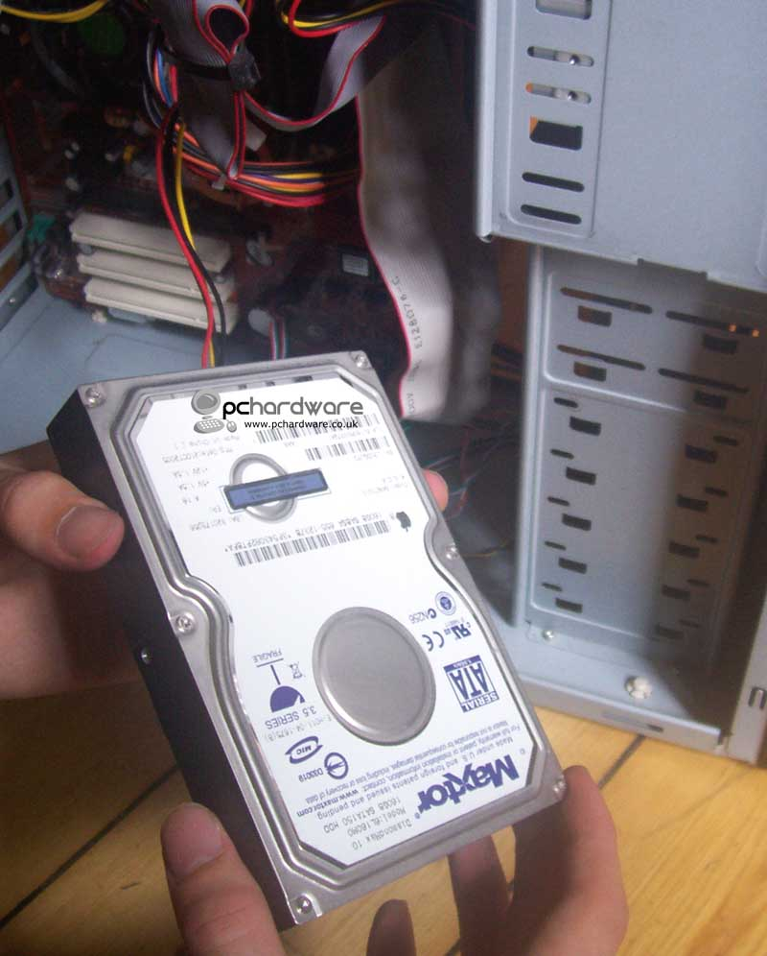
How Thieves beat BIOS &Windows Passwords
Remove Drive
Insert in another computer as second drive
Second drive becomes completely readable

Slide 24

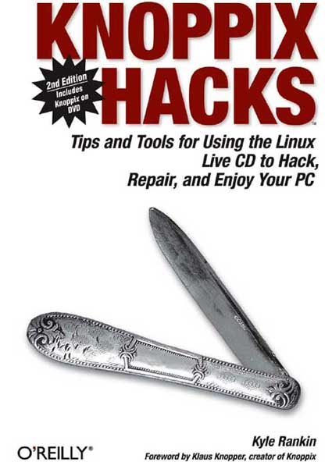
How Thieves beat BIOS & Widnows Passwords
Or they use Knoppix

Slide 25
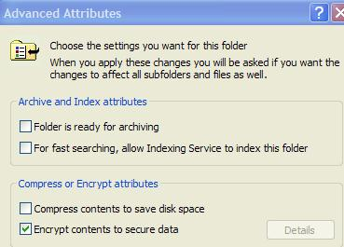
3. Encrypt Files or Folders
Must use NTFS (in Windows XP)
Right click file or folder, select “Properties”
Select “Advanced”

Slide 26
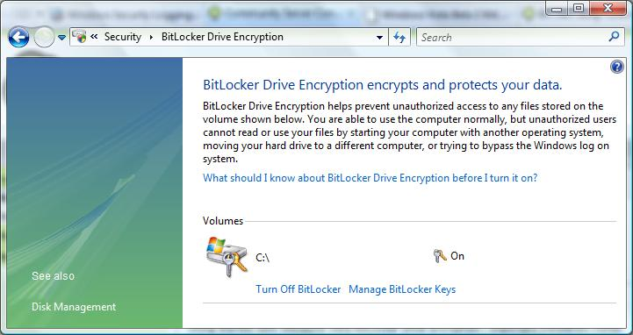
4. Or Use Vista BitLocker
New in Vista

Slide 27
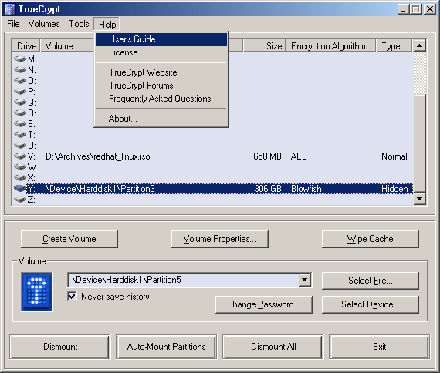
5. Or Use TrueCrypt
Hard drive is encrypted and decrypted on the fly

Slide 28
8. Encrypting Your E-Mail

Slide 29

PGP (Pretty Good Privacy)

Slide 30
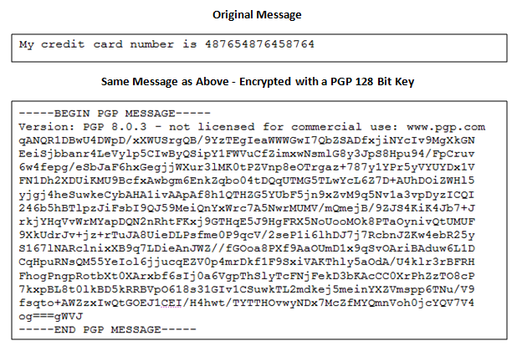

Slide 32
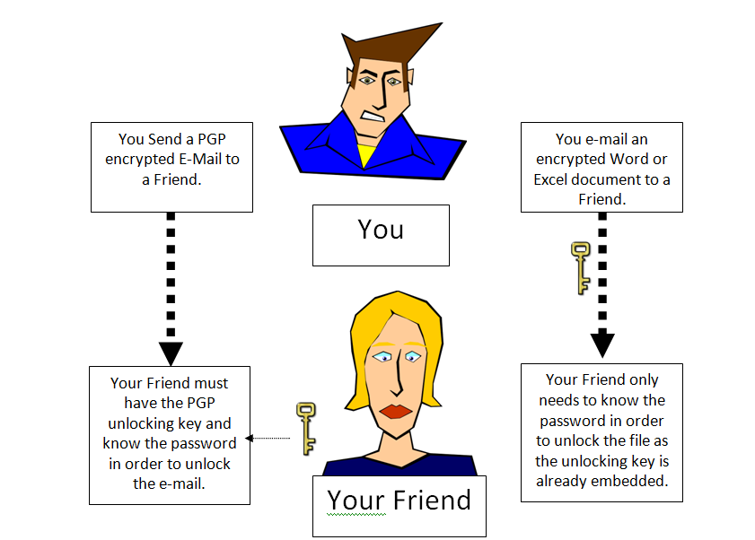

Slide 33
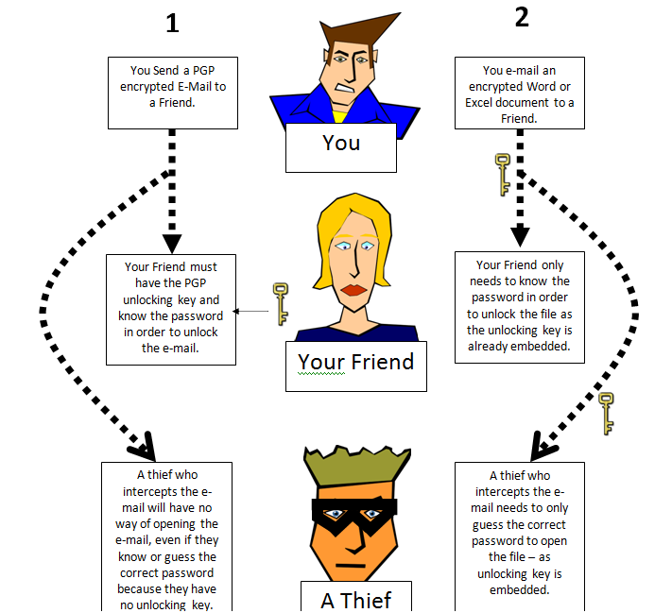

Slide 34
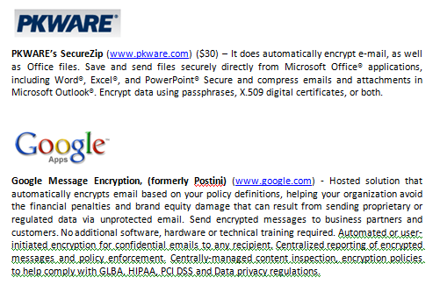
E-Mail Encryption Software

Slide 35
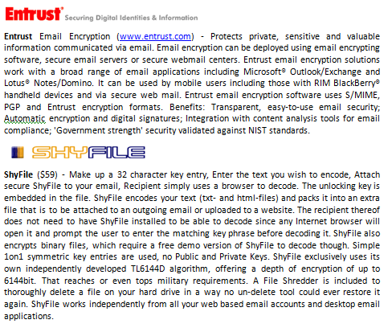
E-Mail Encryption Software

Slide 36
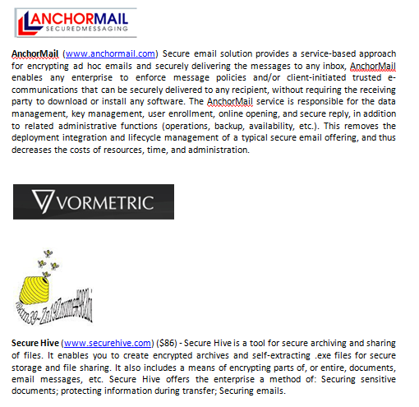
E-Mail Encryption Software

Slide 37
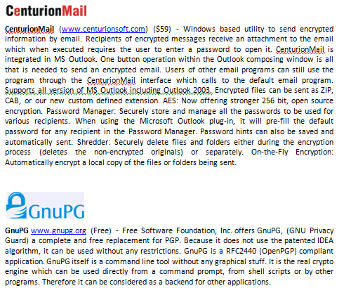
E-Mail Encryption Software

Slide 38
9. Use Windows Vista

Slide 39
Why Vista?
  I know, I know – the image that Vista stinks
  I told people Vista stinks for almost a year, I now believe otherwise
  Vista is the greatest operating system ever written on the planet
  Far more secure than Windows XP
  Sees more RAM and processors
  Very fast
  Instant Search
  3-D Flip

Slide 40
10. Regular Backups

Slide 41
Online Backup
  Carbonite - $50 year
  XCentric - Superior

Slide 42
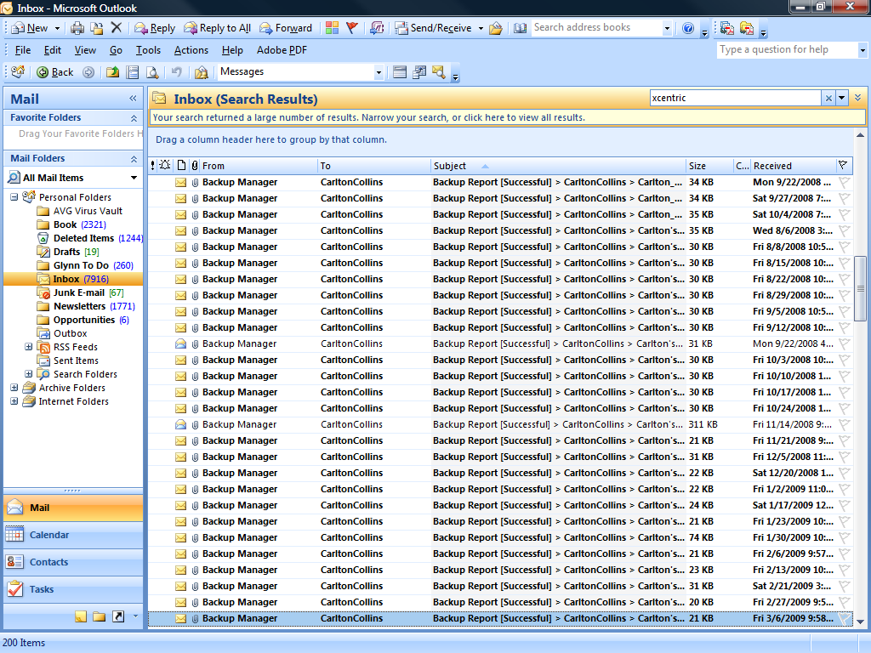

Slide 43
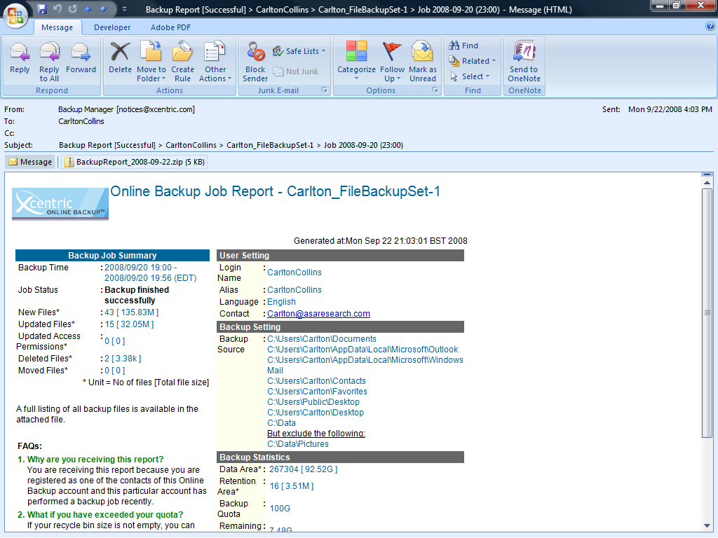

Slide 44
11. Use an Uninterruptible Battery Backup Device

Slide 45
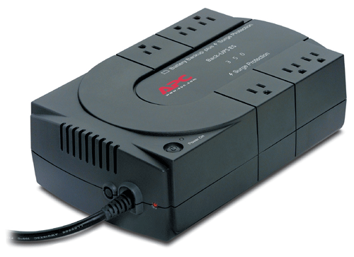

Slide 46
12. Filter Your Searches

Slide 47
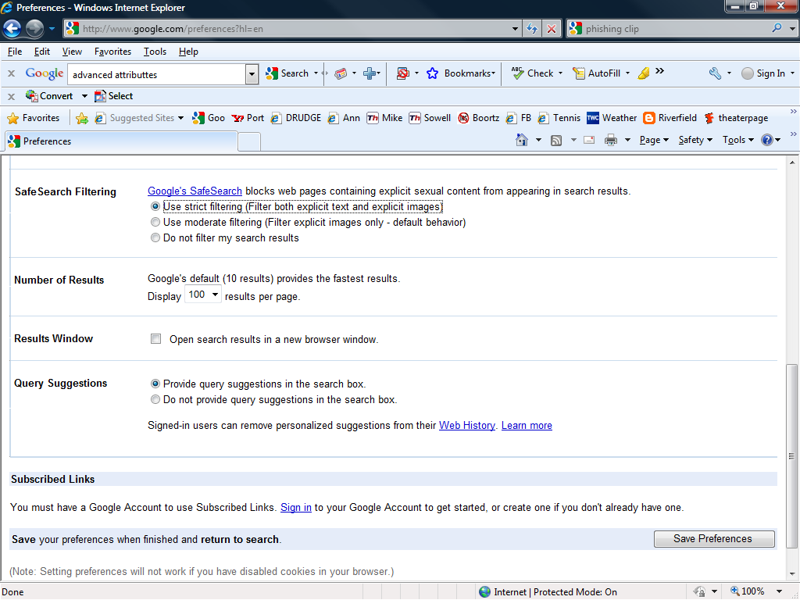

Slide 48
13. Strong Passwords

Slide 49
3. Use Strong Passwords Page 28
Happy – 5 minutes to break
Happy44 – 15 minutes to break
hAPP5y44 – Many hours to break
(Microsoft recommends using Upper/lower/special characters)
I recommend the old phone number method:
9126384822Delta4499
delta
delta 4499
912 638 4822 delta 4499
9126384822delta4499

Slide 50
14. Employee & Customer Background Checks

Slide 52
15. Follow Good Computer Disposal Practices

Slide 53
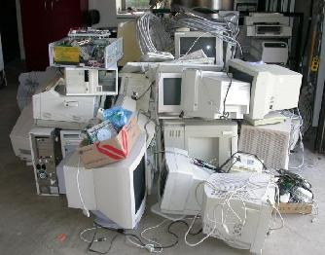

Slide 54
Federal Environmental Law - The Resource Conservation and Recovery Act (RCRA) has been updated recently to include guidelines regarding the disposal of computer monitors.
Sarbanes Oxley and HIPPA - Sarbanes Oxley and HIPPA laws require that all data be properly removed before hard drives are properly disposed of.
Hazardous Materials - Computers contain hazardous materials such as mercury, cadmium (a known carcinogen), and hexavalent chromium (associated with high blood pressure, iron-poor blood, liver disease, and nerve and brain damage in animals).
CRT Concerns - Most environmental concerns are associated with monitors. Specifically, a color cathode ray tube (CRT) contains about four to five pounds of lead, which of course is considered hazardous waste according to the EPA.
Computers in Landfills Outlawed - California, Massachusetts, and Minnesota have outlawed the disposal of computer waste in landfills.
Ponder This - Suppose what might happen if groundwater becomes contaminated and a search for the source finds that your old computer (identified by a control tag or manufacturer’s number) has been discarded nearby. You could be subject to potentially costly criminal and civil litigation (i.e., SARA, formerly CERCLA, litigation). This could happen even if the organization had donated the equipment to a charity or paid a company to recycle it.
License Considerations - If you donate your computer, you should evaluate software license agreements to determine if they preclude transfer of the software along with the computer.

Slide 55
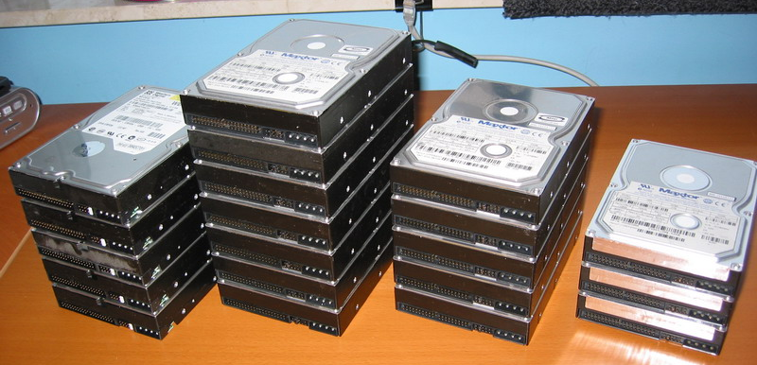

Slide 56
16. Use Pick Proof
Door Locks

Slide 57
Open any padlock with a beer can - | http://www.metacafe.com/watch/yt-1eGxRQlWTrM/open_a_master_padlock_with_a_beer_can/
Learn how locks work | http://www.metacafe.com/watch/yt-cuLC9klMsRI/the_visual_guide_to_lock_picking_part_06_of_10/
Open door locks with picking tools | http://www.metacafe.com/watch/877739/kwikset_door_lock_picked/
Make your own pick tools | http://www.metacafe.com/watch/1029493/home_made_lock_picks/
Pick a padlock with homemade pick tools | http://www.metacafe.com/watch/1015152/how_to_open_padlock_lockpicking/
Open door locks with a bump hammer | http://www.metacafe.com/watch/yt-zTfEwChCG0U/brockhage_bump_hammer_set/
Open a door lock with a pick gun | http://www.metacafe.com/watch/884219/how_to_pick_locks_with_a_lock_pick_gun_lockpicking_tutorial/
Open a car with a tennis ball | http://www.metacafe.com/watch/410981/blondie_unlocks_car/
Open car with wood wedge and pole | http://www.metacafe.com/watch/1078391/how_to_unlock_car_without_keys/
Open a tubular lock | http://www.metacafe.com/watch/1029502/lock_picking_tubular_locks/
Pick a club and pick a car ignition | http://www.metacafe.com/watch/1029496/lock_picking_club_and_car_ignition/
Pick tools described | http://www.metacafe.com/watch/1363050/lock_picking_with_all_my_sets_tools/
Order picking tools online | http://www.lockpicks.com/index.asp?PageAction=VIEWCATS&Category=204
Order a pick gun online | http://www.lockpicks.com/index.asp?PageAction=VIEWCATS&Category=215
Order a bump hammer online | http://www.lockpicks.com/index.asp?PageAction=VIEWCATS&Category=324
Order car pick tools online

Slide 58
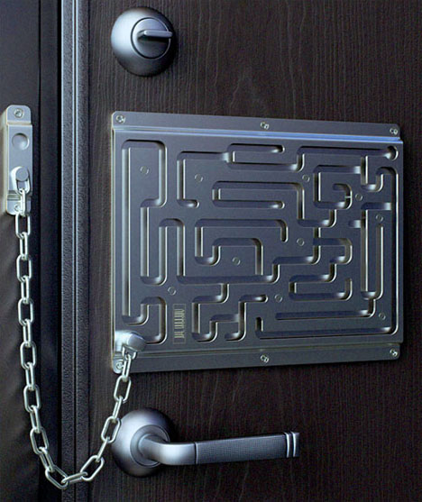

Slide 59
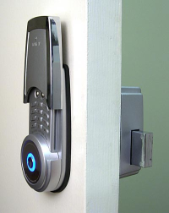

Slide 60
17. Shred Everything

Slide 61
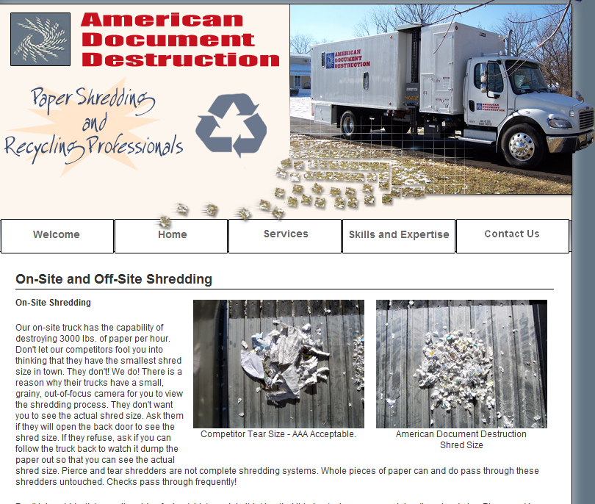

Slide 62
18. Online
Security Tests

Slide 63
ShieldsUp! - Port Authority Edition grc.com
Broadband Tests and Tools www.broadbandreports.com/tools
BrowserSpy gemal.dk/browserspy
GFI Email Security Testing Zone www.gfi.com/emailsecuritytest
Hacker Whacker www.hackerwhacker.com
PC Flank www.pcflank.com
PC Pitstop www.pcpitstop.com
[Checkup browsercheck.qualys.com
Privacy.net privacy.net/analyze

Slide 64
19. Employee Agreements

Slide 66
20. Periodic Computer Checks

Slide 67
Recent Applications
Search history
Browsing History
Cookie History
Temporary Internet Files
Search for JPGs
Recycle Bin
Suspicious Password Protected Files
Requesting Lost Passwords
Review Sent and Received E-Mail
Review Deleted E-Mail Folder
Review Junk E-Mail Folder
Use E-Mail Rules to Track Usage
Use E-Mail Server Settings to Track Usage
Game High Scores
Microsoft Coffee

Slide 68

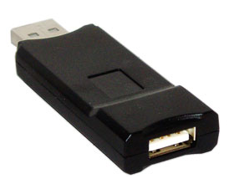
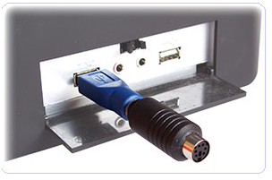
Tools to help You Track Computer Usage
Key Loggers
Print Monitor Pro (free)
Give Me Do (free)
Desktop Spy (free)
Hardware Keylogger ($60)
Internet Spy (free) -
Evidence Tracker
Evidence Blaster ($23)

Slide 69
21. Physical Inventories & Surprise Cash Counts

Slide 70
22. Bolt Down
Computer Systems

Slide 71
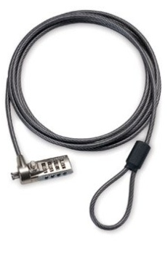
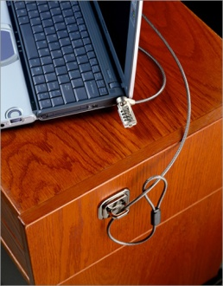
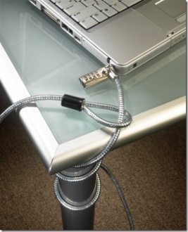
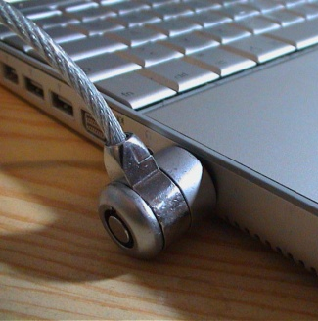

Slide 72
23. Filter Out Spam

Slide 73
Spam
Robs you of productivity
Many approaches to reducing spam
  Anti-spam Software - SpamFighter
  Outlook Junk Mail Filter
  Filter Junk Mail at the Mail Server - GMail
  Filter Junk Mail at your Router - Barracuda
  Microsoft’s Suggestions

Slide 74
24. Be Wary of Hacking Tools

Slide 75
Hacking & Cracking Tools
Crackz
Hackz
Warez
Serialz

Slide 76
25. Identity Theft Tips

Slide 77

http://www.asaresearch.com/web/security_identity_theft.htm

Slide 78
Avoid Phishing

Slide 79
How Serious
is the Problem?

Slide 80

Organization: National Institute of Health
Date of Theft: February 2008
Type of Data Stolen: Patient data for 2,500 patients over a 7 year period
How Stolen: From an employee’s home

Slide 81

Organization: Davidson County Election Commission - (Nashville, TN)
Date of Theft: December 28, 2007
Type of Data Stolen: Names and complete Social Security numbers for 337,000 registered voters
How Stolen: Someone broke into several county offices over Christmas and stole laptop computers

Slide 82

Organization: Transportation Security Administration (TSA)
Date of Theft: August 10, 2006
Type of Data Stolen: Social Security numbers, payroll information, and bank account data for approximately 133,000 employee records
How Stolen: From a government vehicle

Slide 83

Organization: Federal Trade Commission (FTC)
Date of Theft: June 22, 2006
Type of Data Stolen: Data on about 110 people that was "gathered in law enforcement investigations”
How Stolen: Stolen from a locked vehicle

Slide 84
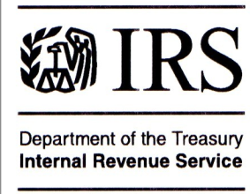
Organization: Internal Revenue Service (IRS)
Date of Theft: June, 2006
Type of Data Stolen: 291 employees and job applicants, including fingerprints, names, Social Security numbers, and dates of birth
How Stolen: In transit on an airline flight

Slide 85

Organization: AICPA
Date of Theft: June, 2006
Type of Data Stolen: Unencrypted hard drive containing names, addresses and Social Security numbers of 330,000 AICPA members.
How Stolen: Lost during shipping

Slide 86

Organization: US Government Veterans Affairs Administration
Date of Theft: May 3, 2006
Type of Data Stolen: 26.5 million veterans, their spouses, and active- duty military personnel
How Stolen: Laptop stolen from employees home

Slide 87

Organization: Citibank Student Loan Corporation
Date of Theft: March 8, 2006
Type of Data Stolen: Information on 3.9 million customers
How Stolen: Lost in transit while being shipped

Slide 89










Long List of Documented Thefts of Data
Victims Include:

Slide 90
Here’s An Even Bigger List

Slide 91
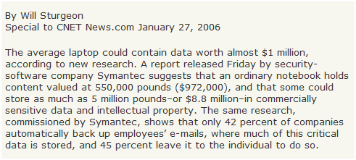

Slide 92

Organization: Drug Enforcement Agency (DEA)
Date of Theft: June 7, 2004
Type of Data Stolen: Laptop of DEA Informants
How Stolen: From the trunk of an Auditor’s car while he was at a bookstore coffee shop in suburban Washington

Slide 93
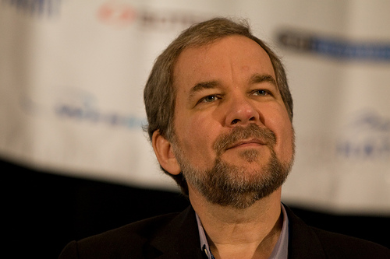
PGP (Pretty Good Privacy)
Phil Zimmerman

Slide 94

Is Big Brother Watching You Anyway?
‘Widely Rumored that a master key' exists

