Slide 1

is pleased to present
“Evaluating and Selecting
Accounting Software”
Conference Host & Key Note Presentation
J. Carlton Collins, CPA

Slide 2

J. Carlton Collins, CPA
“It is my honor to host the
2010 Accounting Software Expo”
Installing Systems for 25+ Years
Author of the World’s Number One Book On Installing Accounting Systems
Has Implemented 275+ Systems in the Atlanta Area

Slide 3

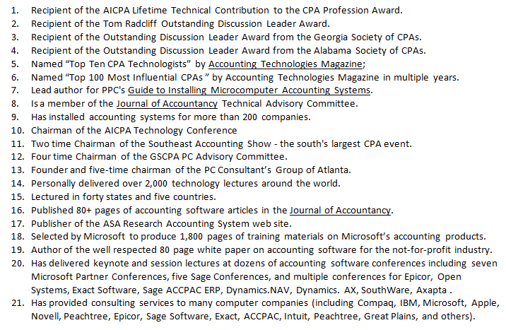
J. Carlton Collins, CPA

Slide 4

Today’s OBJECTIVES
Present to you the very best accounting solutions in the world.
Introduce you to knowledgeable industry experts.
Present the information in an educational format & help you learn what to look for in an accounting system.
Provide you with strategies, tips, and suggestions for evaluating and selecting just the right system for your needs.
Provide top High quality continuing professionals education for those who need CPE credits

Slide 5

The Importance of Today’s Topic
Your Accounting System is the Lifeblood of your Organization
According to the U. S. Bureau of Labor and Statistics, the number two leading cause of business failure is an inadequate accounting system.

Slide 6
Eight well-respected solutions
NetSuite and Intacct – Together they represent the world’s top two web-based accounting solutions.
Dynamics GP and SAP Business One - Together they represent two of the most popular high-end accounting systems on the planet – loaded with modules, features, and world class technology.
Epicor and Dynamics AX - Represent two the world’s top manufacturing solutions, also terrific for distribution and numerous other industries.
Dynamics SL - A widely respected project accounting solution, also fits well in the non-profit sector as well as other industries.
xTuple - While newer, features similar capabilities to the products mentioned above including manufacturing, but delivered to you in an open source code framework.

Slide 7
EIGHT points
I would like to make
8

Slide 8

1. Who’s Number one?

Slide 9
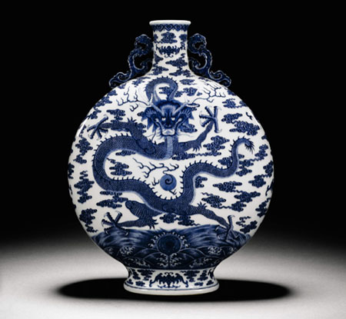
2. ERP Vs Accounting Systems

Slide 10
3. Definitions
ERP System
Accounting System
Accounting Software
Trial Balance Software
GL Package
GL System
Business Software
Business Management System
All systems have evolved into “Information” systems.
I recommend that you use these terms interchangeably.

Slide 11


4. Most Important Factor
The Quality of the Reseller

Slide 12
Criteria For Selecting A Reseller
1. At least 3 experienced consultants on staff, with at least 2 years experience each.
2. All consultants trained and certified and in good standing with the vendor.
3. All consultants receive annual training, as evidenced by certificates of completion.
4. At least 1 support person dedicated full time.
5. At least 35 customer implementations under their belt.
6. At least 3 customer references who check out fine.
7. Vendor reference that checks out fine.
8. Evidence of a sustained marketing program (good indicator that the reseller is doing
things right).
9. Attendance of vendor's annual conference by at least one consultant.
10. Physical inspection of facilities meets expectations.
11. Background check with Better Business Bureau is positive.
12. Background check with your CPA, or a local CPA is positive.
13. Background check with credit bureau is positive.
14. Reseller is able to demonstrate availability of time to meet your needs.
15. Good vibrations – seems like personalities match your organization.

Slide 13

5. Beware of “Maintenance Mode” Solutions
When vendor “milks” existing customer base for annual support fees, sales and payroll tax table updates, and forms sales.
Expect few, if any, product enhancements. Typically, only minimal support enhancements to fix bugs and keep up with newer operating systems.
No marketing effort.
No Annual Conference.
Few or no New Add-on Solutions.
Few or no new customers.

Slide 14
6. Beware of brand new solutions
There are 8,000+ accounting system solutions in the world. New ones crop up monthly. Many look and sound great.
In reality, most new systems have missing modules, missing features, and bugs waiting to be discovered.
Better to have 30,000+ companies debug and test the system before you purchase and implement the system.
Only 60 or so accounting systems are used by more than 5,000 companies.
CFOs, and executives have lost their jobs over failed implementations, companies have even died. Don’t trust an unproven system – choose a well-proven solution.

Slide 15

7. It’s a training engagement!

Slide 16




8. 15 Year Timeline for
Accounting System Engagements
Due to Fears Regarding Y2K Bug, massive Replacement of Accounting Systems
Begins
After Y2K Companies Stop Buying Accounting Systems
For Many Years Y2K Affects the Normal Buying Behavior of the Public.
12 years Later - Is it Nearly Time for Companies to Once Again Replace Their Accounting Systems?
Many Experts Think So!

Slide 17
List of 3,600 Features
http://www.asaresearch.com/articles/features_list.htm

Slide 18
Carlton’s Top Ten 10 Selection Criteria
(With 10 additional criteria for good measure)
Look and Feel
Financial Statements
Customization
Drill Down
Account Number
Office Integration
Add-On Modules
Database
Notes & Attachments
Well-Proven
Inventory Pricing
Unit of Measure
Allocations
Commissions
Web Store
Supply Chain
Web Portal
Product Configurator
Sales Order processing
Ratio Reporting

Slide 19
Look and Feel

Slide 20
Look and Feel
Consistent look and feel.
Attractive, colorful.
Data Fields that are easy to read.
Fonts that are large enough to read.
Icon buttons and spinners that are large enough to easily click on.
Well-designed menus.
Tabbed Dialog boxes.
Spinners, pull down boxes, and radio buttons.
Mouse-less data entry.
Icons that are understandable, perhaps with tool tips thrown in.
Titles that line up, data input fields that line up.
Screens that fill the page, no background clutter visible.
The ESC closes the current window and backs you through the system.
Hyperlinks that help you drill around.
Double clicks that allow you to drill down.
Following are Some Examples screens from selected products:

Slide 21
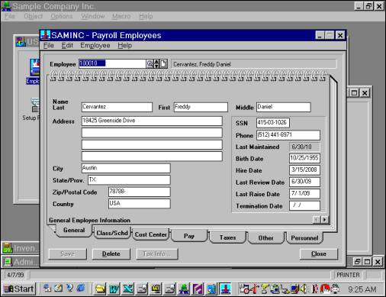
Sage ACCPAC ERP
Data Fields have white background and borders
Data labels Line Up Neatly
Data Boxes Do Not Line Up Neatly
Tabbed Dialog Boxes help Organize Multiple Screens
This Spinner is Too Small
Company Name is Clearly Visible
4/7/08
Current Date is Clearly Visible

Slide 22
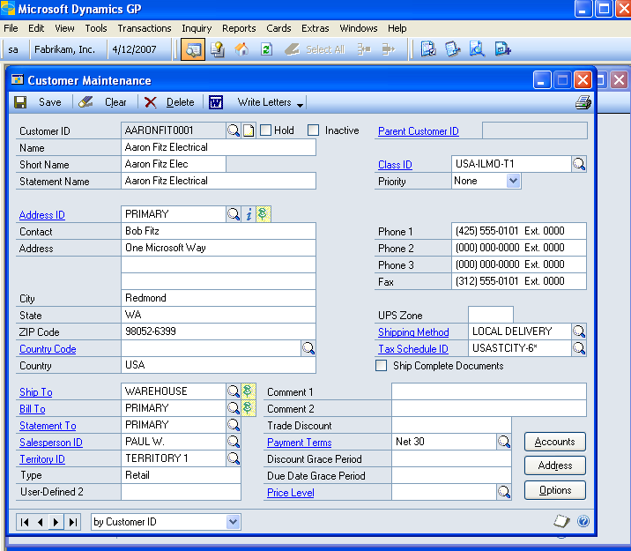
Dynamics.GP
Data Fields have Easy Search and Lookup Buttons
Data labels Are Hyperlinked to Detailed Lists
VCR Buttons for Scrolling through Lists
Integration to Microsoft Office

Slide 23
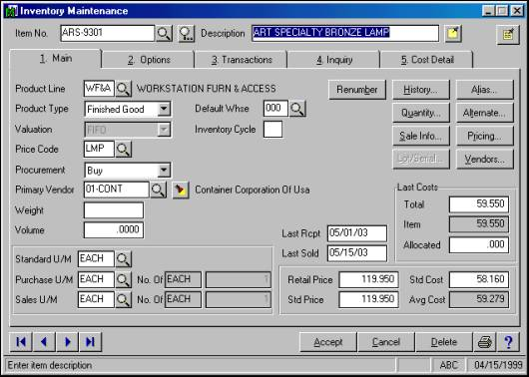
Sage MAS 200 ERP
Nice Tabbed Dialog Boxes
But screen is busy and data labels do not line up – eyes
VCR Buttons for Scrolling through Lists
Clear, Easy to Read Icons

Slide 24
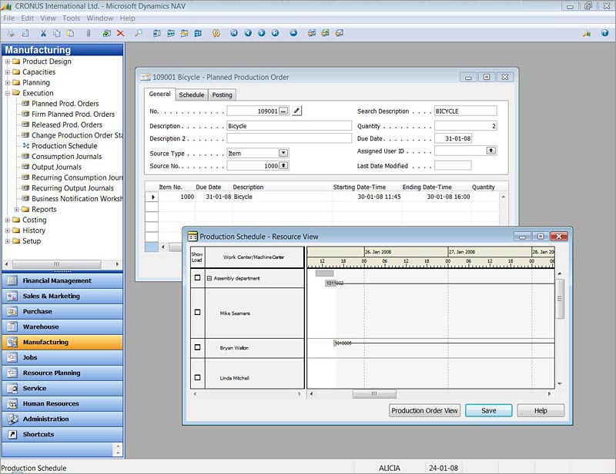
Dynamics.NAV
Main Menu on the Side is Always Visible
Tabbed Dialog Boxes
Data Labels and Data Field Line Up Neatly
Current System Date Displayed at Bottom

Slide 25
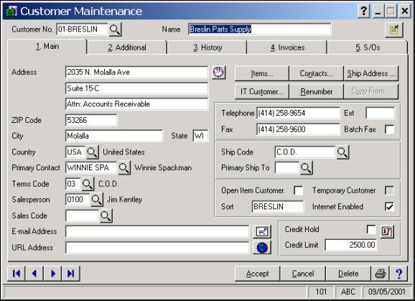
Let’s Play
What’s Wrong Here?
This Sage MAS 200 ERP Screen
is a Little Busy

Slide 26
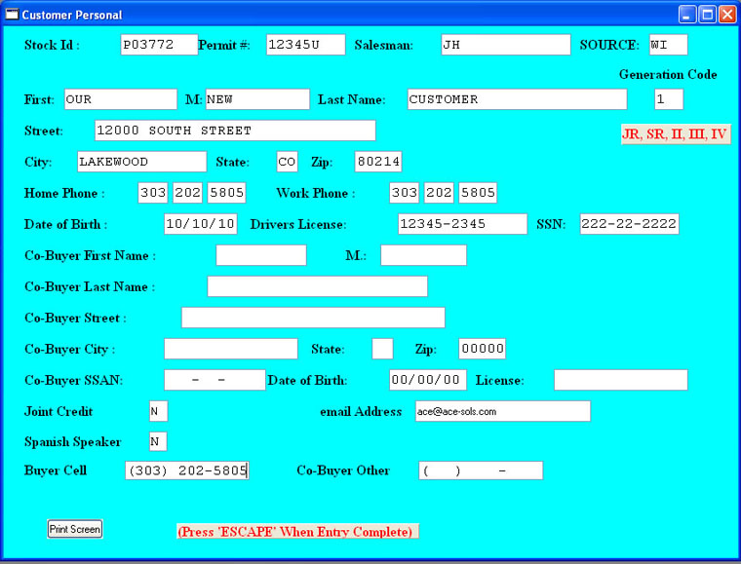
Let’s Play
What’s Wrong Here?
This Ace Solutions screen has data fields all over the place

Slide 27
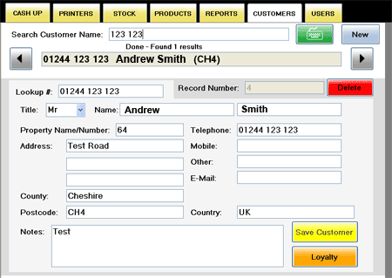
Let’s Play
What’s Wrong Here?
This FutureSmooth screen does not contain many data fields

Slide 28
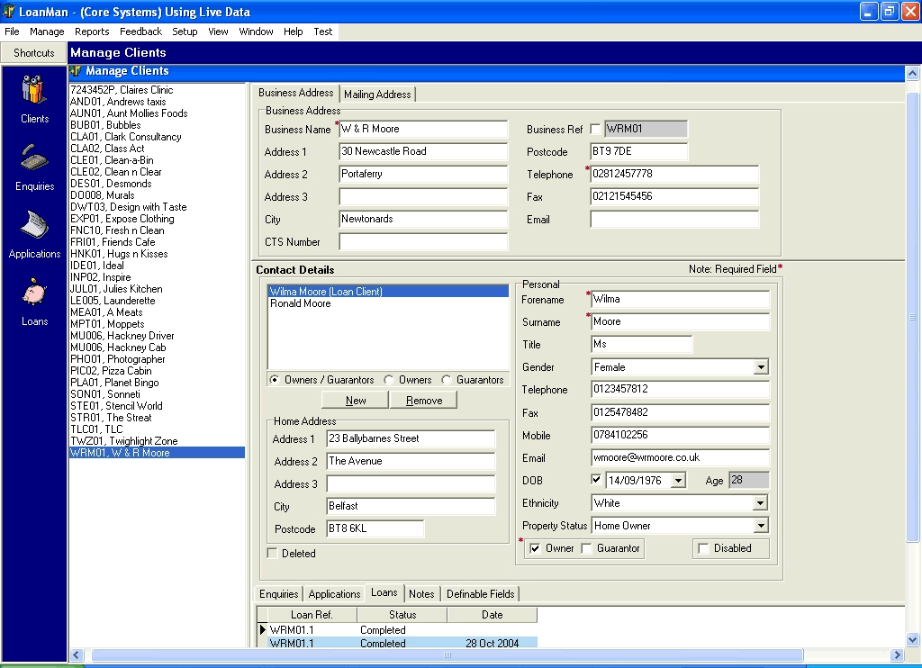
Let’s Play
What’s Wrong Here?
This Core Systems screen is not bad, but it has no company name, system date, look up buttons, VCR buttons, hyperlinks, OK button.

Slide 29
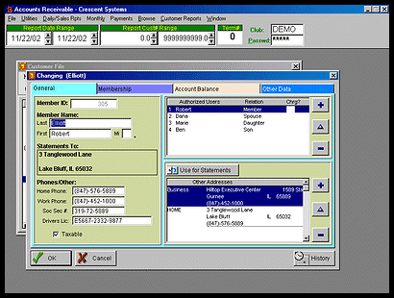
Let’s Play
What’s Wrong Here?
Do the Data Labels and Fields in this Cresent Systems Screen Line Up Neatly?

Slide 30
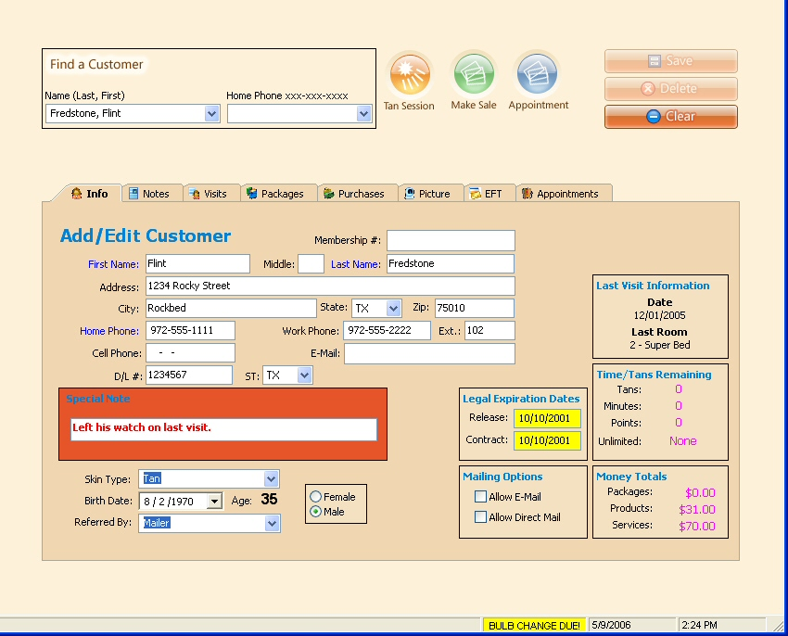
Let’s Play
What’s Wrong Here?
The data labels on this TanTrack screen are right justified – which makes the eye ball work a little harder

Slide 31
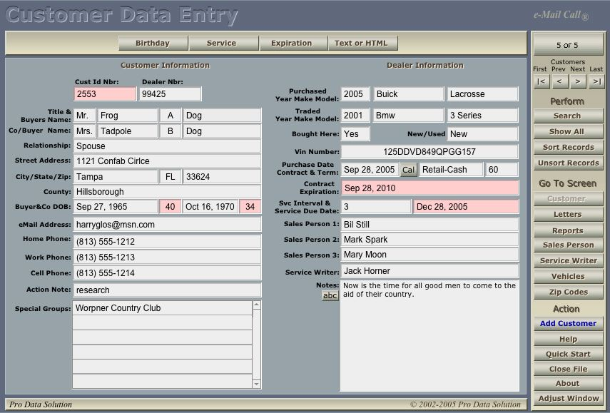
Let’s Play
What’s Wrong Here?
The data labels on this ProData screen are right justified – which makes the eye ball work a little harder
No system date is shown
No company name is shown

Slide 32
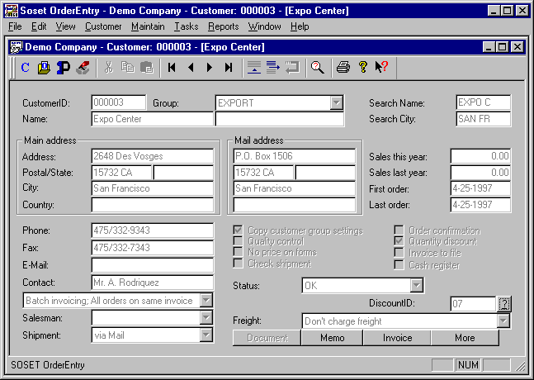
Let’s Play
What’s Wrong Here?
This Soset screen is fairly busy, and the grayed out check boxes are difficult to read – even when checked.

Slide 33
Financial Reporting

Slide 34
How many default financial statements come standard with the system?
Is a Statement of Cash Flows included? (FASB 52 Requirement)
Can you define the desired date range to the day?
Can you report on a single a department, division, fund or account segment?
Can the report be scheduled to print, publish, or send automatically?
Can the reports be sent to an e-mail address (or fax machine)?
Can multiple reports be grouped together and printed as a single group, instead of selecting dozens of individual reports each month?
Can the report format be easily customized to add new columns or rows?
Do reports print fast?
Can you print financial reports to the screen?
Do reports printed to the screen have fixed headers and row labels so you can scroll the data and still know what you are looking at?
Can reports be exported or cut and pasted into Microsoft Excel for “what-if” analysis or charting?
Do reports offer “drill-down” and “drill-around” capabilities?

Slide 35
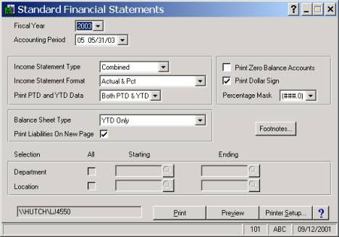
Sage MAS 200 Print Reports Options Box

Slide 36
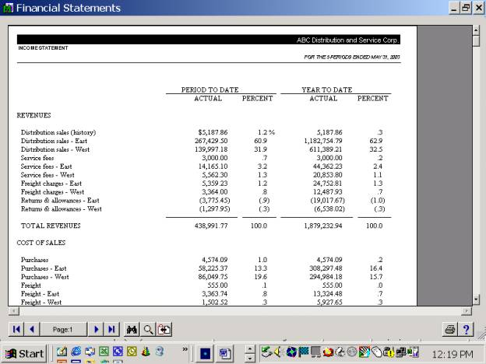
Sage MAS 200 Printed Report
No option to e-mail report
Headers and row labels not fixed
No drill down capabilities on this particular report
No export to Excel or Word option

Slide 37
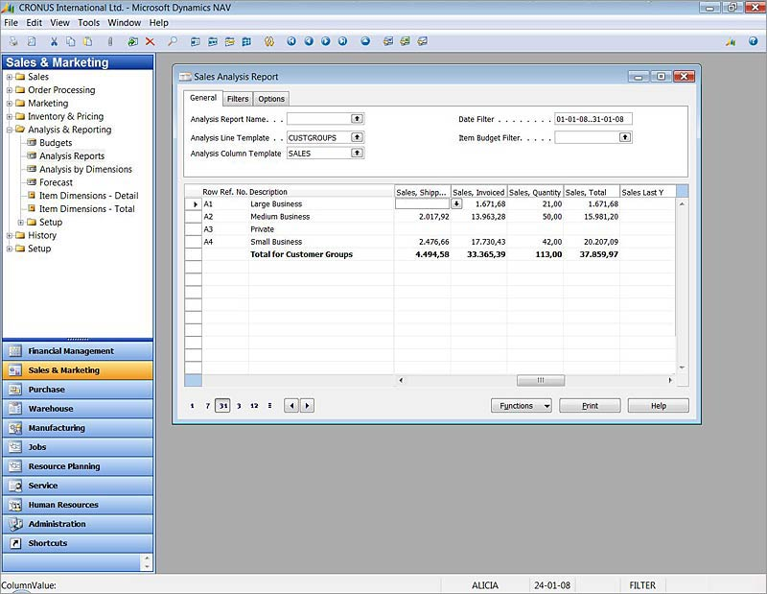
Dynamics.NAV Printed Report
Drillable
Filterable
Export to Excel or Word
Scrollable
Menu of Reports shown on left

Slide 38
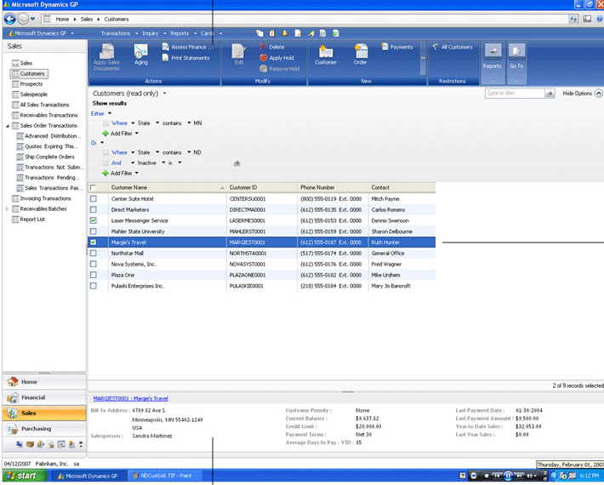
Dynamics.GP Reporting
1
Action pane at top for easy printing and exporting
Info bar at bottom displays details, so less reporting is really needed
2

Slide 39
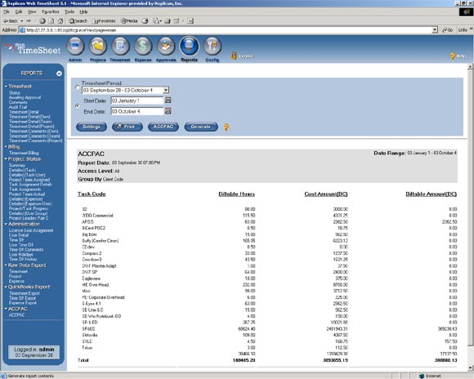
Sage ACCPAC Report
Fonts are pretty small

Slide 40
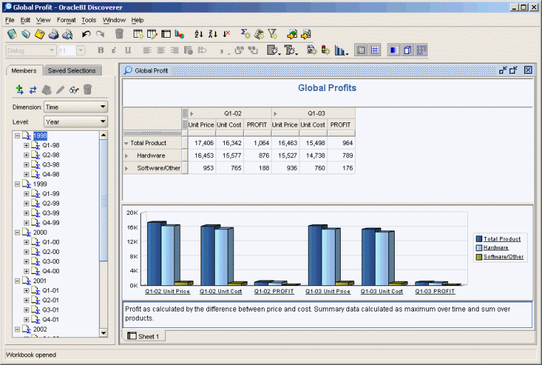
Oracle Sample Report
Nice menu of reports to the left
Nice selection of tools at top
Scrollable
Drillable
Multiple sheet format (similar to Excel)

Slide 41
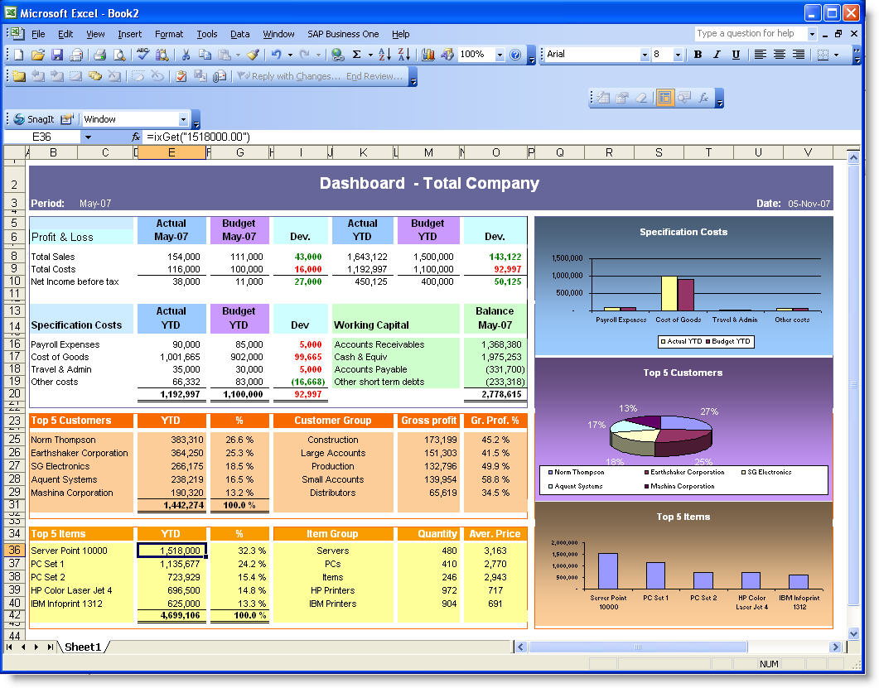
SAP Business One Dashboard Report
Attractive, well organized
Excel-based report
Uses ODBC technology to create live link to Excel

Slide 42
Customization

Slide 43
Customization is the most important feature.
There is more than one facet to customization - consider:
Reports
User Input Screens
Database
1
3
Documents
4
2

Slide 44
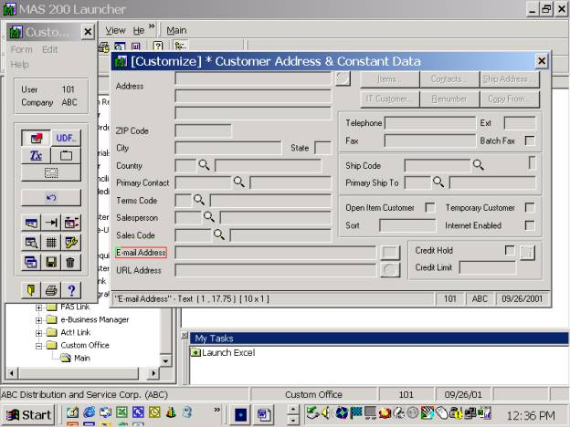
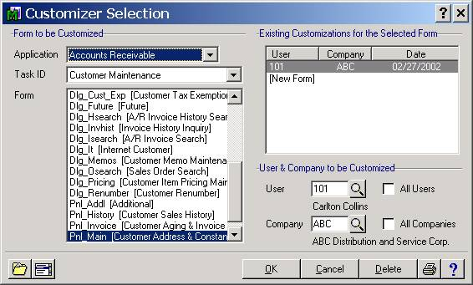
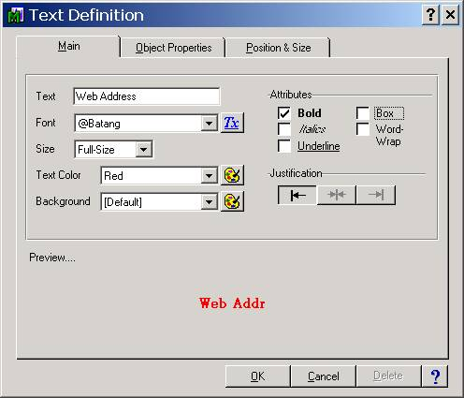
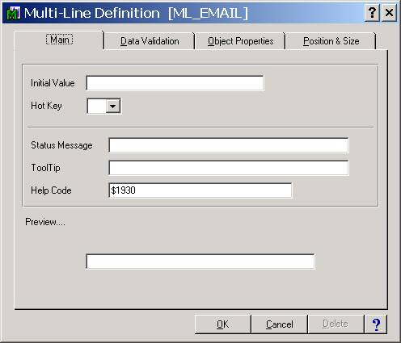
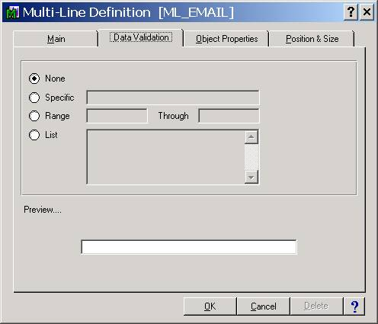
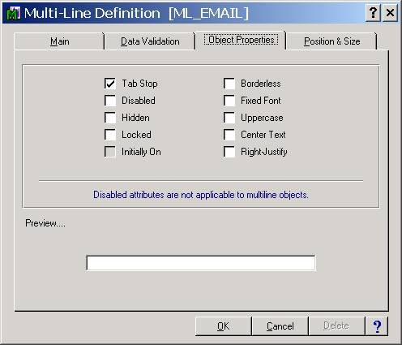
Customizing Sage MAS 200 ERP

Slide 45
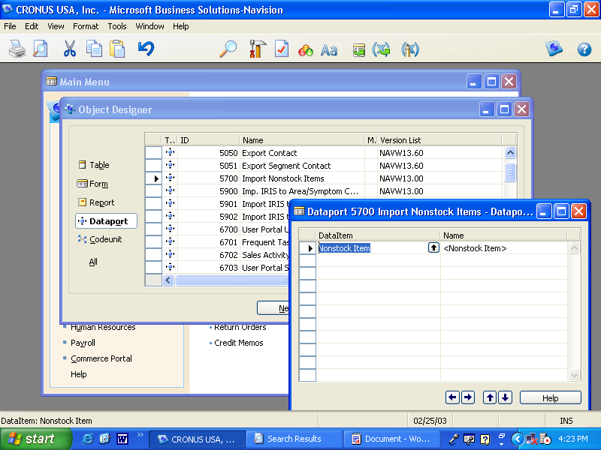
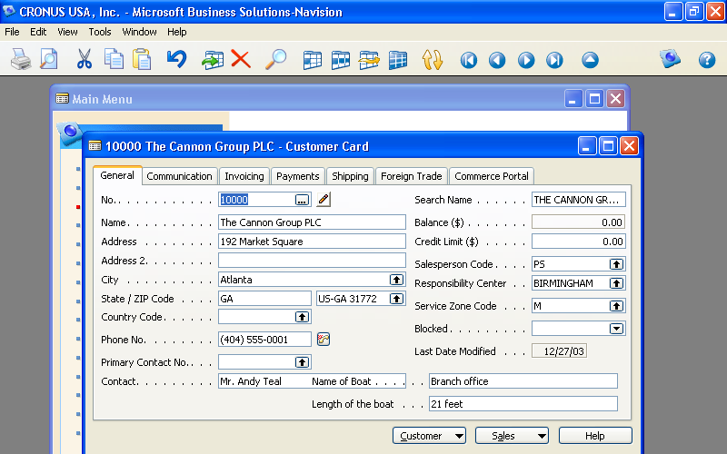
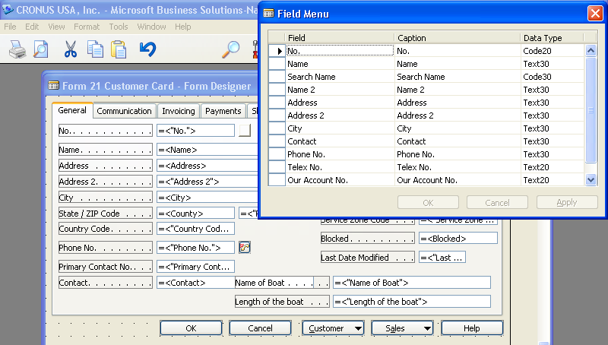
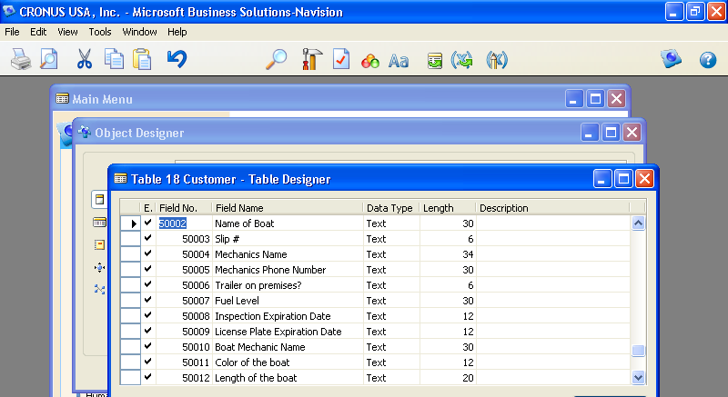
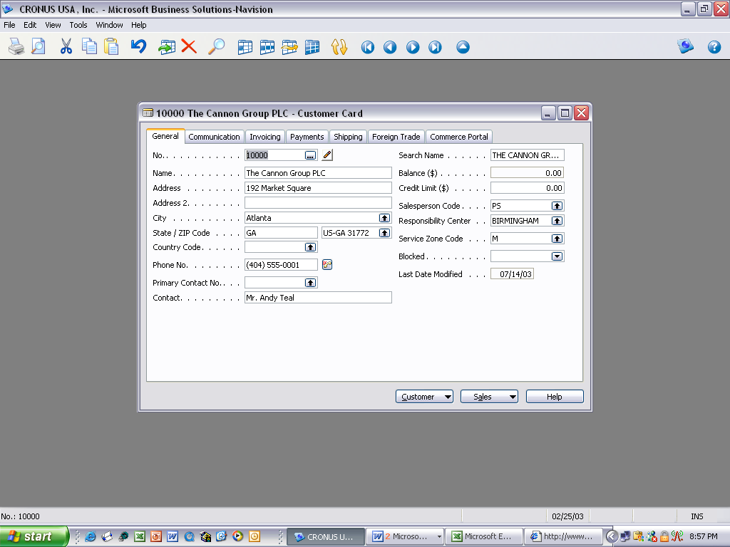
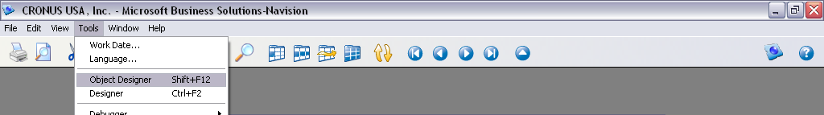
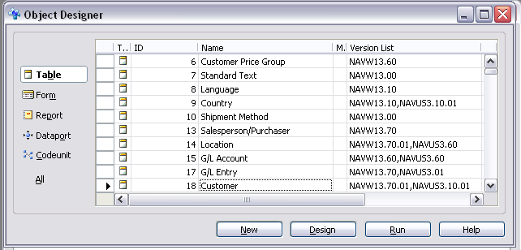
Customizing Dynamics.NAV

Slide 46
Drill Down

Slide 47
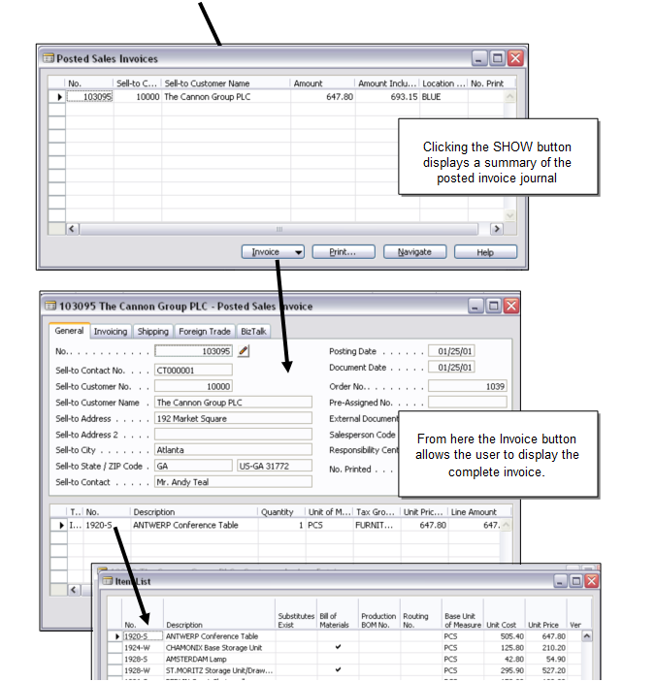
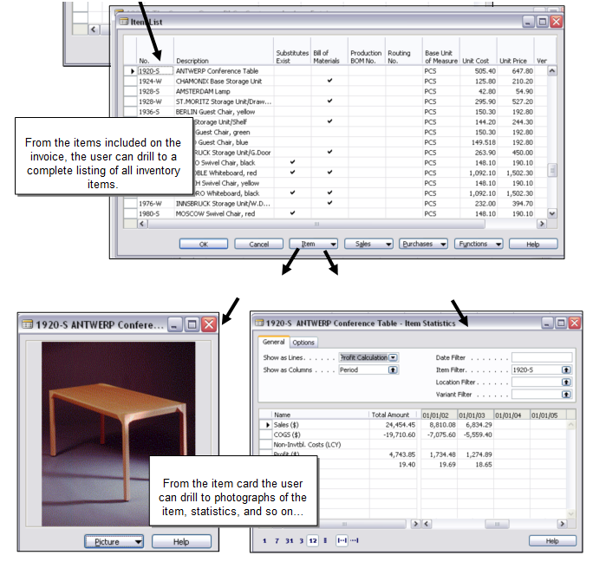
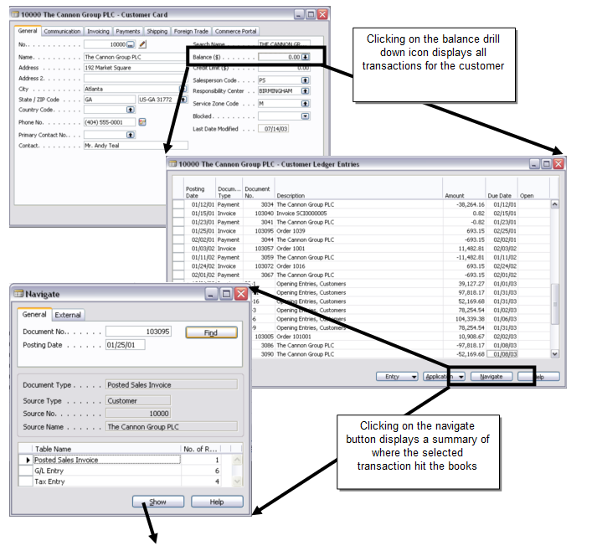
Drilling Dynamics.NAV

Slide 48
Account Number

Slide 49
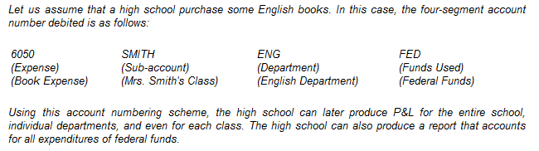

Slide 50
Beginning ERP Products
Sage ACCPAC Executive Series | 81 characters, 9 segments
Dynamics NAV | 10 segments default, Unlimited, Freely Modifiable
Dynamics GP | 66 characters, 10 segments
Sage MAS 500 ERP | 100 characters, 15 segments
Deltek | 15 characters, 15 segments
Epicor | 32 characters, 4 segments
Lawson Enterprise | 53 characters, 15 segments
Macola Progression | 15 Characters, 3 segments
Sage ACCPAC Executive Series | 78 characters, 9 segments
Dynamics.SL | 30 characters, 9 segments
Syspro | 15 characters, 15 segments
Enterprise Products
Dynamics AX | Unlimited, Freely Modifiable
Dynamics GP | 66 characters, 10 segments
JD Edwards One World | 26 characters, 26 segments
Oracle E-Business Suite | 2000 characters, 30 segments
PeopleSoft | Unlimited characters, unlimited segments
SAP R/3 | Unlimited characters, unlimited segments
Sage ACCPAC Executive Series | 78 characters, 9 segments
Dynamics.SL | 30 characters, 9 segments
Mid Market Products
Sage ACCPAC ERP | 45 characters, 10 segments
Sage BusinessVision | 5 characters, 1 segment
Cougar Mountain | 30 characters, 6 segments
CYMA | 24 characters, 10 segments
Dynamics.GP | 66 characters, 10 segments
Macola Progression | 15 Characters, 3 segments
Sage MAS 200 ERP | 9 characters, 3 segments
Dynamcs.NAV | 20 characters, 10 segments (May be modified to an unlimited number)
Sage PFW (Platinum for Windows) | 32 characters, 30 segments
Sage Pro ERP | 24 characters, 6 segments
Dynamics.SL | 30 characters, 9 segments
Syspro | 15 characters, 15 segments
Traverse | 30 characters, 7 segments
Visual AccountMate | 30 characters, 9 segments
SAP R/3 | Unlimited characters, unlimited segments
Sage ACCPAC Executive Series | 78 characters, 9 segments
Dynamics.SL | 30 characters, 9 segments
Entry Level Products
ACCPAC Discovery Series | 12 characters, 2 segments
ACCPAC Simply Accounting | 4 characters, 1 segment
APPGEN | 10 characters, 10 segments
BusinessVision 32 | 5 characters, 1 segment
BusinessWorks Gold | 6 characters, 2 segments
M.Y.O.B. Premier | 4 characters, 4 segments
NetSuite | 27 characters, 1 segment
One Write Plus | 6 characters, 2 segments
Peachtree 2000 | 11 characters, 4 segments
Peachtree for Windows | 15 characters, 15 segments
Peachtree Complete Accounting | 15 characters, 15 segments
QuickBooks | 13 characters, 1 segment
QuickBooks Pro 2000 | 13 characters, 1 segment

Slide 51
Office Integration

Slide 52
Nine Key Office Integration Functions to look For:
Export to Excel
Import from Excel
OLAP Data Cubes
ODBC Connectivity
Export to Word
Send reports through Outlook E-Mail
Updated Contacts sync to Outlook/Accounting system
Integration to project
Integration to InfoPath

Slide 53
Add-on Modules

Slide 54
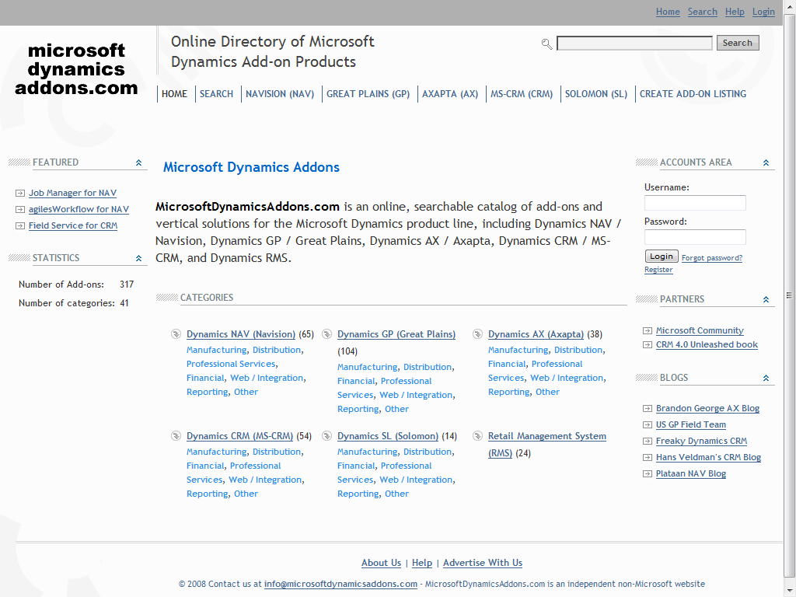
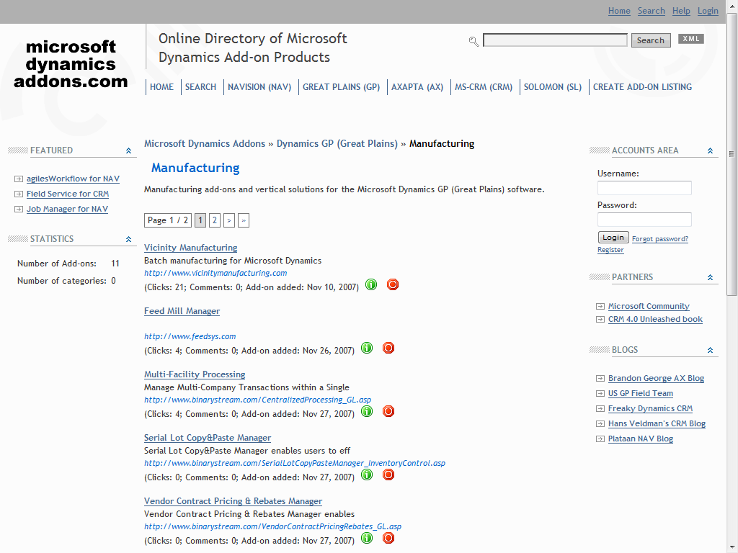

Slide 55
Database

Slide 56
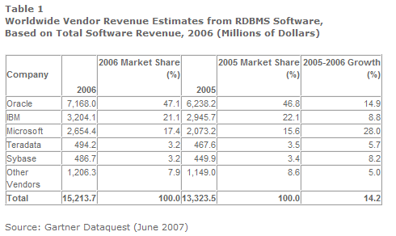
These 3 databases dominate – 86%
IBM & Oracle are very good, but expensive and complex
Microsoft SQL Server is the most popular mid-market database – companies with revenues less than $1 billion
This is based on total revenue, not users
http://www.gartner.com/it/page.jsp?id=507466

Slide 57
Notes and Attachments

Slide 58
Notes and Attachment Features to look for:
Insert unlimited notes to any record or document.
  ie: Attach collection call notes to the outstanding invoice
Attach documents to any record or document.
ie: Attach employee review Word document to employee record
ie: attach driving directions to customer record
ie: attach pictures of customer to customer record
ie: Attach pictures of inventory to inventory record
ie: Attach Excel worksheet commission calculation to salesperson record
3. Attach reminder notes to any record or document.
ie: “Customer is now 6 months old, time to extend a better discount. Sally Jefferson – 505-434-8734”
4. Going Paperless – Notes and attachments will eliminate 42% of your paper

Slide 59
Well Proven

Slide 60
25 - Step Blueprint for Selecting the Right Accounting Software

Slide 61
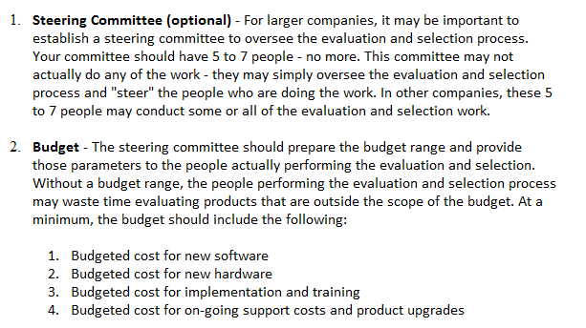

Slide 62
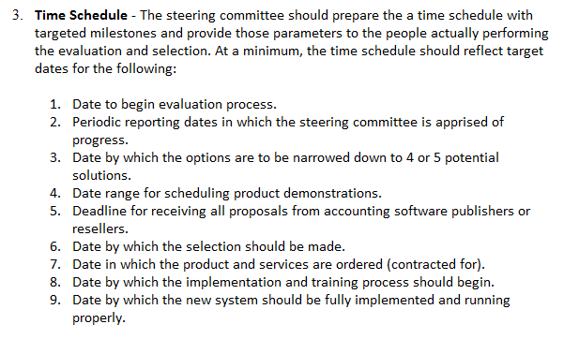

Slide 63
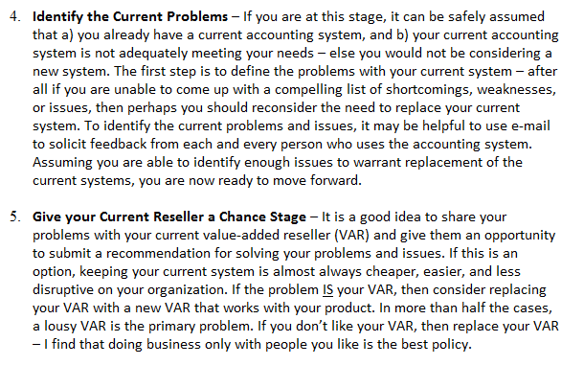

Slide 64
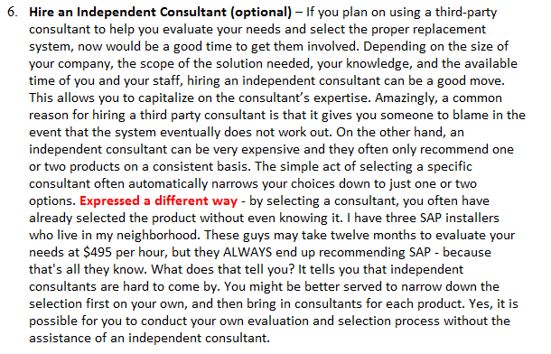

Slide 65
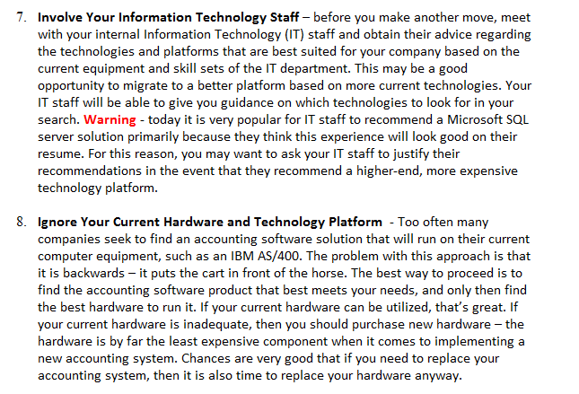

Slide 66
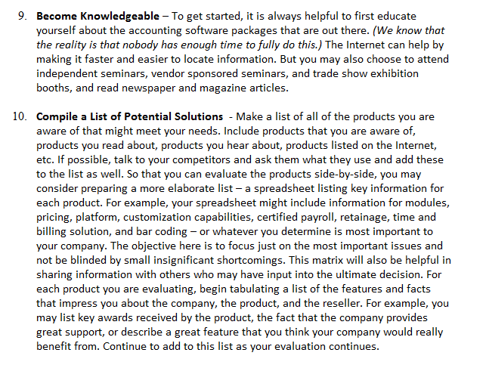

Slide 67
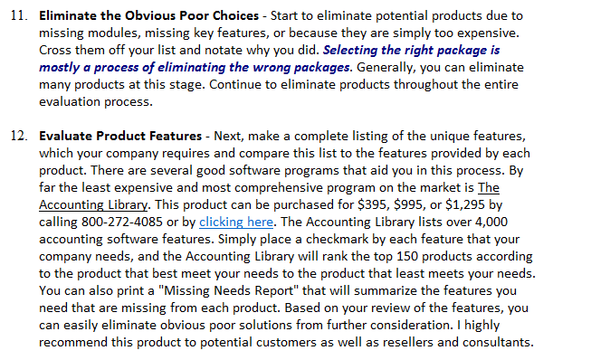

Slide 68
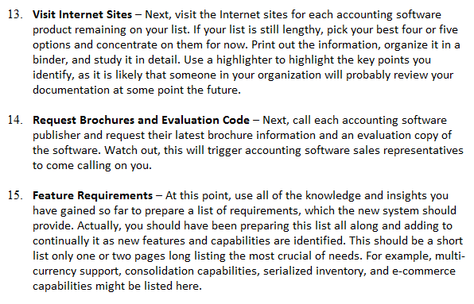

Slide 69
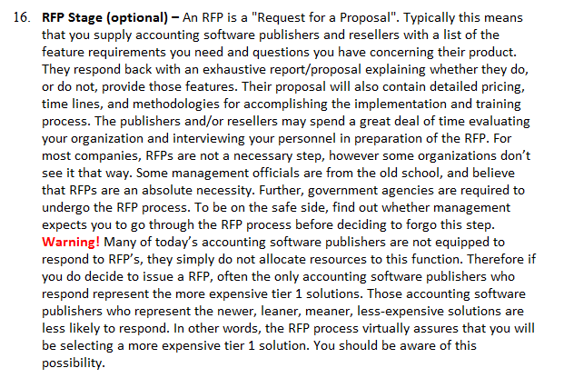

Slide 70


Slide 71


Slide 72


Slide 73


Slide 74


Slide 75


Slide 76
END

Slide 77
END

