Slide 1

Technology Tips

Slide 2
A Few
Gadgets & Newer Technologies

Slide 3
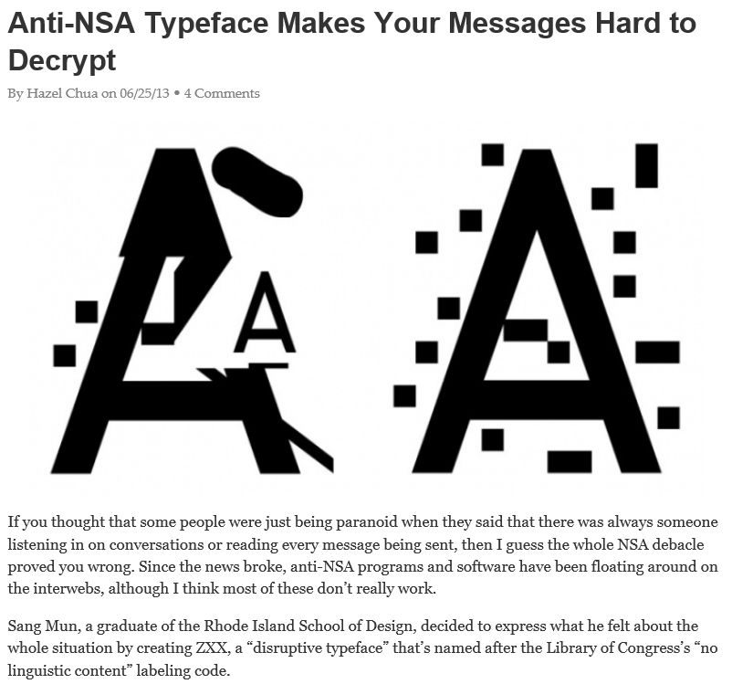

Slide 4
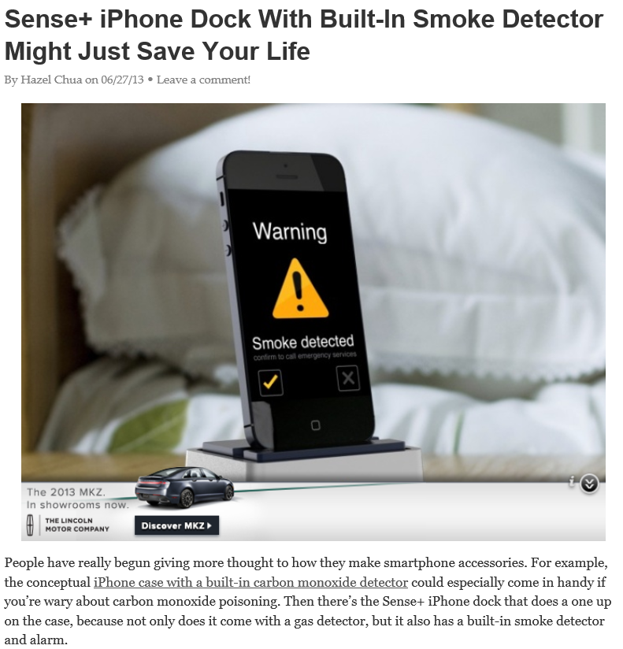

Slide 5
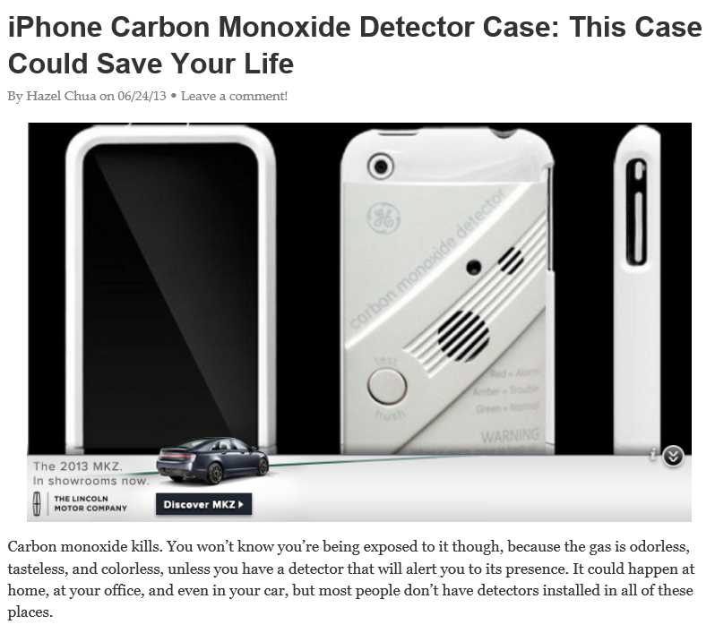

Slide 6
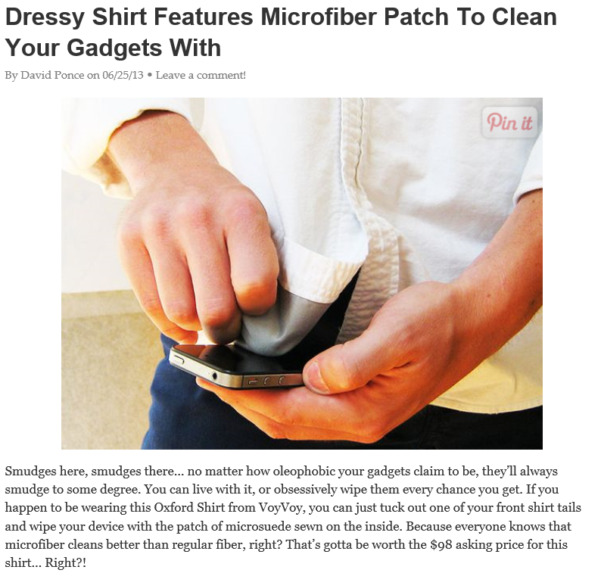

Slide 7


Slide 8
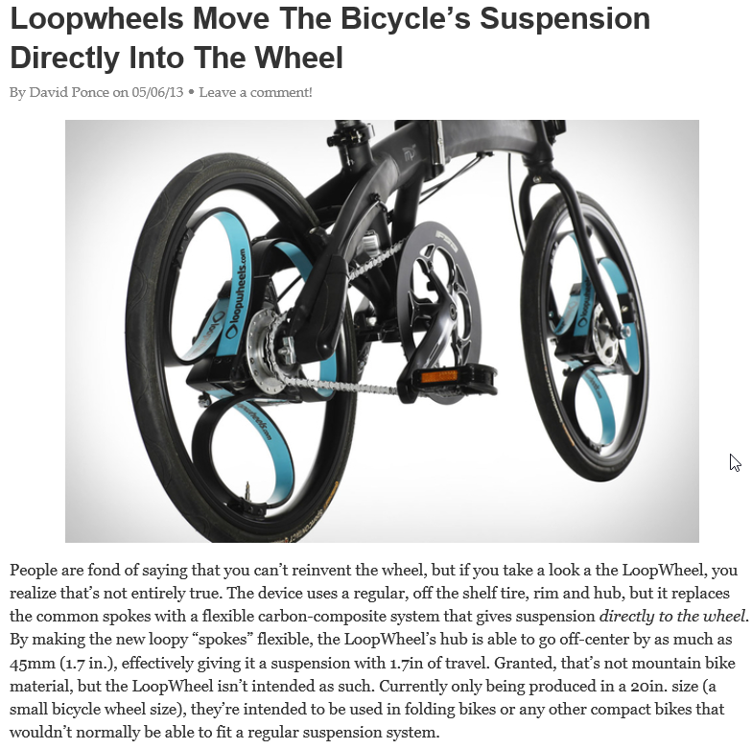

Slide 9


Slide 10
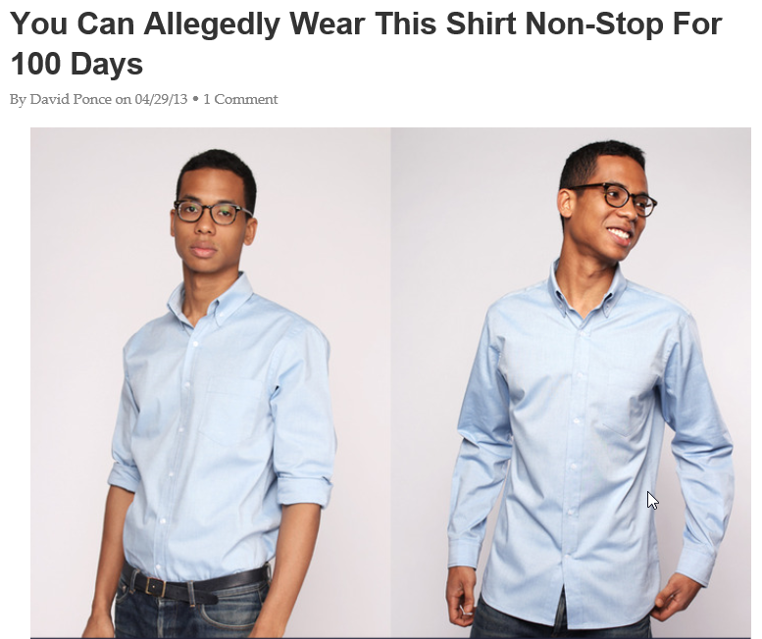

Slide 11
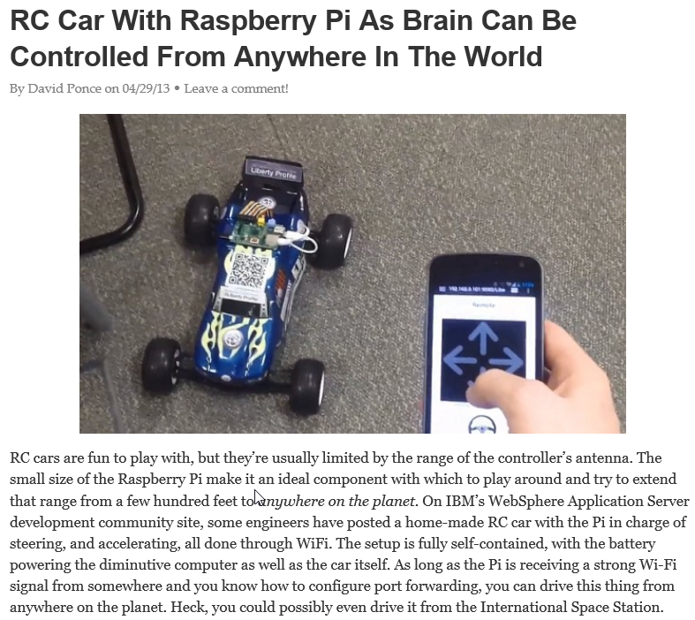

Slide 12
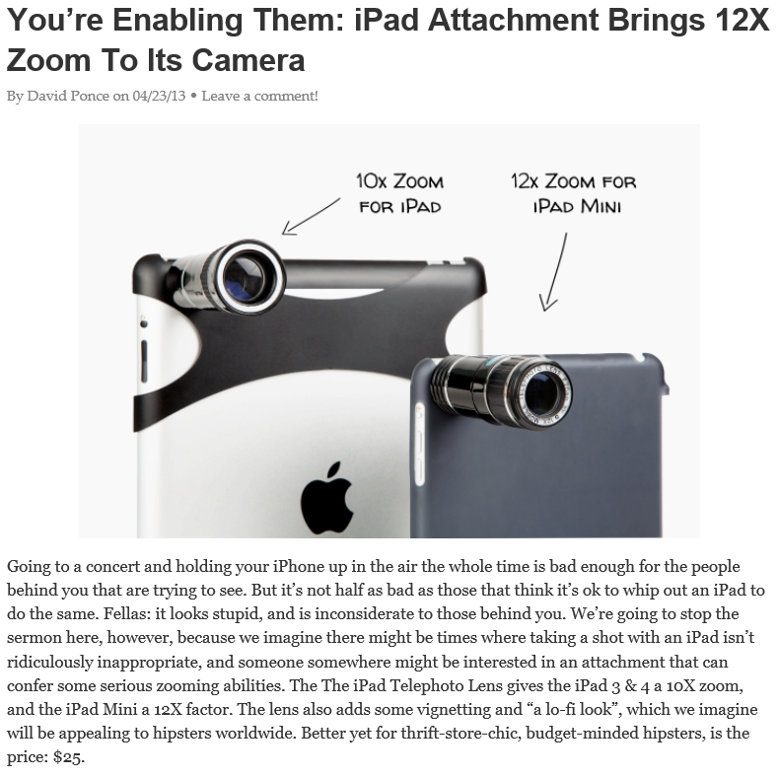

Slide 13
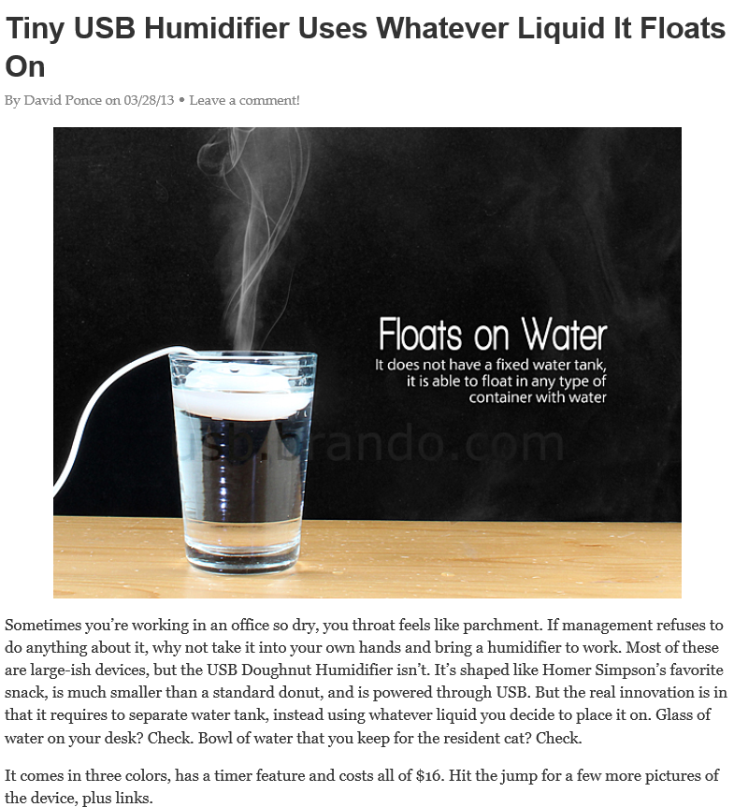

Slide 14
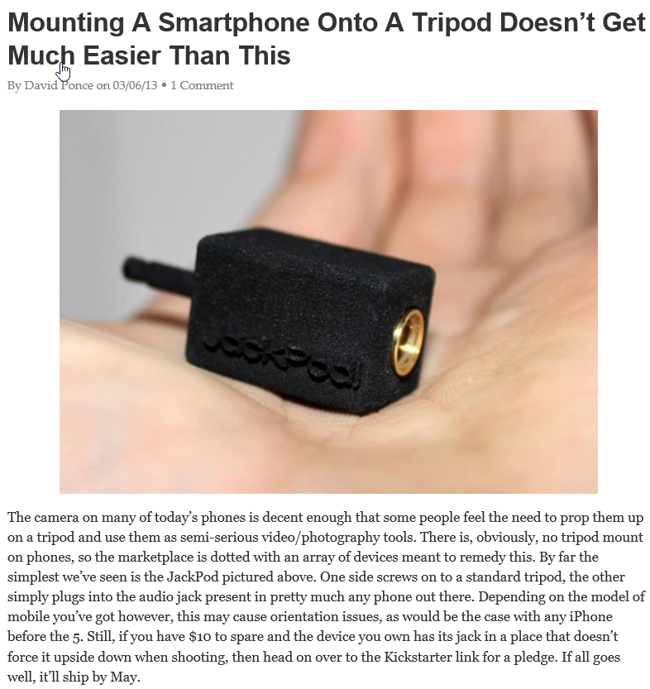

Slide 15
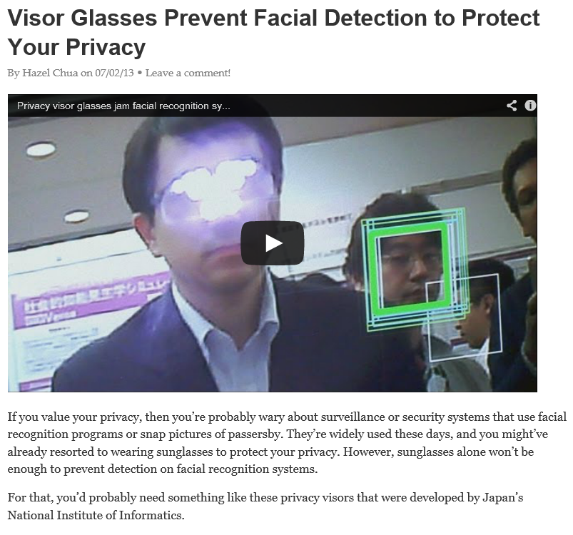

Slide 16
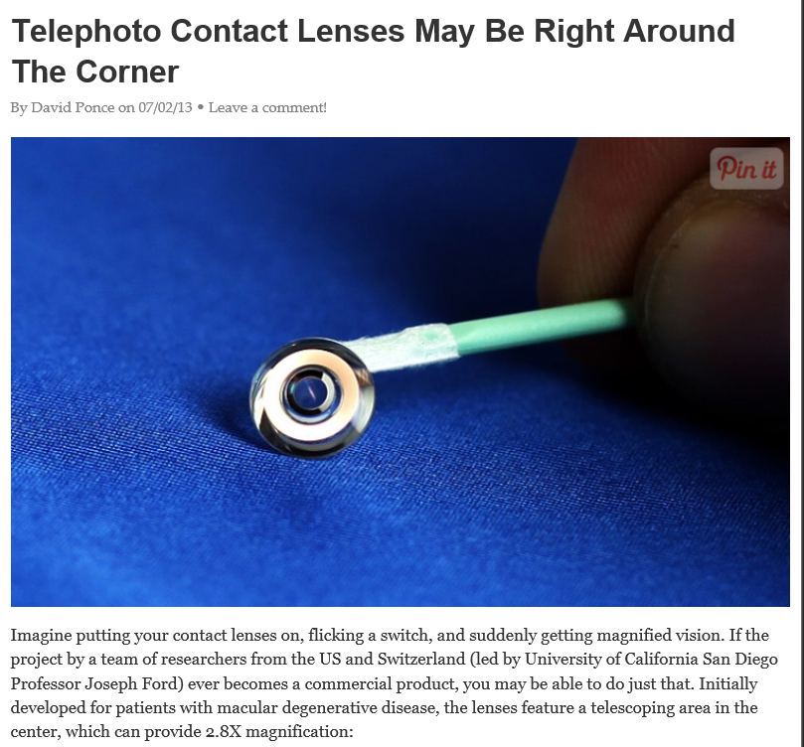

Slide 17

Instant Search

Slide 18
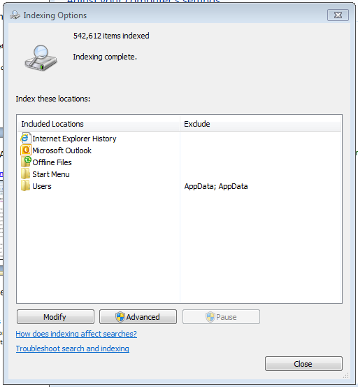
Instant Search (Indexed Searching)
Windows 8, 7 & Vista
Improved in Windows 8
Stacking Results
Must modify through control panel to index your data folders other than My Documents

Slide 19

Google
Fiber-Optics

Slide 20
Google Fiber
Google Fiber is a project to build an experimental broadband internet network using fiber-optics, 100 times faster than today’s broadband.
Austin, Texas; Kansas City, Kansas; Kansas City, Missouri; North Kansas City, Missouri and Provo, Utah.
  Three pricing options:
  Free – 5 Mbps speed
  2. $70 per month 1 Gbps (1,000 Mbps) speed, Includes 1 terabyte of Google Drive.
  3. $120 per month also includes television with 2 terabyte DVR recording up to eight live television shows simultaneously. Nexus 7 tablet acts as a remote control for the system.

Slide 21
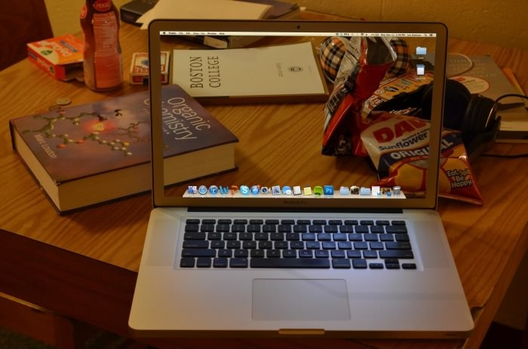
Transparent Glass

Slide 22
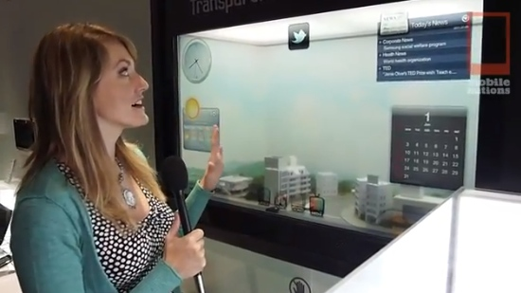
Samsung’s Transparent Smart Window
Example Uses - http://www.tubechop.com/watch/732846

Slide 23
Smart Mirror
http://www.wimp.com/screentechnology/

Slide 24
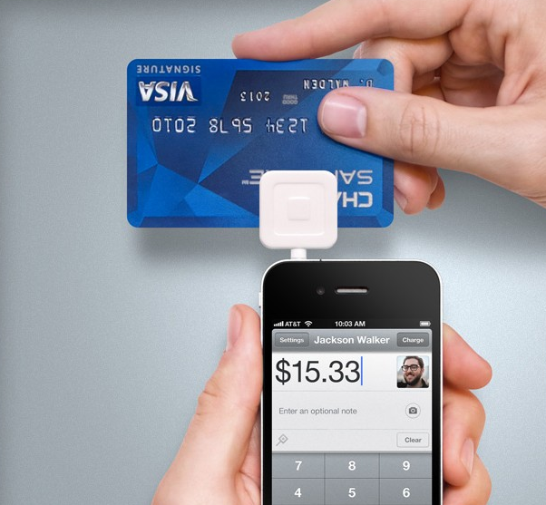
The Square

Slide 25
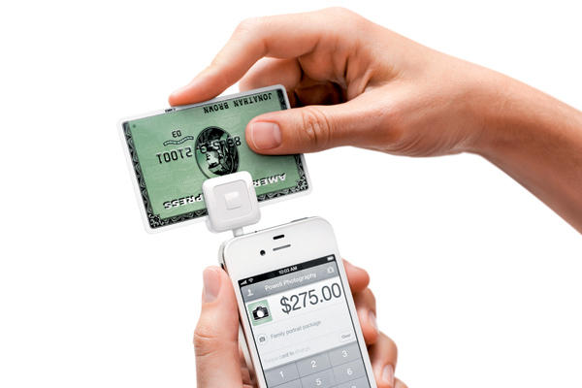
Square, Sage Credit Card Reader
$20 device that plugs into any computer, tablet, or smartphone audio jack) in order to accept credit card payments on the go.
3,500 Girl Scout troops in Ohio used Sage credit card readers (connected to the scout’s smartphones) to accept electronic payments, boosting sales of Girl Scout cookies by 30% because the scouts were able to take orders and accept payments from cashless customers who were only able to pay using their credit card.
Video
(Cost versus transaction fee
and percentage fee should be considered)
Sage’s Credit Card Reader

Slide 26
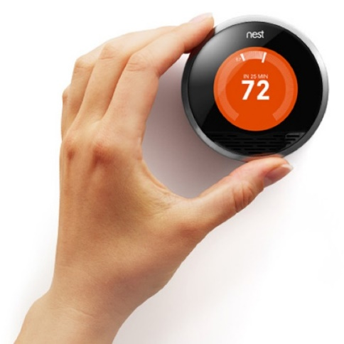
Learning Thermostat

Slide 27
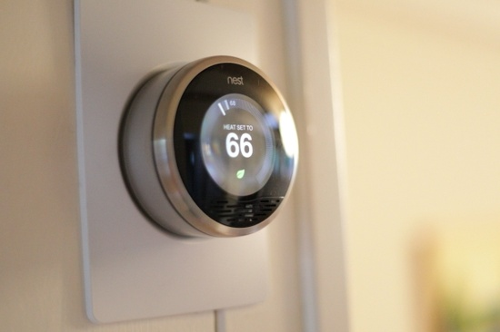
http://reviews.cnet.com/appliances/nest-learning-thermostat/4505-17889_7-35179222.html#reviewPage1
The Nest Learning Thermostat might be the thermostat of the future

Slide 28

3-D Printing

Slide 29
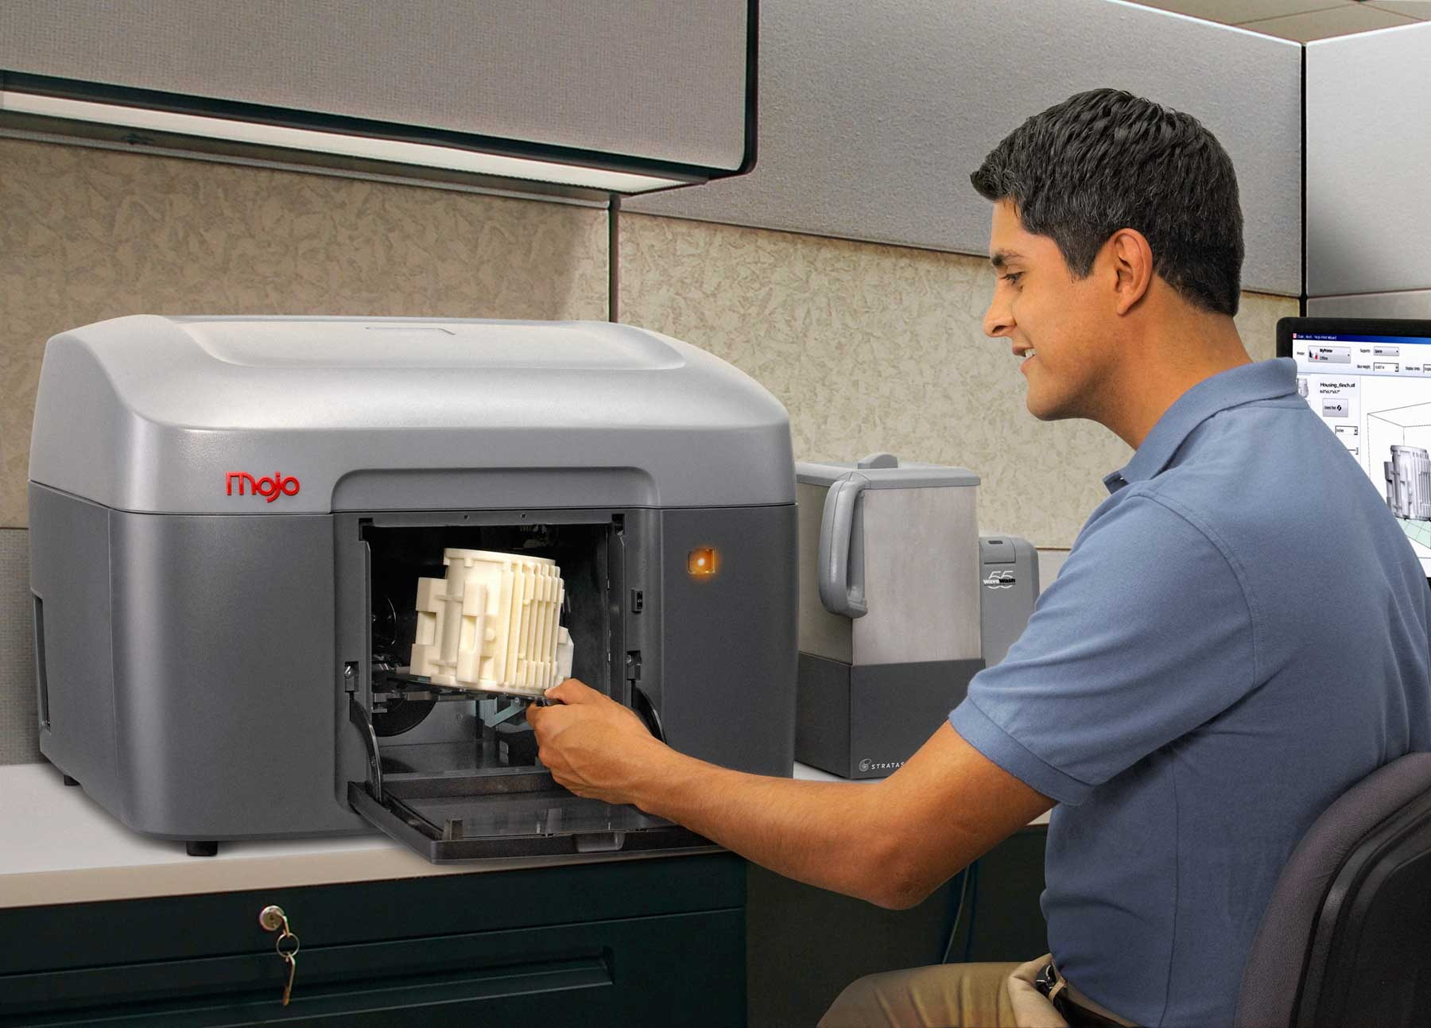
Wrench
Gears
Body parts – 55 seconds
Starting at $1,469

Slide 30
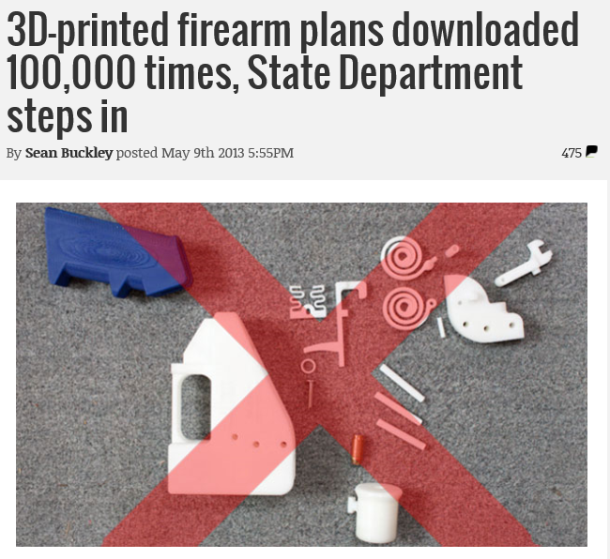

Slide 31
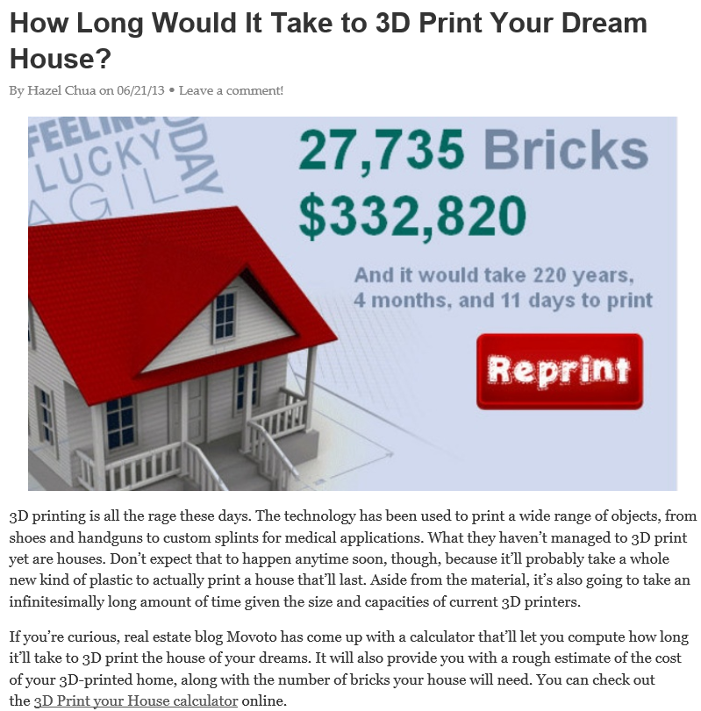

Slide 32

BitCoin

Slide 33
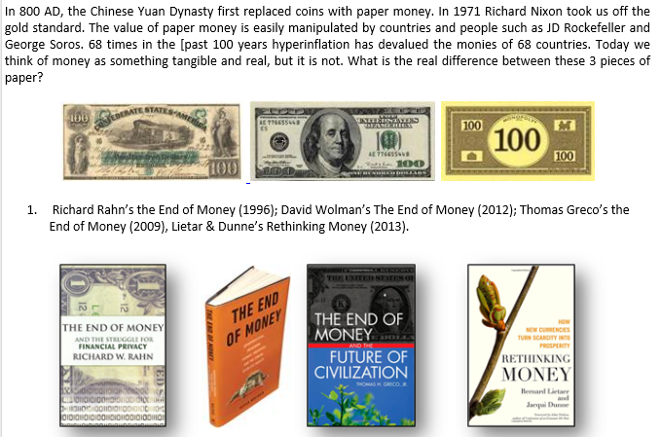
Digital Money
By J. Carlton Collins

Slide 34
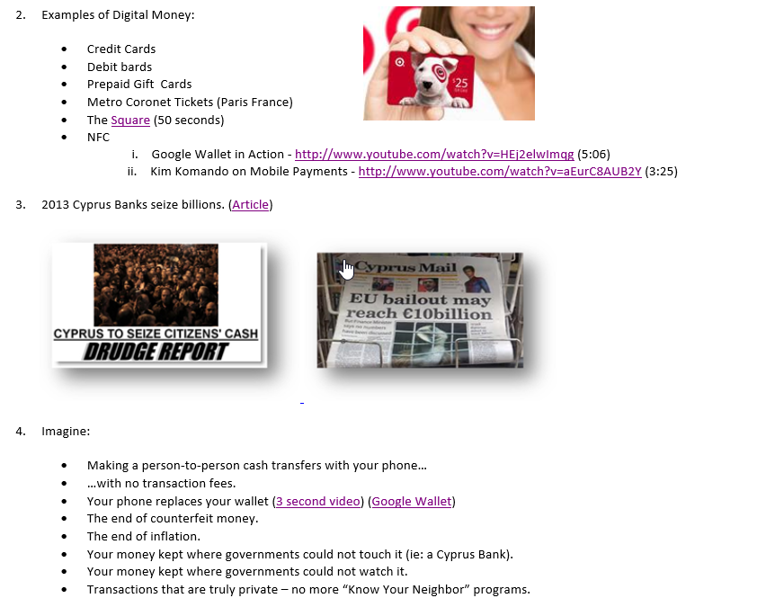

Slide 35
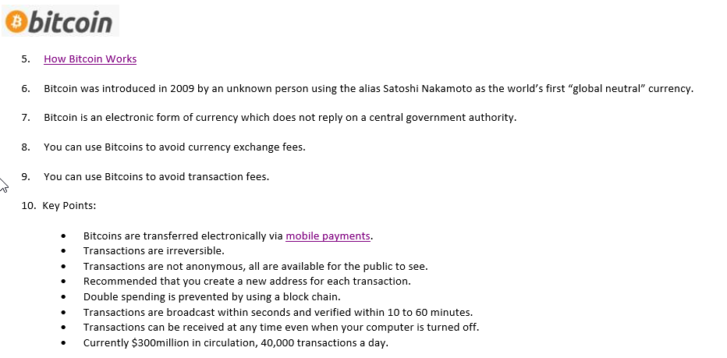

Slide 36
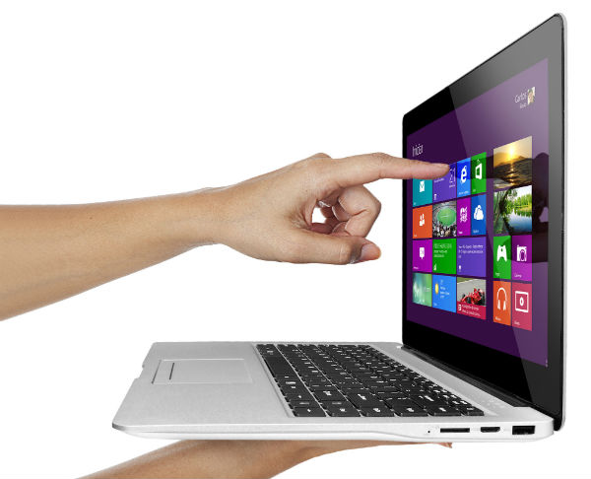
Touchscreen
UltraBooks

Slide 37
Touchscreen Ultrabooks
Touchscreen Ultrabooks (TUs) offer both touchscreen and keyboard/mouse interfaces.
Touchscreen Ultrabooks are thin, lightweight, fast booting, and usually larger than tablet PCs.
Some TUs can be split, so the monitor portion can be used as a tablet.
Windows 8 supports both application interfaces.

Slide 38
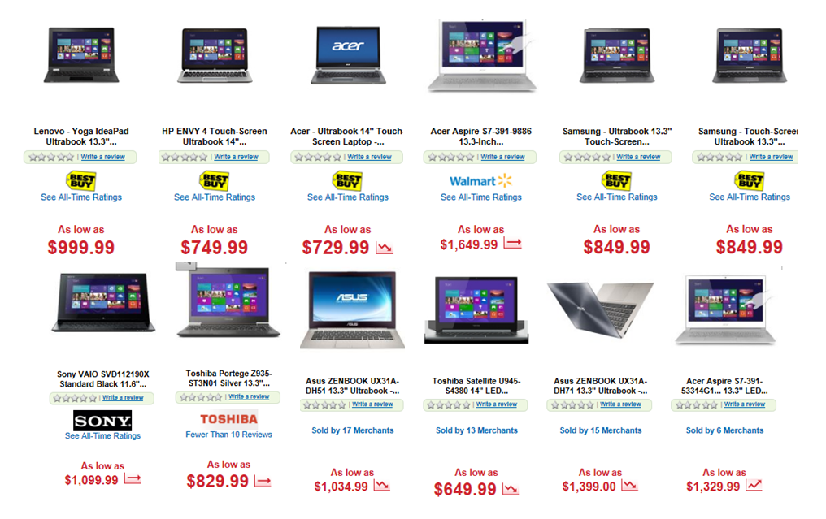
Examples of Touchscreen Ultrabooks
As of November 10, 2012

Slide 39

Snipping Tool

Slide 40

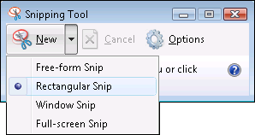
Snipping Tool
Start Button, Program Files, Accessories
Higher resolution than Print Screen
Save to Different Formats
Highlighter, Eraser
Add to your Quick Launch Tool Bar
PrintScreen (resolution not as high)
Shift + PrintScreen (to capture active window/box only

Slide 41
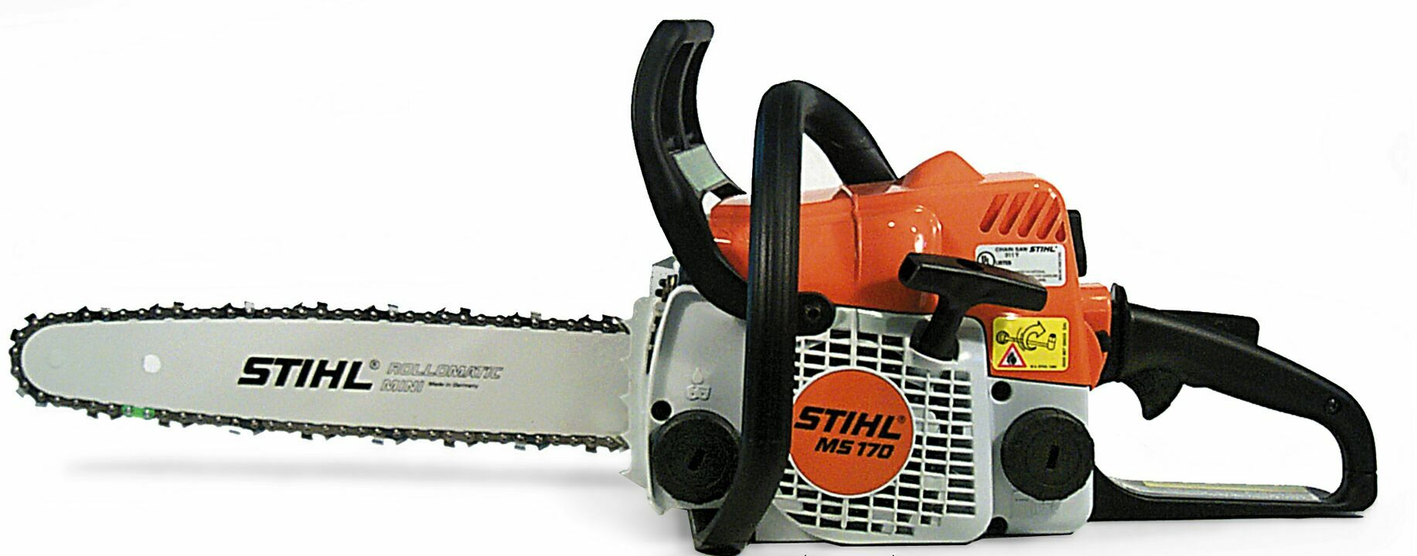
Saw Stop

Slide 42
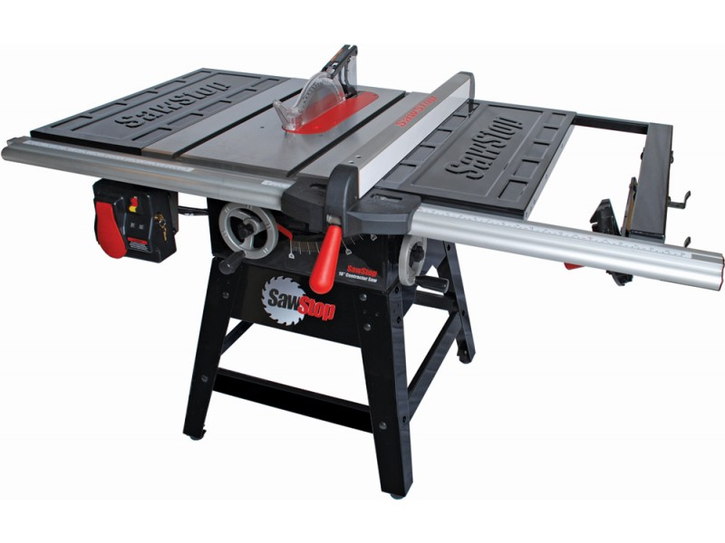
Saw Stop
60,000 table saw accidents a year, 10 fingers a day
Video 30 seconds
Chain saw - http://www.youtube.com/watch?v=Ah-FmYnaIWw&feature=fvwp

Slide 43

Microsoft Tags

Slide 44
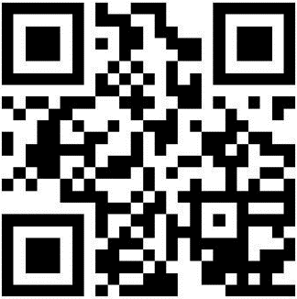


1. Everyone has a barcode scanner in their pocket
2. Works like a bar code using free Smartphone tag scanning app
3. Demo - Make your own Tag(s) for free (tag.microsoft.com)
4. Links to your web site, text, phone number, vCard, or app download
5. Option allows you to set tags to expire
6. Make custom tags from any design
7. You can later edit a Tag, but not a QR code
8. Reports show you tag traffic
9. See a tag in action
10. Tag success stories
11. JagTags send text message - a smartphone is not required…
Microsoft Tags/QR Codes

Slide 45
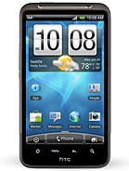
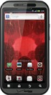
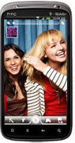
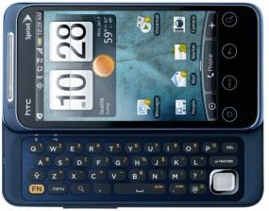
Smartphones
Tablets & Apps

Slide 46
Detailed Comparison of Smartphones by features: http://en.wikipedia.org/wiki/Comparison_of_smartphones
Smartphones

Slide 47
1. Tag Reader
2. Text Message (Using Voice)
3. Navigation (Using Voice), with Turn-by-Turn Directions
4. Traffic
5. Wells Fargo App
6. CVS App
9. Gas Buddy
15. PriceCheck
4. Camera, Pictures to FB or EverNote
8. DropBox
10. Open Table
11. Maps
12. TripIt
13. YouTube
14. Google Search
Smartphone Apps Demonstration
16. Drudge Report
17. Exit
18. EverNote
19. Mobile Hotspot
20. Flashlight
21. SkyMap
22. Compass
23. Decision Making Tools
24. Piano
25. E-Mail
26. Docs, Calendar, More
27. Apps Store
28. Radar Now
29. Connect Wi-Fi
30. GolfShot

Slide 48
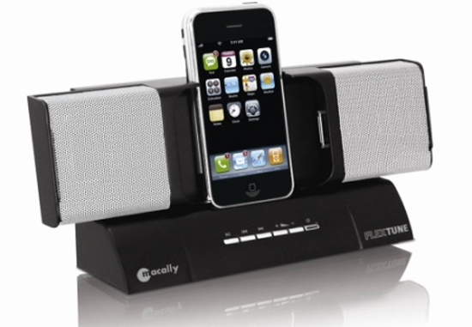
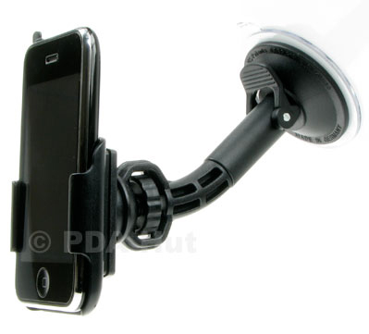
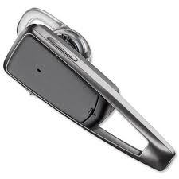
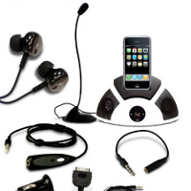
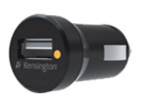
1. Recharger – Office
2. Recharger – Home
3. Recharger – Car
4. Recharger – Luggage
5. Ear Piece (Bluetooth)
6. Headphones for Office use
7. Boom Microphone
8. Speakers
9. Protective Case – Otter Box
10. Cigarette Converter
11. Docking Station
12. Dash mount
13. Motorcycle Headphones
Smartphone - Recommended Accessories

Slide 49

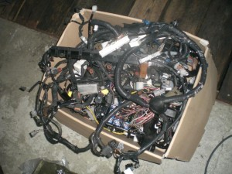
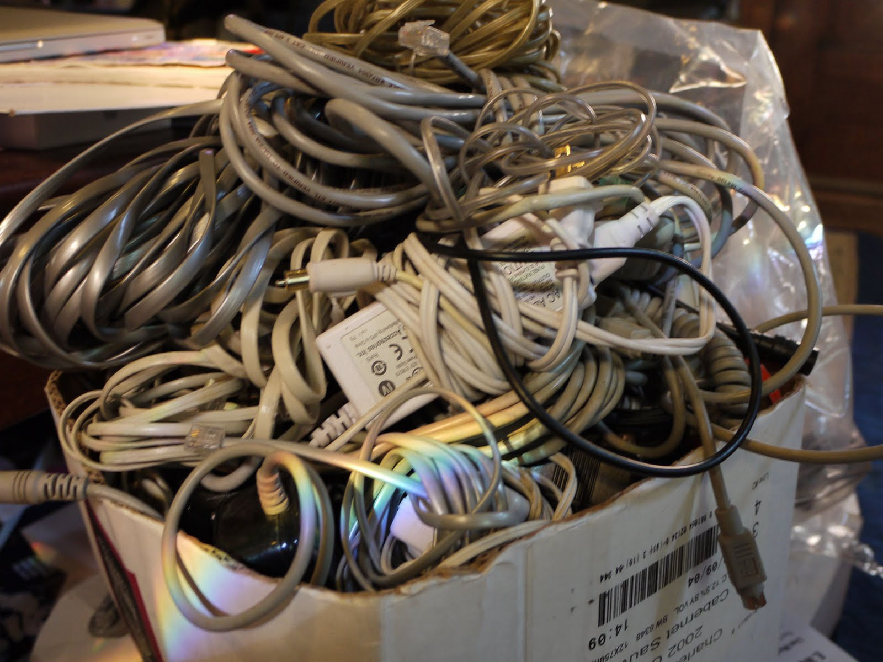
Any Hotel Lost and Found

Slide 50
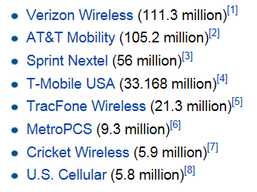
1. Start with best provider in Your Locality.
2. Chose a 4G option
Usually $0 to $200 with contract.
Choosing A Smartphone

Slide 51
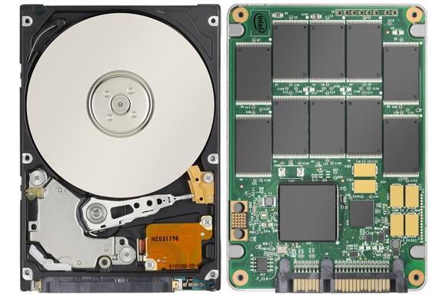
Solid State Drives

Slide 52
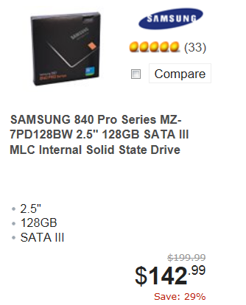
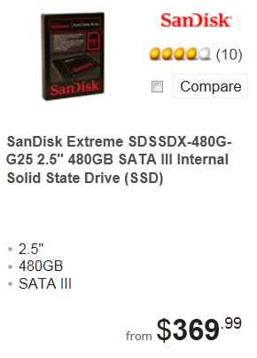
1. No Moving Parts, Much Faster, Less Susceptible to Damage
2. No spin up time – so almost immediate results
3. Uses far less energy
4. Fragmenting not an issue
5. 10 times more expensive ($1-$2 /GB vs $10-$20/GB)
6. HDD 5600, 7200, 10,000, 15,000 RPM
7. Performance degrades over time.
8. Limited life span???
(Only 2 Million hours)
9. SSD Video
9. Hybrid drives
Solid State Drives (SSD)

Slide 53

Google Glasses

Slide 54
Google Glasses
Fantastic or Really Creepy?
In 2013, Google announced Google Glasses ($1,500), a set of eye glasses you wear on your face like regular glasses that use a built-in smartphone, video camera and microphone to capture everything you see and do. It’s like wearing a miniature running camcorder on your face continuously. You could use these to create a Video Journal much like GoPro does.
https://www.youtube.com/watch?v=V3SAS1xpQw0
Google Glasses also have a voice active smartphone built in so you can make phone calls or search the web, and the results are displayed on the glass for one eye to see.
With this announcement, at the same time, Google has introduced amazing break-though technology with many possible benefits, and at the same time really creepy technology invasion of privacy technology.
The Bad
You could watch the football game in your right eye while pretending to listen to your wife talk.
You could cheat on a test in school by displaying answers in your glasses.
You could boot leg a movie at the movie theater.
You could secretly record your first date with an unsuspecting participant.
If a friend shouts “Glass” followed by an obscenity - your Google Glasses might display the disgusting picture instantly.
Someone can record themselves slaughtering dozens of people
App that undresses the person you are viewing
The Good
TV Enhancement
Bio Feedback
Face recognition
Instruction – baking, assembly, matrix style training
Navigation

Slide 55
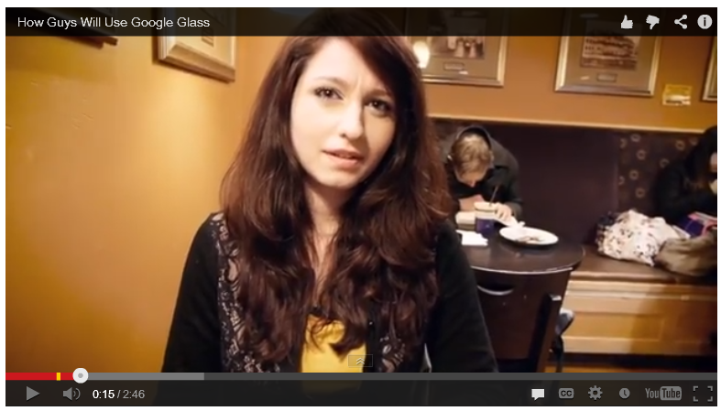
http://www.youtube.com/watch?feature=player_embedded&v=8UjcqCx1Bvg

Slide 56

Privacy Concerns

Slide 57
Privacy Concerns
Cloud monitoring
Echelon
Copy machine and printer hard drives
Google search history
Comcast web page history (case)
Traffic cameras, store cameras, beach, Old Faithful, Gorillas, SB, beach, Aruba, Bees
Drones in the sky, small drones
GPS Tracking, Google Latitude
Social media data mining & profiling
RFIDs
Arrest Records
Carlton’s Top 25 Security Measures

Slide 58
Google Latitude

Slide 59
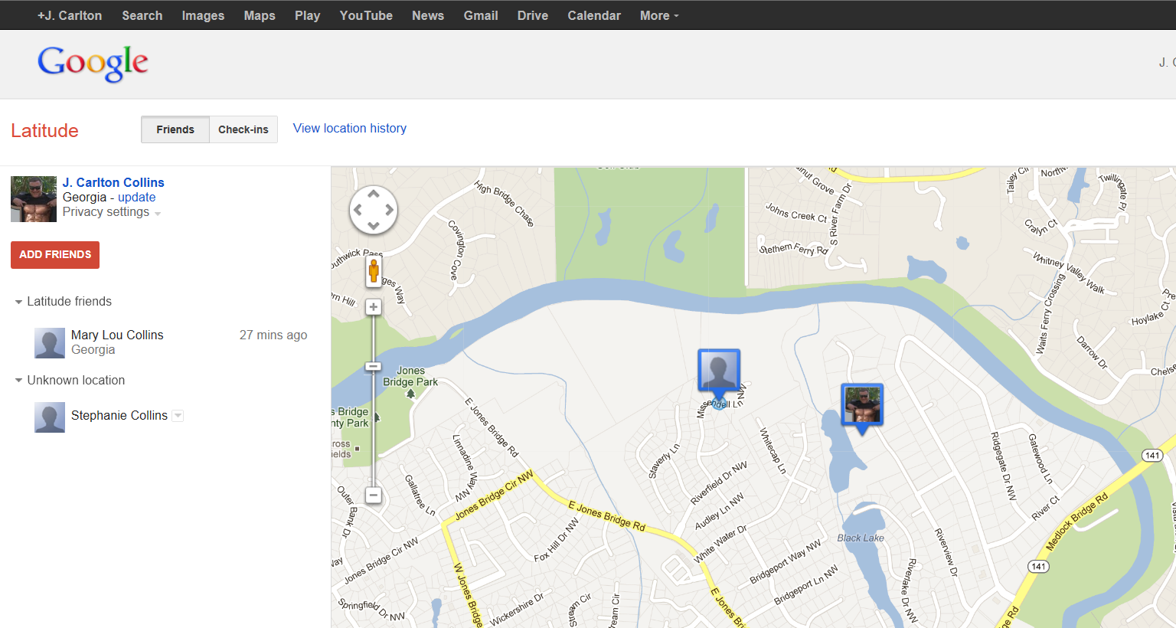
Google Latitude
Track a person via their smartphone

Slide 60
NFC

Slide 61
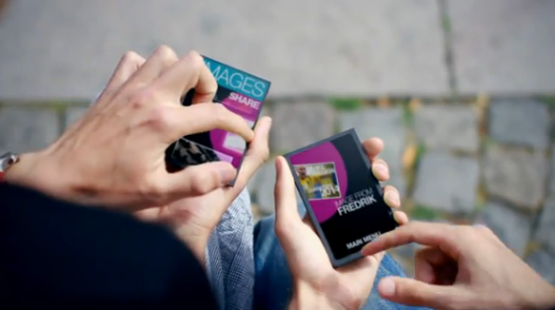
NFC – Near Field Communication
6 Inch Range
http://www.tubechop.com/watch/732835

Slide 62

Tiny URL

Slide 63
Tiny URL
Make a shorter URL
Avoid extra long URLs that might break in email
Hide URLs (so the reader does not know where the content is coming from)
Make a TinyURL Tool Bar Button
Bit.ly does the same thing

Slide 64
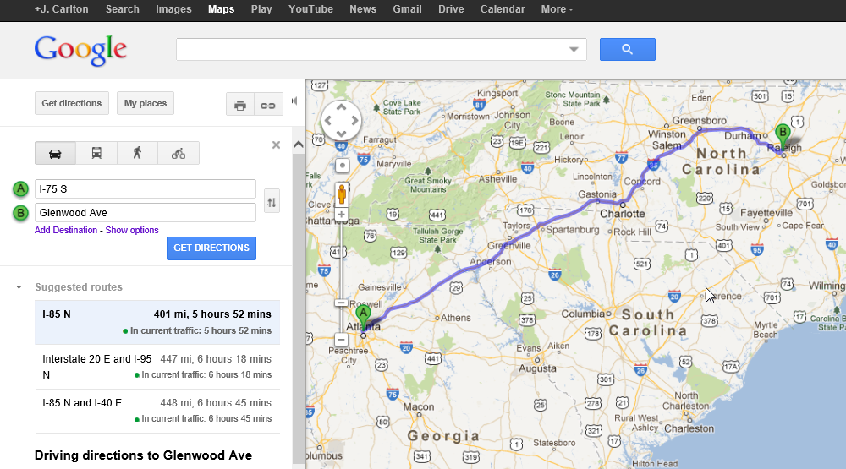
Google Map Tips

Slide 65
Google Maps
Driving Directions
Add Destinations
Ad destinations by right clicking the map
Rerouting by dragging the route
Printing Directions
Satellite or Map View
Traffic View

Slide 66

Field Monitor Pro

Slide 67
Field Monitor Pro
$275
Uses USN Port
Gives you 2 USB Ports
Daisy Chain up to 7
Number Pad

Slide 68

Google Alerts

Slide 69

Google Alerts

Slide 70

Encryption File System (EFS)

Slide 71

EFS – Encryption File System
Takes just 5 Seconds
In Pro versions of XP, Vista, 7 & 8
Not in Home versions
Encrypt a file, folder, or drive

Slide 72

YouTube

Slide 73

YouTube
More content than CBS, NBC & ABC every 60 days
Upload Demo
Editing Tools
Embed Code Demo
Lila Ann Rose - https://www.youtube.com/watch?v=nwn6_qtQMN8
Maisy & Lennon, Butter - https://www.youtube.com/watch?v=7_aJHJdCHAo
Maisy & Lennon Headlock - https://www.youtube.com/watch?v=uxdUuk_l2Lk
Rachel Price - http://www.youtube.com/watch?v=sAIVlOvsMuM
Maisy & Lennon, Nashville……………………………………………………..

Slide 74
Example YouTube Clips
RFIDS - https://www.youtube.com/watch?v=_xNhL39uD7I
RFID Forklift - http://www.tubechop.com/watch/734446
ATM Scam - https://www.youtube.com/watch?v=m3qK46L2b_c
Installing Electrical Wiring - http://www.tubechop.com/watch/734456
Installing Bee Hive - http://www.tubechop.com/watch/734467
Learn the Guitar - http://www.youtube.com/watch?v=6Obf278F_00

Slide 75
YouTube:
  More content published to YouTube in a 60 day period than the three major U.S. television networks created in the past 60 years. 490 million unique users worldwide per month, who rack up an estimated 92 billion page views each month.
  YouTube is a phenomenal learning center. Carlton’s Prediction – YouTube University will be the world’s largest learning center within 5 to 10 years.
  www.tubechop.com – Crop a portion from any YouTube video
  www.mixpod.com – Combine cropped portions of YouTube clips
  www.vixey.com – Convert YouTube clips to self-running MP4s on your computer
  Uploading to YouTube is Easy (quick demonstration)
Embedding Code (Bandwidth and Codecs come from YouTube web site)

Slide 76

Ted Talks

Slide 77

Ted Talks
Who is Ted and why does he talk so much?
TED = Technology, Entertainment & Design
Average 6 to 12 minutes, not professional speakers
Creativity - http://www.tubechop.com/watch/733384
Best Thing - http://www.tubechop.com/watch/733396
Sugata Mitra shows how kids teach themselves - http://www.ted.com/talks/sugata_mitra_shows_how_kids_teach_themselves.html
Start at 7:45, or 9:37

Slide 78

Distance Learning

Slide 79

Distance Learning
No admission, No Credits (Certificate)
Harvard & MIT (EdX) 150,000 from 160 countries in 2011
Fathom (2000 Columbia & Michigan); All Learn (2003 Yale, Princeton and Stanford)
Remote Access Tools for Remote Training
  Skype

Slide 80

500 Pages of Tips

Slide 81

Carlton’s JofA Articles
www.CarltonCollins.com

Slide 82
1. Soon to be obsolete due to ultrabooks?
2. 2001 - Microsoft introduced first tablet
Laptop with touchscreen
Still had to boot up
3. Jan 2010 – Apple iPad
Basically a big iPhone, without the phone
Easier to read
No monthly subscriptions cost *
Tablets

Slide 83


Tablets
http://www.tabletpccomparison.net/
Brands

Slide 84
1. Safari Browser
2. Keyboard
3. Camera
4. Pictures (pinch, tap)
5. Photobooth
6. Video
7. Notebook
8. Maps (Peek behind)
Tablet Demonstration
9. YouTube
10. GoToMyPC
11. iBooks
12. Skype
13. Angry Birds
14. Fruit Ninja
15. Apps

Slide 85



High-End Computers

Slide 86
Rain Computers of Ringwood, NJ (raincomputers.com) produces a liquid-cooled desktop computer equipped with up to sixteen i7 core processors (two i7 cores with 8 processors each), 20 MB of core cache, Tesla companion processor, up to 96 GBs of RAM, up to six 480 GB solid state hard drives (SSD), hyper-threading, Turbo Boost, running Windows 8 64-bit, with prices starting at $2,499.
Rain also produces a laptop computer equipped with an i7 quad core processor, up to 32 GBs of RAM, dual 480 GB solid state hard drives (SSD), hyper-threading, turbo boost, running Windows 8 64-bit, priced starting at $1,299.
Rain computers are primarily targeted towards the high-end audio-visual industry, but are well suited as high-end business computers. Other high performance desktop computer manufacturers include Alienware (www.alienware.com), targeted primarily towards the gaming industry; and Maingear (www.maingear.com), targeted primarily for business professionals.

Slide 87
Gestures

Slide 88
Gestures
In this video, asks questions about using gestures “Why can’t we do the following?”
Control TV - https://www.youtube.com/watch?v=lt60r3AwuV8
Wii Bowling - https://www.youtube.com/watch?v=zwXX27U6WnI
Example of Gestures with a Smart Window:
Minority Report - http://www.tubechop.com/watch/734400

Slide 89

Robotics

Slide 90

http://www.tubechop.com/watch/1134209

Slide 91

Paperless

Slide 92

Paperless
Few CPAs have regrets
Large Scanner versus desktop scanners
Sheet Feeder
OCR File naming & Keyword creation

Slide 93
1
CATEGORY:
Going Paperless
1. Scanners. Your first step should be to implement a document scanner policy, either a network-based scanner (such as a Fujitsu fi-6670 for $5,599.99) capable of scanning color and 14-column ledger paper for all to share, or personal scanners (such as the $304 Epson Workforce Pro GT-S50, which I use) for each employee’s desk. Some key features to look for are two-side, multipage scanning; a fast automatic sheet feeder (at least 12 pages per minute); scanning to the cloud; and automatic paper size detection, color detection, and cropping. You might also consider implementing a business card scanner (such as a Corex CardScan Executive for $225).
2. Centralized data storage. To share scanned documents throughout your organization, you should either implement file server data storage or a cloud-based data storage solution (such as Microsoft SkyDrive, Google Drive, Amazon EC2, Dropbox, or SugarSync—which all offer at least 1 GB of free data storage with additional storage available for a monthly fee). Set up all authorized personnel as users, grant them the proper share and security permissions, and set scanners to automatically save files to your shared data location. For added protection, files containing client data should be password-protected using 128-bit encryption prior to uploading to a cloud-based drive.
3. Indexed search tools. Implement an indexed searching tool (such as Fast Find included in Windows 8, 7, and Vista). Indexed tools index every word in each data file, including the file name and associated keywords, so users can locate files quickly. Indexed search tools use the same type of technology employed by Bing and Google to return nearly instant search results. Similar search tools include Copernic Desktop Search ($49.95), dtSearch Desktop ($199), Voidtools Everything (free), and X1 Professional Client ($49.95).
4. Shredders. It is also a good idea to have a few shredders so paper documents can be properly discarded after scanning, or establish a collection box for centralized or professional shredding.
5. Paperless fax. Implement an online fax solution that enables you to send and receive faxes via email. You can usually implement this type of faxing capability directly from your cloud storage solution for no additional charge (initially), or subscribe to specific online faxing solutions such as PATLive ($9.95 per month), MyFax ($10 per month), RapidFAX ($9.95 per month), or RingCentral ($19.99 per month).
6. Paperless bill management. New services such as Manilla (free) can automatically collect and organize all of your bills. Thereafter, log in to see your bills summarized in one location, and if desired, you can set the system to remind you as bills come due. You can also use Manilla to collect and organize frequent flyer and rewards program statements. Similar services include PayTrust ($9.95 per month), Billeo (free), and MyCheckFree (free).
7. Paperless expense reporting. Online expense reporting solutions such as Expensify (free) and Concur expense reporting ($8 per month) enable your employees to fill out expense reports online, including from their smartphones. Thereafter, electronic expense reports containing attached scanned or photographed images of supporting receipts can be submitted electronically. Expensify can even recognize and convert your scanned receipts and enter the data details for you. This approach eliminates paper and rekeying, improves accuracy, saves time, and enables faster work flow and reimbursement approvals.
8. Paperless travel management. Travel management services such as TripIt (free) enable you to plan and capture the specific details of business trips, which are then organized into chronological itineraries and synced to your smartphone for easy access. After the trip, you can save electronic copies of your itineraries, including notes, photos, and documented events, for archival and IRS reporting purposes.
9. eSignatures. Secure digital signature products such as HelloSign (free) enable you to sign electronic documents with legally binding signatures so you can execute paperless contracts without having to print and physically send paper documents back and forth. Similar products include DocuSign (starting at $15 per month) and YouSendIt (free). 10. Electronic notebooks. Encourage employees to use electronic notebooks such as Microsoft OneNote (free with Windows Live account) or Evernote (free) to capture their notes electronically instead of on paper. These tools enable users to capture text, notes, hyperlinks, and images from computers, tablets, or smartphones; thereafter, the information can be accessed from all of a user’s computers or devices. With proper permissions, colleagues can be granted access to selected notes, links, and images as well.
11. Electronic PIM. Use an electronic personal information manager (PIM) to manage your calendar, contacts, and to-do lists (such as those in Outlook) to electronically organize your information, both personally and professionally. Thereafter, your data can be synced to all of your computers or devices for easy access, and if desired, you can share portions of your calendar with colleagues or your administrative assistant.
12. Paperless financial statements and reports. No matter which accounting system you use, you can usually print the system’s financial statements and reports to Excel, PDF, or XPS file formats and send them electronically—and in most cases, you can apply password protection before sending. This method saves paper and toner, and recipients can easily maintain and archive the reports, copy and paste results into Excel without retyping (for what-if analysis purposes), and include portions of the electronic reports in Word documents and emails.
13. Digitize client/customer files. Hire a company specializing in paperless conversions to use high-powered scanning equipment to convert historical paper-based client files to electronic data files, then eliminate your filing cabinets and file rooms.
14. Access news online. Switch paper-based newspaper subscriptions and newsletters to electronic subscriptions, then read online using your computer, Kindle, tablet, or smartphone.

Slide 94
Quick Tech Tips

Slide 95
1
CATEGORY:
Internet
xFinity
Speed Test
1

Slide 96
1
CATEGORY:
Office 2013
How to Install the 64 Bit version
1

Slide 97
1
CATEGORY:
Five iPad Tips
1. View full URLs. In Safari, holding your finger on any hyperlink for a few seconds reveals the full URL and also allows you to copy that URL.
2. Full-screen videos. You can increase the size of a video to full-size screen by tapping twice on the video. Pinch the video to return it to its original size.
3. The Google Maps curl on the iPad. It’s not completely obvious when viewing a Google map on your iPad, but swiping the curl in the bottom-right corner reveals a menu of options for viewing Classic, Satellite, Hybrid, or Terrain maps, as well as traffic overlays.
4. Pin a location. On the Google Maps app, hold your finger on any point on the map for a few seconds to place a pin. A pop-up then displays options for accessing street view, getting directions, or sharing that location via email.
5. Convert your iPad into a Picture Frame slideshow. To enable Picture Frame mode, tap the flower icon in the bottom-right corner of the iPad’s Lock screen. To adjust your slideshow, select Settings, Picture Frame, and then select your desired images, transitions, and options. As a promotional device, you might set up an iPad in your company’s lobby to continuously display slides of your company’s products, services, or history. Note: If you use a Passcode Lock, you’ll need to go to Settings, General, Passcode Lock, and slide Picture Frame to On to enable Picture Frame mode from the Lock screen.

Slide 98
CATEGORY:
Five More iPad Tips
1. Print Screen on an iPad – To create an image of my your iPad screen, holding down the Home button and press the Power button (the image is then displayed in your camera roll), and then you can paste that image into a multitude of applications, such as Word, Excel, Evernote, etc.
2. Close Apps on an iPad - To close the unnecessary apps running on your iPad, double-tap the Home button, then press and hold one app until they all start shaking on the screen. Next, press the red circle icon in the upper-left corner of the app’s icon to close the app. Tap the Home button when you have closed all unwanted apps.
3. Disable Your iPad’s Screen Rotation – To prevent an iPad’s screen from rotating when you lean the tablet, from the iPad’s main screen, select Settings, General, and set the Use Side Switch to setting to Lock Rotation (in either portrait or landscape mode). Thereafter, your iPad will no longer auto-rotate as you tilt it from side to side.
4. Secure Your iPad – To prevent others from installing new apps or making purchases under your Apple account, from the iPad’s main screen, select Settings, General, Restrictions, Enable Restrictions. When prompted, enter a four-digit Restrictions Passcode in the Set Passcode screen, then slide the Installing Apps and In-App Purchases On/Off selector buttons to Off to prevent others from performing these functions.
5. Custom Shortcuts - The iPad does not provide an option for memorizing field content, but you can create a customized shortcut, which is almost as good. To do this, from the iPad’s main screen, select Settings, General, Keyboard, and under Shortcuts tap Add New Shortcut…, then enter a phrase (such as carlton@asaresearch.com) and a shortcut name (such as jcc). Thereafter, entering the shortcut phrase into any iPad field will return the full text for that shortcut.

Slide 99
1
CATEGORY:
Five iPhone Tips
1. Magnify. To magnify the iPhone’s screen to improve readability and view image details, enable screen zooming by double-tapping the screen with three fingers. You can then pan the screen image by dragging with three fingers. To use this feature, you must first turn it on by selecting Settings, General, Accessibility, and set Zoom to ON.
2. Undo enlarged text. Sometimes your iPhone’s screen may suddenly display enlarged text, and restoring the screen to display regular size text seems impossible. Usually when this happens, you have accidentally turned on screen zooming as described in the previous tip. If this happens, double-tap the screen with three fingers to restore the screen magnification.
3. Reopen last closed window. If you accidentally close a browser window, reopen it from the History menu by selecting Bookmarks, History, and touch-selecting the desired webpage.
4. When apps lock. If an iPhone app locks up, press and hold the Home button for six seconds to close the app. If this does not solve the problem, press and hold both Home and On/Off for 10 seconds to reboot the iPhone.
5. Scroll to the top instantly. In Safari, after scrolling far down to read dozens of stories, news feeds, or Pinterest pins, tapping the time or the top of the Status Bar returns you instantly to the top of the Safari window.

Slide 100

CATEGORY:
Speakers
The PowerPod360 vibration speaker ($120 suggested retail price, but I found several priced as low as $38 on Amazon). This small, cylinder-shaped speaker is approximately 2 inches high by 2 inches wide, and I find it works well in a room of up to 75 people. Interestingly, this device emits heavy vibrations to turn any solid object it is placed upon into a bass speaker. Held in the air, the speaker doesn’t produce much sound, but when you place it on a solid table or cardboard box, that table or cardboard box becomes a subwoofer bass, and the room comes alive with some serious sound.
The speaker unit is powered by a USB cord, so it does not take up a valuable electrical outlet in my seven-outlet surge-protected PowerSquid. Further, a built-in micro SD slot allows the unit to operate as a stand-alone mp3 player. Note: Don’t get this speaker confused with the lower-end PowerPod Jr., which is less powerful.

Slide 101
1
CATEGORY:
Browser
Ctrl+Enter to avoid typing “WWW.” and “.COM”
Shift+Hyperlink Click Opens New Browser
1

Slide 102
2
CATEGORY:
Browser
F11 Key to See Full Screen
Set up
Links Bar on your Browser
1

Slide 103
3
CATEGORY:
Google
Google Desktop
Google Alerts
1

Slide 104
4
CATEGORY:
Google
Google Earth
Google Map
1

Slide 105
5
CATEGORY:
Google
Turn on Filtering & Show 100
Web Sites
Google Translate
1

Slide 106
Document Imaging
Piece of paper costs $52 – Xerox Corporation
Electronic Version costs just 37 cents

Slide 107
6
CATEGORY:
Useful Web Sites
Atlanta
Traffic Cameras
Arrest Records E-Mailed to You
1

Slide 108
6
CATEGORY:
RFIDs
RFID
Clip
Alien Technologies
Show & Tell
1

Slide 109
7
CATEGORY:
Useful Web Sites
JFax
Zoomerang
1

Slide 110
8
CATEGORY:
Gadget
Power Squid
USB Extension Cable
1

Slide 111
9
CATEGORY:
Security
TruCrypt Hard Disk Encryption
Security Cable
1

Slide 112
10
CATEGORY:
Virus Protection
Avast - Free Virus Protection
Don’t use Norton – Norton is the Virus
1

Slide 113
11
CATEGORY:
Ergonomic
Flat Panel Monitor
Ergonomic
Key Board
1

Slide 114
12
CATEGORY:
Buying Online
Pricegrabber
or PriceScan
Quantity in Stock Status? Avoid Drop Shippers
1

Slide 115
13
CATEGORY:
Hardware Tip
Leave Computer On Always
Dual Flat Panel Monitors
1

Slide 116








Slide 117
Leave Computer On Always
  It Will Last Longer
  Spam Check at 1:00am
  Virus Check at 2:00am
  Automatic Updates at 3:00am
  Backup at 4:00am
  Mail Retrieved Every 3 Minutes
  Remote Access Always Available
  Uses Same Energy as 40 Watt Light Bulb
  Monitor Should Cut Off After 10 Minutes

Slide 118
14
CATEGORY:
Microsoft Word
Voice Recognition
Auto Summarize
1

Slide 119
15
CATEGORY:
Outlook
Signature Block with Disclosure Statement
Set up Rules
to Block Mail with Specific Words/Organize
1

Slide 120
27
CATEGORY:
Useful Web Site
Skype
Linked-in
1

Slide 121
16
CATEGORY:
Media Player
Rip and Burn CDs
Create Playlist, Sync to Your MP3 Device,
Avoid DiePods
1

Slide 122
17
CATEGORY:
Fun Web Sites
Police and Fire Scanners
Magic 8 Ball
or
Bubble Wrap
1

Slide 123
19
CATEGORY:
Windows Control Panel
Regional Language Settings
Snapshot and Restore
1

Slide 124
20
CATEGORY:
Digital Photographs
Photoshop’s Healing, Blurring & Cloning Tools
View as
Film Strip or Slide Show
1

Slide 125
21
CATEGORY:
Backup
Windows Backup
QuickBooks Online Backup
1

Slide 126
22
CATEGORY:
QuickBooks
Merge Duplicated Vendors or Customers
Calculator Tape in all Financial Fields
1

Slide 127
23
CATEGORY:
Printers
Never Hook Printer with Parallel Cable
Set up Multiple Instances of the Same Printer Driver
1

Slide 128
24
CATEGORY:
Wireless
Change Password on Wireless Router
Pre-N Standard – 10X the Range, 15X the Performance
1

Slide 129


Slide 130
28
CATEGORY:
Useful Web Site
Plaxo
(Free)
Log Me In
(Free)
1

Slide 131
28
CATEGORY:
YouTube
Unlock Car with Tennis Ball
Pick Lock with Coke Can
1

Slide 132
31
CATEGORY:
Gadget
Web Camera
USB Drive
1

Slide 133
32
CATEGORY:
Microsoft Office
Tools – Save My Settings
Wizard
Organizational Chart
1

Slide 134
33
CATEGORY:
Mouse Tip
Avoid Wireless Mice
Optical Wheel Mouse
1

Slide 135


Wireless Mouse Problems
    Heavy – Leads to Hand Cramps
    Batteries Need Replacing
    Easy to Lose Wireless Mouse
    Solution – Get Some String and Tape

Slide 136

Wireless Technology

Slide 137


Frequency Allocation Chart
FCC reserves many frequencies and auctions off others
Higher frequencies provider greater bandwidth, lower frequencies provide greater range
License-free spectrums (amateur)
FCC restricts power output among license-fee frequencies
More WiMax info
Wireless Technology
Is WiMax Dead for Router Use?

Slide 138


Slide 139


Slide 140

Multiple Monitors

Slide 141



Slide 142

My Old Computer System

Slide 143



My New Computer System
The screens are so bright, the camera won’t take a decent picture of them
Though it does not look like it, the lights are fully on in my office

Slide 144

Ergonomics

Slide 145

Laptops are not Ergonomically Sound
Ouch
Ouch

Slide 146

Well Organized Computer System

Slide 147





Slide 148


Slide 149





Slide 150

Interactive Paper

Slide 151

http://www.diginfo.tv/v/13-0025-r-en.php
http://m.digitaltrends.com/computing/fujitsu-makes-paper-interactive-with-just-a-webcam-and-projector/

Slide 152

Technology Steam Rolls Along
Revenue per employee to is 5 to 50 times higher per employee today than 30 years ago
Woolworths, JC Penny’s, Sears, Wal-Mart
Stage Coaches, Train Industry, Typewriters, Retail Strip Malls, Digital Cameras
Out-sourcing, In-sourcing
Keep up or get left behind???

Slide 153
Thank You

Slide 154

Microsoft
Office 2013

Slide 155


Slide 156

Subscription Pricing
Installs on more PCs
Never upgrade again
Superior iMap email
Better security
File Sharing
Eliminate upfront capital costs
Eliminate balance sheet liabilities

Slide 157

A free limited version of Office 2013 is available at home.live.com, Outlook.com or Skydrive.com
(See cloud slide for more details)

Slide 158



Office 2013
Touchscreen ready
Smartphone enabled
Windows 8 Look & Feel with Modern Tiles
Cloud-friendly
Runs on Win7 & Win8, not on XP or Vista
Buy or Rent (Rent on premise)

Slide 159
Windows 8

Slide 160

Examples of Windows 8 Screens
Windows 7 Style Desktop Touchscreen (Modern U/I)

Slide 161

Examples of Windows 8 Screens
Figure 3 - Installed Apps Screen

Slide 162


Key Windows 8 Enhancements

Slide 163

Faster boot-up

Slide 164

Tap and do

Slide 165

Windows To Go

Slide 166

SkyDrive

Slide 167

Improved WiFi

Slide 168

Windows Store

Slide 169


Picture Password

Slide 170
Windows Key
Pressing the Windows key toggles between the Modern Start screen, the last-run Modern app, and the classic Windows 7 Desktop view.
Windows + C
Displays the Charm Bar .
Windows + D
Launches the classic Windows 7-style Desktop view.
Windows + E
Launches a Windows 7-style Explorer window.
Windows + F
Opens the File Search pane.
Windows + H
Opens the Share pane.
Windows + I
Opens the Settings pane (tiles, volume, brightness, power off, etc.).
Windows + K
Opens the Devices pane.
Windows + L
Locks your computer or device.
Windows + P
Displays Windows 8 on a second screen (when available).
Windows + Q
Opens the global search utility.
Windows + R
Displays the Run box.
Windows + U
Displays the Ease of Use utilities (Narrator, Magnifier, and more).
Windows + W
Instantly searches for settings.
Windows + X
Displays the Power Users menu.
Windows + Z
Displays the App Bar in the Modern view.
Windows + 1, Windows + 2, and Windows + 3
Opens the first, second, and third (and so on) open apps in the classic Windows Desktop, respectively.
Windows + F1
Displays Windows Help and Support.
Windows 8 Shortcuts

Slide 171

Cloud Computing

Slide 172
Shhhhh!
Cloud computing is really just another word for the Internet

Slide 173


Before the Cloud
SYNC

Slide 174

After the Cloud
SYNC
SYNC

Slide 175

After the Cloud
Weather Conditions
Airport Info
Gate Changes
Driving Directions
Flight Delays
Friend Alerts
SYNC
SYNC

Slide 176
Eight Ways in which Cloud Computing is Transforming the Way We Work
Merging Real Time Data with Your Information – Your TripIt itinerary doesn’t just show you your hotel and car rental information, it shows you real time weather reports, airplane arrivals and delays, airport gates. GasBuddy shows you the gasoline prices all around you. Your maps show you the speed of the traffic ahead of you.
Easier Access - Cloud computing means that you will be able to access information from a number of devices that are connected to the Internet. All you will need to have are the login credentials in order to get to your particular area on the cloud.
Easier Storage - There is going to be much more room for information storage in a cloud. This means that there is going to be more information that can be stored on the cloud.
Back Ups For Business - Businesses are going to need backups for the information that they are holding. This is going to mean taking a good look at your systems and find out how you can restore all of that information quickly. With cloud systems, this becomes much easier.
Security - All cloud systems are becoming more and more secure. Even if you are just looking for your own personal online form of storage, then you will be happy to know that your information is going to be protected.
Convenience - Easier access is going to make for more convenience. You do not have to carry around a hard drive with you all the time if you are on the go. This is good for individuals as well as businesses.
Pricing - The price of cloud storage actually doesn't cost that much. For businesses in particular, it ends up becoming a very cost-effective form of backup. All you will need to do is rent a certain amount of space.
Flexible - Flexibility is one of the main reasons that a lot of businesses enjoy using cloud services. If they have a certain amount of space, then they can use that to store information. If more space is needed, then all you need to do is increase it and pay the increased fees. This means that you do not have to buy more space than you need. You can always get more data storage and pay for it as you need it. Again, this ties in with the overall cost-effectiveness of using a cloud system.

Slide 177

Microsoft’s Mail & SkyDrive (Formerly) Windows Live
Windows Live is a set of services and software products from Microsoft; consisting of selected Office applications, a 7 Gigabit SkyDrive, HotMail, and a services platform.

Slide 178

Google Docs
Like Windows SkyDrive, Google Docs is a free, Web-based office suite and data storage service offered by Google within its Google Drive service. It allows users to create and edit documents online while collaborating in real-time with other users. Google Docs combines the features of Writely and Spreadsheets with a presentation program incorporating technology designed by Tonic Systems. Data storage of files up to 1 GB total in size was introduced on January 13, 2010, but has since been increased to 10 GB, documents using Google Docs native formats do not count towards this quota. The largely anticipated cloud storage feature by Google is said to be replacing most of Docs' features in 2012. This extension or replacement of Google Docs called Google Drive was opened to the public on April 24, 2012.

Slide 179

DropBox
Dropbox is a file hosting service operated by Dropbox, Inc. that offers cloud storage, file synchronization, and client software. Dropbox allows users to create a special folder on each of their computers, which Dropbox then synchronizes so that it appears to be the same folder (with the same contents) regardless of the computer it is viewed on. Files placed in this folder are also accessible through a web site and mobile phone applications.

Slide 180


Slide 181
Importing to GoogleDocs & SkyDrive - http://www.youtube.com/watch?v=txCK3d90GcY
SkyDrive/Office Video - http://www.youtube.com/watch?v=D6O9J_EzmqE&feature=relmfu
Intro to SkyDrive - http://www.youtube.com/watch?v=hoTBiIpz8DI&feature=related
Intermediate SkyDrive - http://www.youtube.com/watch?v=YdhB2u2mOLM&feature=relmfu
GoogleDrive versus DropBox - www.youtube.com/watch?v=0FbjsNsfEmE&feature=related
EverNote – http://www.bing.com/videos/search?q=evernote&view=detail&mid=FC081D4B847324B6E926FC081D4B847324B6E926&first=0

Slide 182

Speech Recognition

Slide 183
Microsoft Speech Recognition Demo
Works better with 1 to 2 hours of training
Works best with 3 to 6 months of corrections

Slide 184
Thank You

