Slide 1

2013 Technology Update
J. Carlton Collins

Slide 2
Objectives
Microsoft Tag
Smartphone Apps
Solid State Drives
UltraBooks
Windows 8
Google Glasses
Privacy
Latitude
Office 2013
NFC & Tap and Do
Bit Coin
3D Printing
Saw Stop
Cloud
Speech Recognition
YouTube
Ted talks & Distance Learning
500 Pages of Tips
4. UltraBooks
5. Windows 8
7. Privacy
9. Office 2013
11. Bit Coin
14. Cloud

Slide 3

Microsoft Tags

Slide 4
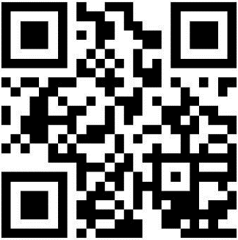
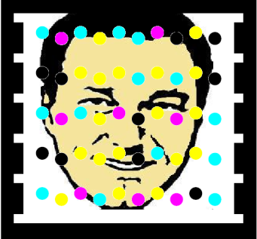

1. Everyone has a barcode scanner in their pocket
2. Works like a bar code using free Smartphone tag scanning app
3. Demo - Make your own Tag(s) for free (tag.microsoft.com)
4. Links to your web site, text, phone number, vCard, or app download
5. Option allows you to set tags to expire
6. Make custom tags from any design
7. You can later edit a Tag, but not a QR code
8. Reports show you tag traffic
9. See a tag in action
10. Tag success stories
11. JagTags send text message - a smartphone is not required…
Microsoft Tags/QR Codes

Slide 5
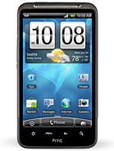
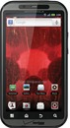
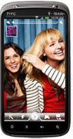
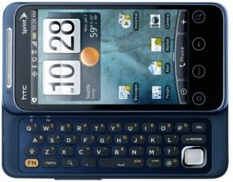
Smartphones
Tablets & Apps

Slide 6
Detailed Comparison of Smartphones by features: http://en.wikipedia.org/wiki/Comparison_of_smartphones
Smartphones

Slide 7
1. Tag Reader
2. Text Message (Using Voice)
3. Navigation (Using Voice), with Turn-by-Turn Directions
4. Traffic
5. Wells Fargo App
6. CVS App
9. Gas Buddy
15. PriceCheck
4. Camera, Pictures to FB or EverNote
8. DropBox
10. Open Table
11. Maps
12. TripIt
13. YouTube
14. Google Search
Smartphone Apps Demonstration
16. Drudge Report
17. Exit
18. EverNote
19. Mobile Hotspot
20. Flashlight
21. SkyMap
22. Compass
23. Decision Making Tools
24. Piano
25. E-Mail
26. Docs, Calendar, More
27. Apps Store
28. Radar Now
29. Connect Wi-Fi
30. GolfShot

Slide 8
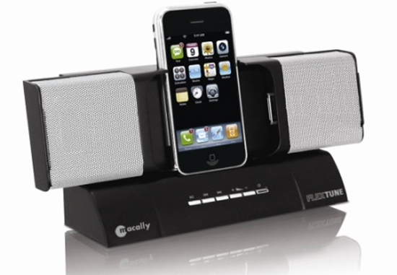
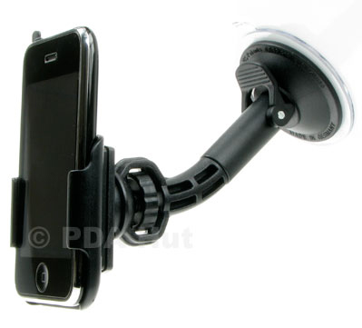
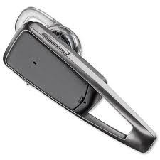
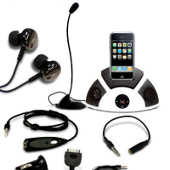
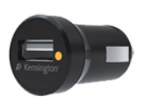
1. Recharger – Office
2. Recharger – Home
3. Recharger – Car
4. Recharger – Luggage
5. Ear Piece (Bluetooth)
6. Headphones for Office use
7. Boom Microphone
8. Speakers
9. Protective Case – Otter Box
10. Cigarette Converter
11. Docking Station
12. Dash mount
13. Motorcycle Headphones
Smartphone - Recommended Accessories

Slide 9

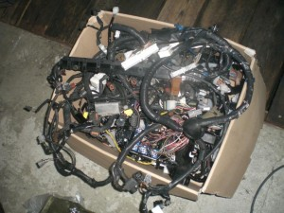
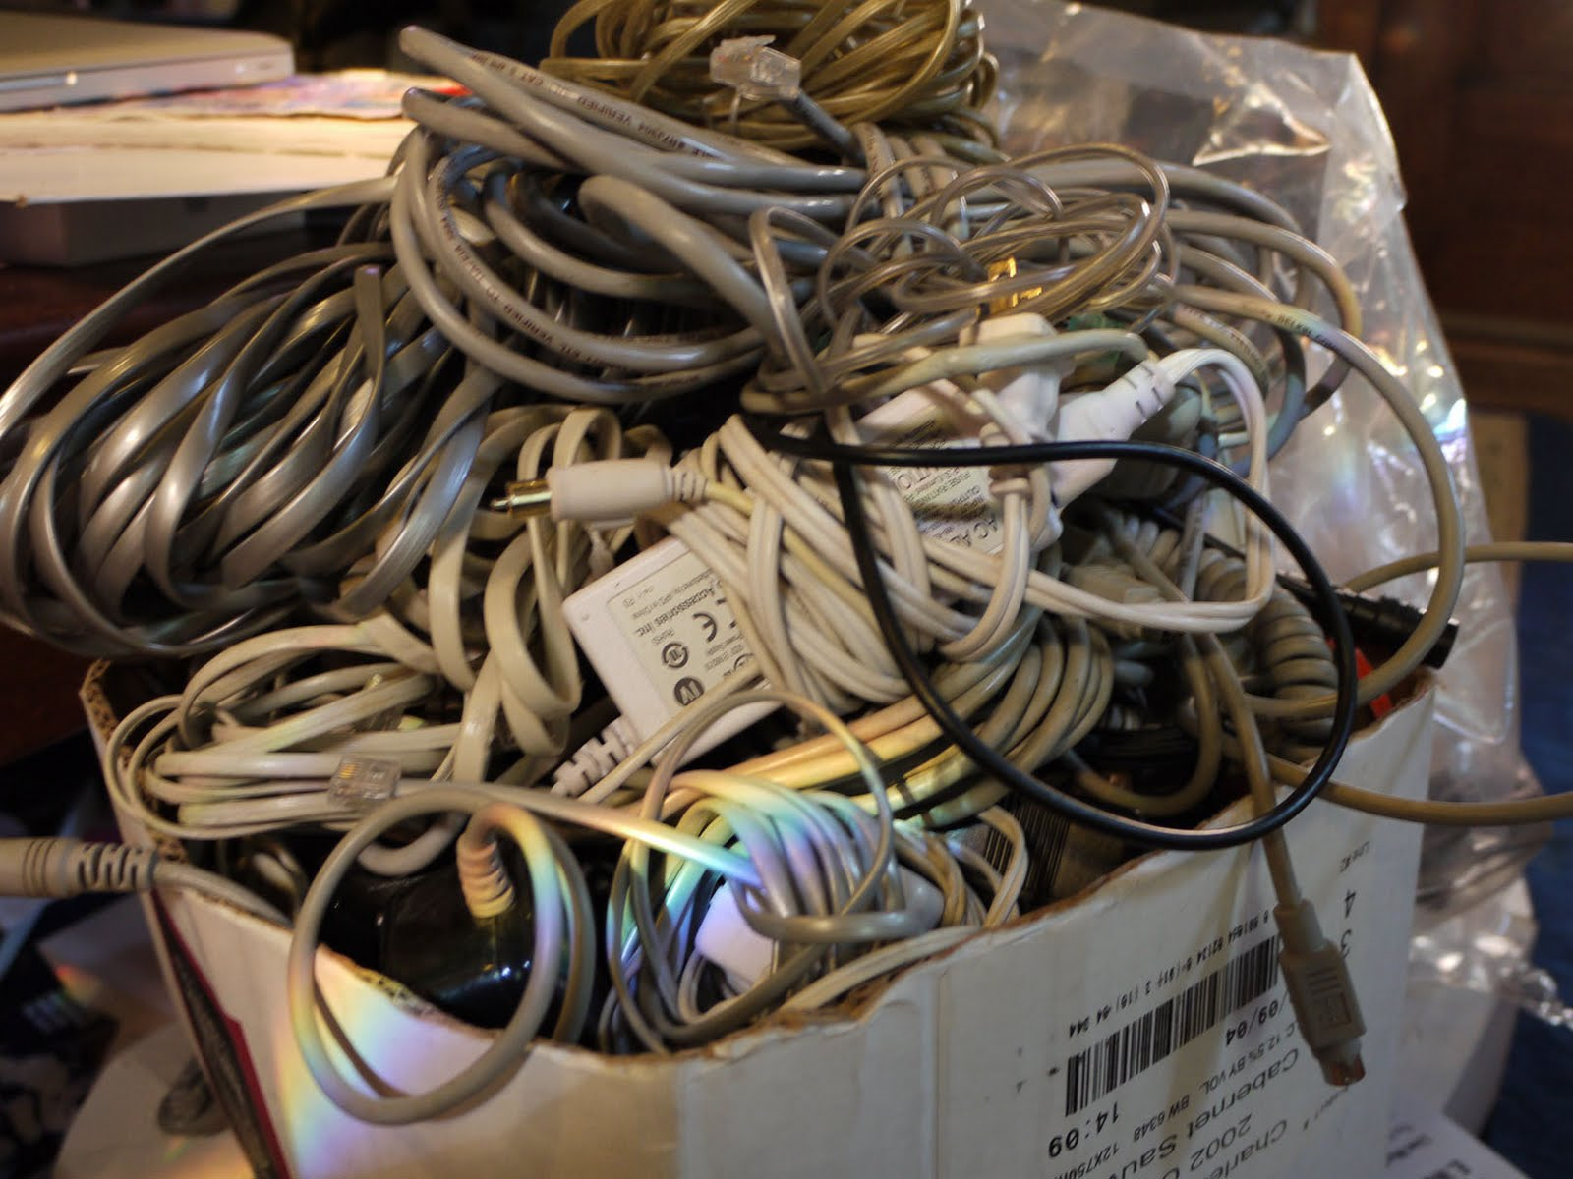
Any Hotel Lost and Found

Slide 10
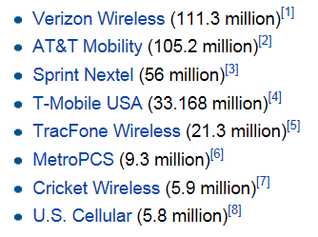
1. Start with best provider in Your Locality.
2. Chose a 4G option
Usually $0 to $200 with contract.
Choosing A Smartphone

Slide 11
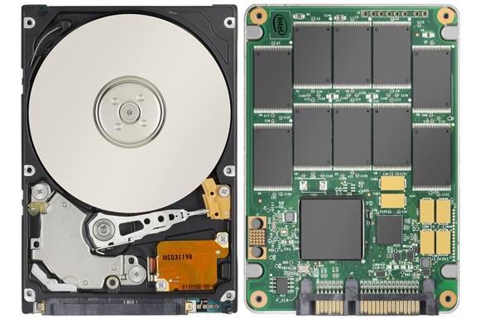
Solid State Drives

Slide 12
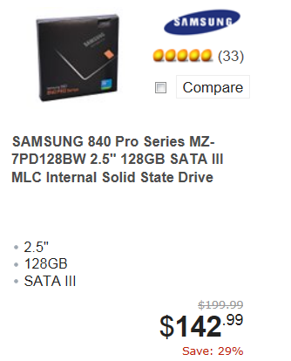
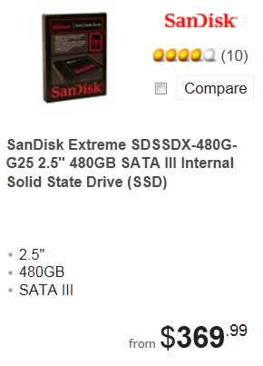
1. No Moving Parts, Much Faster, Less Susceptible to Damage
2. No spin up time – so almost immediate results
3. Uses far less energy
4. Fragmenting not an issue
5. 10 times more expensive ($1-$2 /GB vs $10-$20/GB)
6. HDD 5600, 7200, 10,000, 15,000 RPM
7. Performance degrades over time.
8. Limited life span???
(Only 2 Million hours)
9. SSD Video
9. Hybrid drives
Solid State Drives (SSD)

Slide 13
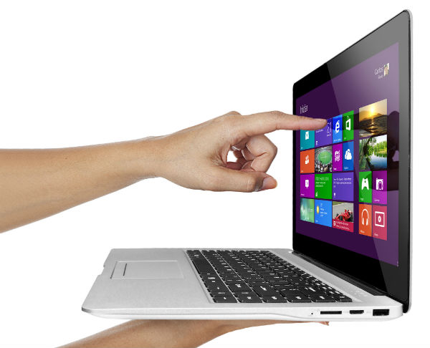
Touchscreen
UltraBooks

Slide 14
Touchscreen Ultrabooks
Touchscreen Ultrabooks (TUs) offer both touchscreen and keyboard/mouse interfaces.
Touchscreen Ultrabooks are thin, lightweight, fast booting, and usually larger than tablet PCs.
Some TUs can be split, so the monitor portion can be used as a tablet.
Windows 8 supports both application interfaces.

Slide 15
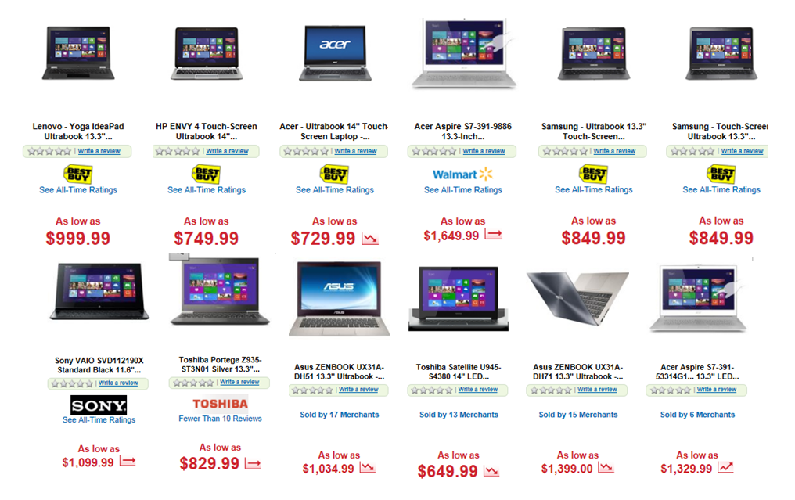
Examples of Touchscreen Ultrabooks
As of November 10, 2012

Slide 16
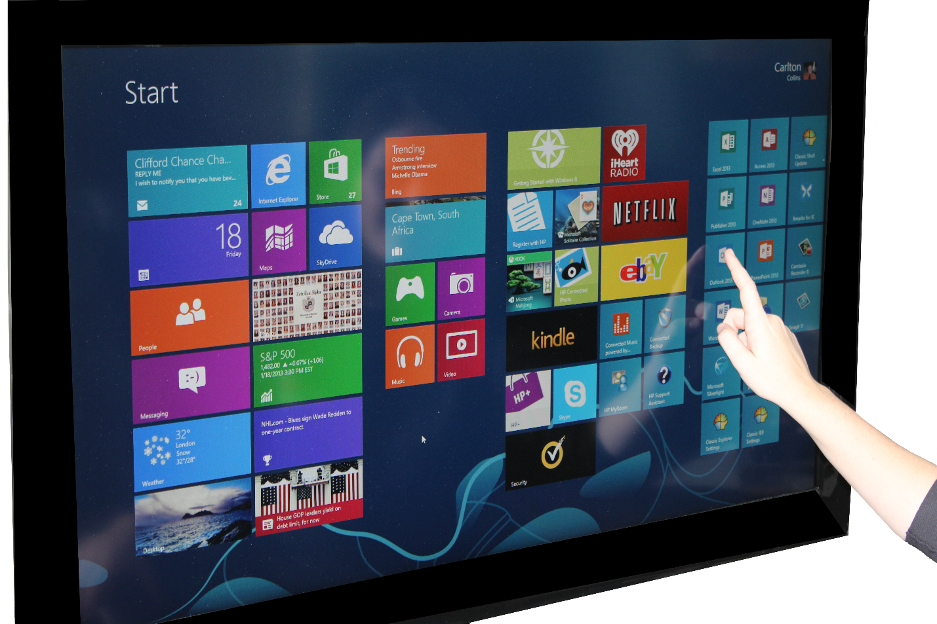
Windows 8

Slide 17
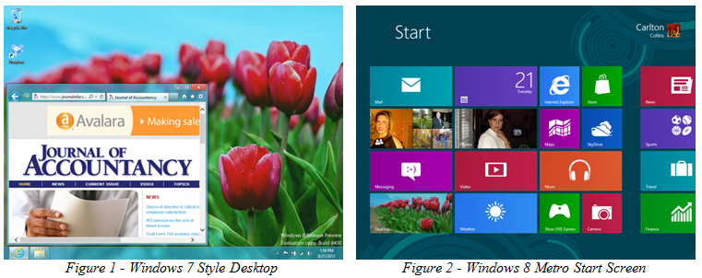
Examples of Windows 8 Screens
Windows 7 Style Desktop Touchscreen (Modern U/I)

Slide 18
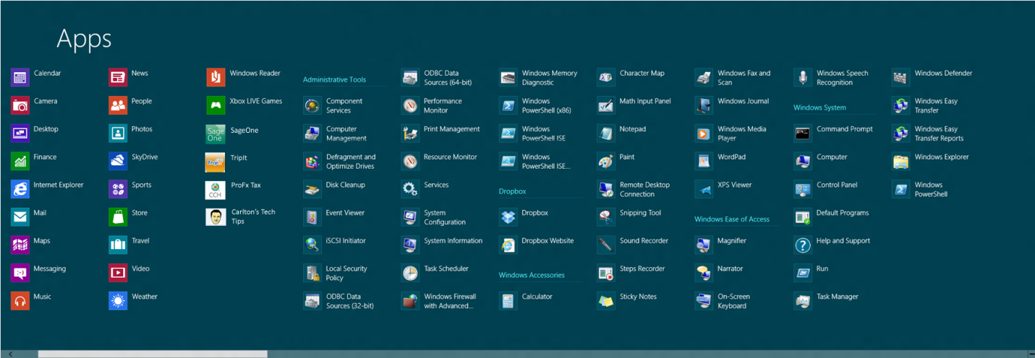
Examples of Windows 8 Screens
Figure 3 - Installed Apps Screen

Slide 19
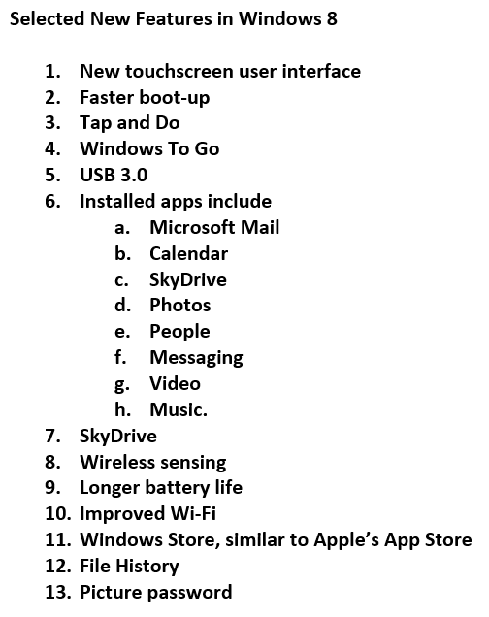
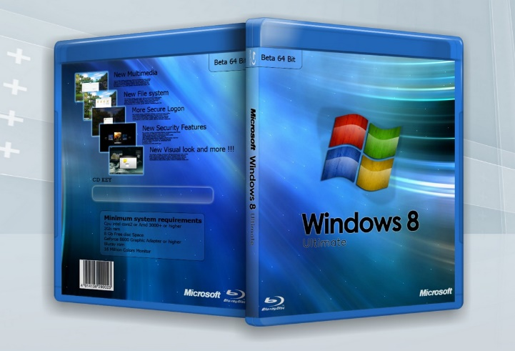
Key Windows 8 Enhancements

Slide 20
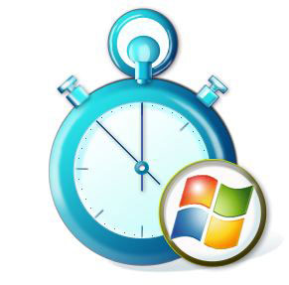
Faster boot-up

Slide 21

Tap and do

Slide 22
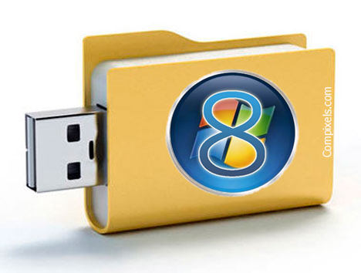
Windows To Go

Slide 23
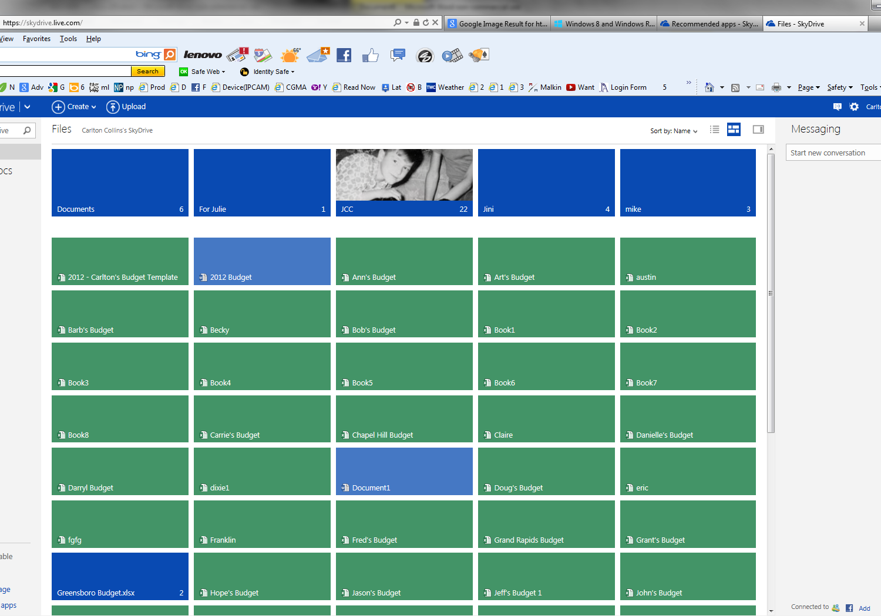
SkyDrive

Slide 24
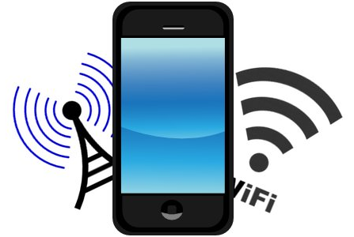
Improved WiFi

Slide 25
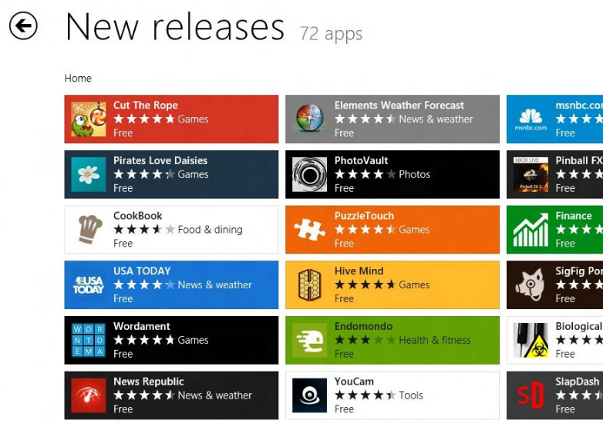
Windows Store

Slide 26
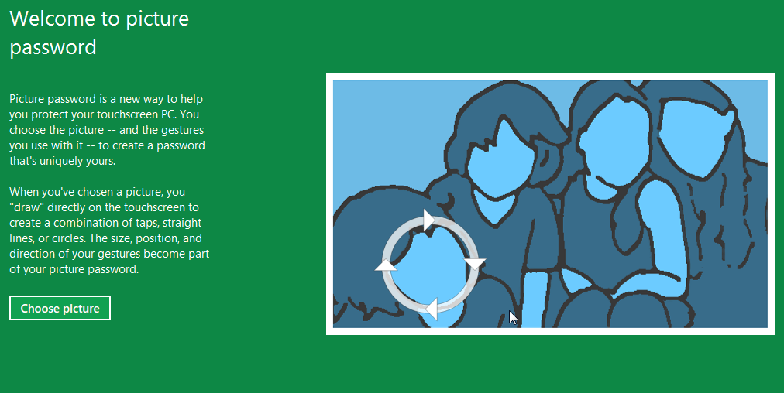

Picture Password

Slide 27
Windows Key
Pressing the Windows key toggles between the Modern Start screen, the last-run Modern app, and the classic Windows 7 Desktop view.
Windows + C
Displays the Charm Bar .
Windows + D
Launches the classic Windows 7-style Desktop view.
Windows + E
Launches a Windows 7-style Explorer window.
Windows + F
Opens the File Search pane.
Windows + H
Opens the Share pane.
Windows + I
Opens the Settings pane (tiles, volume, brightness, power off, etc.).
Windows + K
Opens the Devices pane.
Windows + L
Locks your computer or device.
Windows + P
Displays Windows 8 on a second screen (when available).
Windows + Q
Opens the global search utility.
Windows + R
Displays the Run box.
Windows + U
Displays the Ease of Use utilities (Narrator, Magnifier, and more).
Windows + W
Instantly searches for settings.
Windows + X
Displays the Power Users menu.
Windows + Z
Displays the App Bar in the Modern view.
Windows + 1, Windows + 2, and Windows + 3
Opens the first, second, and third (and so on) open apps in the classic Windows Desktop, respectively.
Windows + F1
Displays Windows Help and Support.
Windows 8 Shortcuts

Slide 28
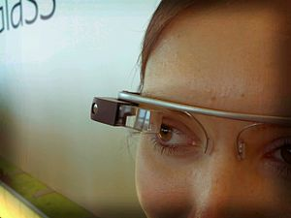
Google Glasses

Slide 29
Google Glasses
Fantastic or Really Creepy?
In 2013, Google announced Google Glasses ($1,500), a set of eye glasses you wear on your face like regular glasses that use a built-in smartphone, video camera and microphone to capture everything you see and do. It’s like wearing a miniature running camcorder on your face continuously. You could use these to create a Video Journal much like GoPro does.
https://www.youtube.com/watch?v=V3SAS1xpQw0
Google Glasses also have a voice active smartphone built in so you can make phone calls or search the web, and the results are displayed on the glass for one eye to see.
With this announcement, at the same time, Google has introduced amazing break-though technology with many possible benefits, and at the same time really creepy technology invasion of privacy technology.
The Bad
You could watch the football game in your right eye while pretending to listen to your wife talk.
You could cheat on a test in school by displaying answers in your glasses.
You could boot leg a movie at the movie theater.
You could secretly record your first date with an unsuspecting participant.
If a friend shouts “Glass” followed by an obscenity - your Google Glasses might display the disgusting picture instantly.
Someone can record themselves slaughtering dozens of people
App that undresses the person you are viewing
The Good
TV Enhancement
Bio Feedback
Face recognition
Instruction – baking, assembly, matrix style training
Navigation

Slide 30

Privacy Concerns

Slide 31
Privacy Concerns
Cloud monitoring
Echelon
Copy machine and printer hard drives
Google search history
Comcast web page history (case)
Traffic cameras, store cameras, beach, Old Faithful, Gorillas, SB, beach, Aruba, Bees
Drones in the sky, small drones
GPS Tracking, Google Latitude
Social media data mining & profiling
RFIDs
Arrest Records
Carlton’s Top 25 Security Measures

Slide 32
Google Latitude

Slide 33
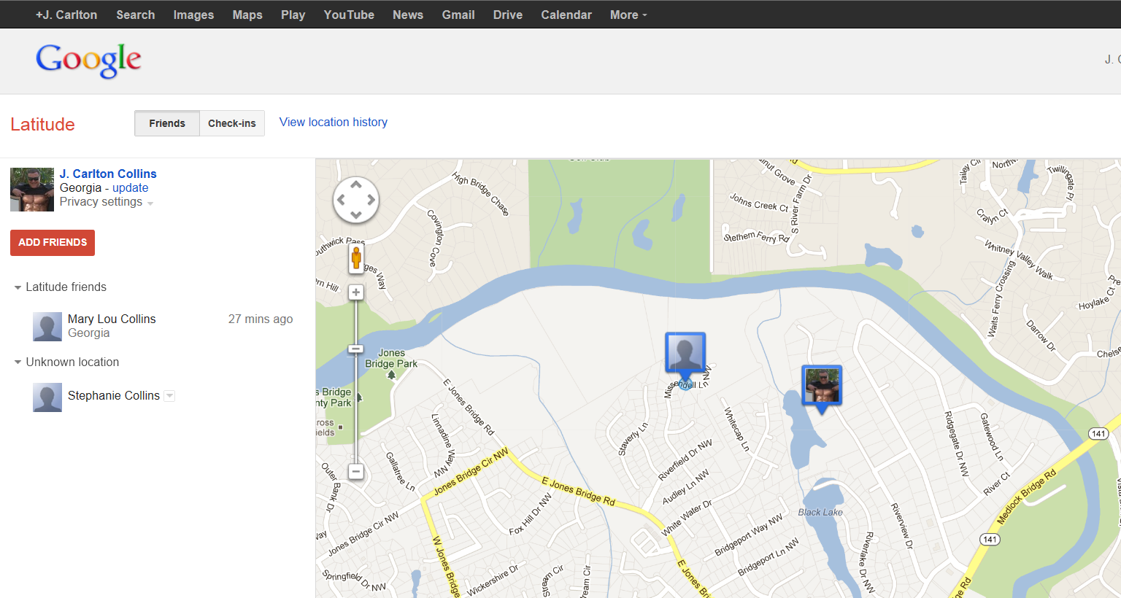
Google Latitude
Track a person via their smartphone

Slide 34
Microsoft
Office 2013

Slide 35
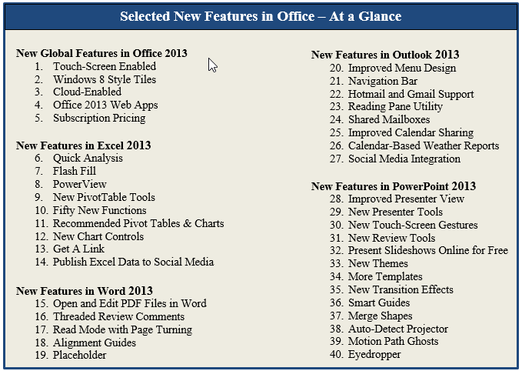

Slide 36
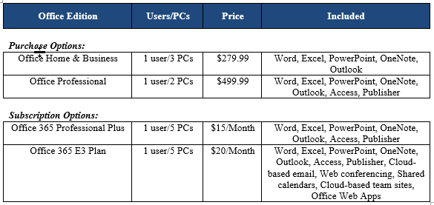
Subscription Pricing
Installs on more PCs
Never upgrade again
Superior iMap email
Better security
File Sharing
Eliminate upfront capital costs
Eliminate balance sheet liabilities

Slide 37
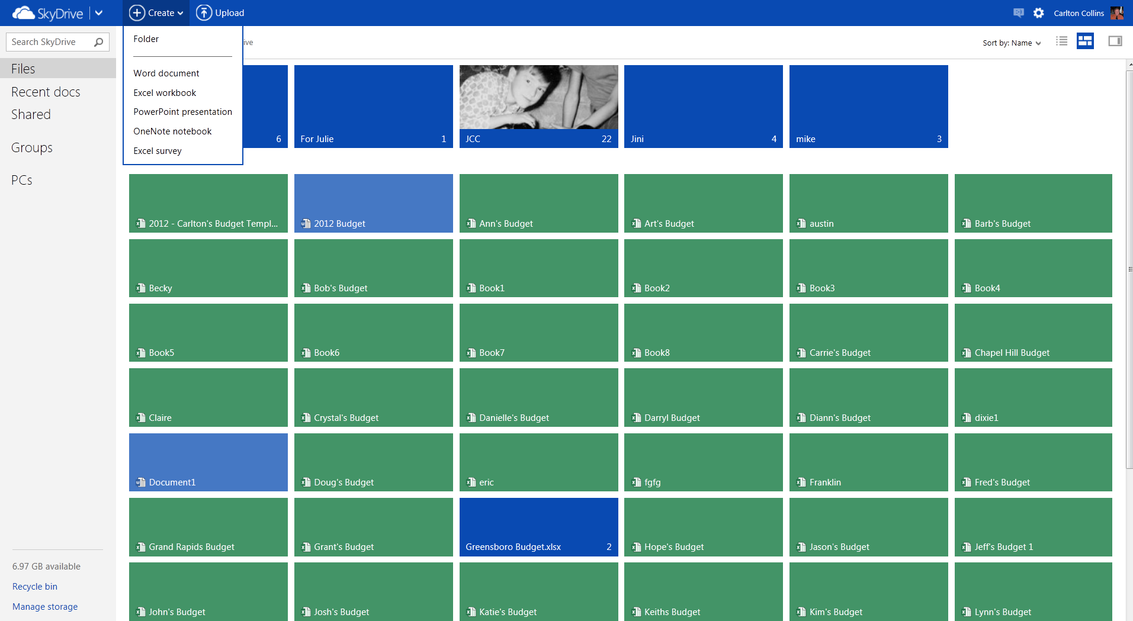
A free limited version of Office 2013 is available at home.live.com, Outlook.com or Skydrive.com
(See cloud slide for more details)

Slide 38
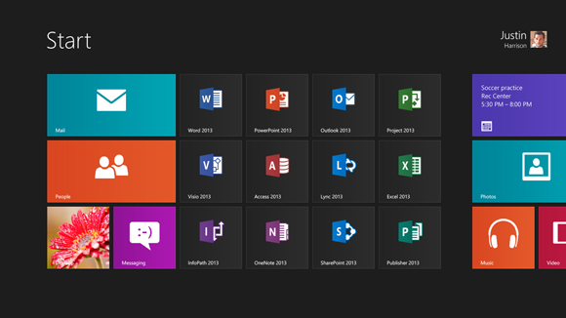
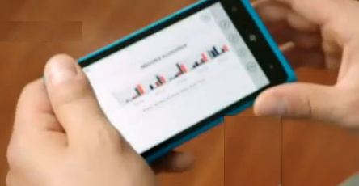
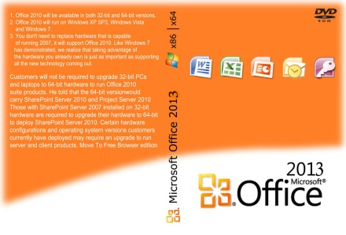
Office 2013
Touchscreen ready
Smartphone enabled
Windows 8 Look & Feel with Modern Tiles
Cloud-friendly
Runs on Win7 & Win8, not on XP or Vista
Buy or Rent (Rent on premise)

Slide 39
NFC

Slide 40
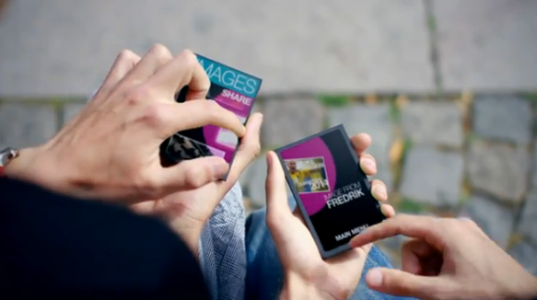
NFC – Near Field Communication
6 Inch Range
http://www.tubechop.com/watch/732835

Slide 41

BitCoin

Slide 42
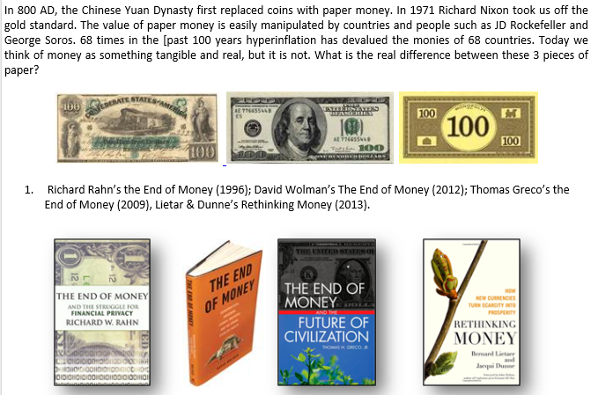
Digital Money
By J. Carlton Collins

Slide 43
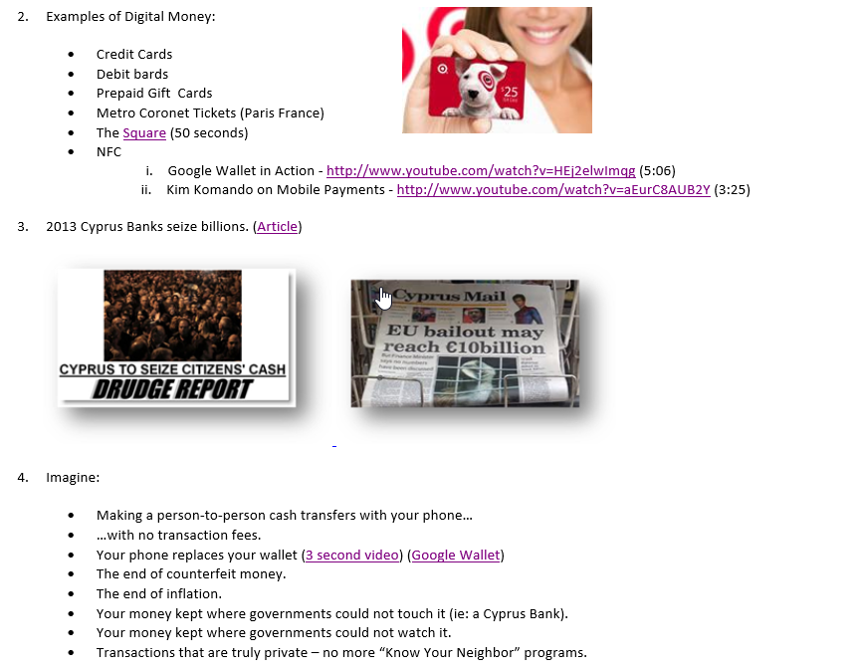

Slide 44
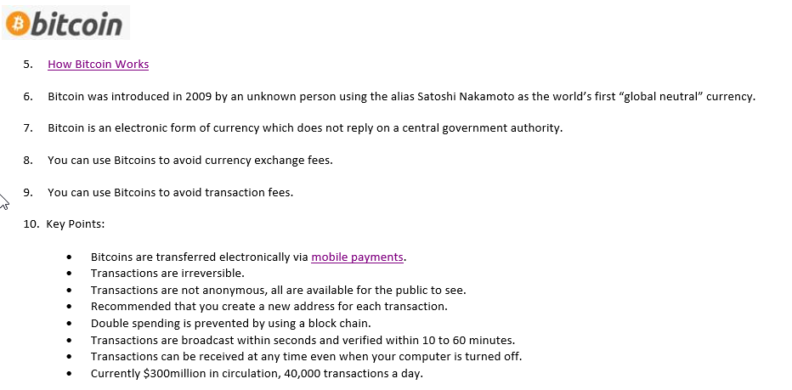

Slide 45
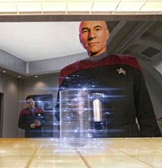
3-D Printing

Slide 46
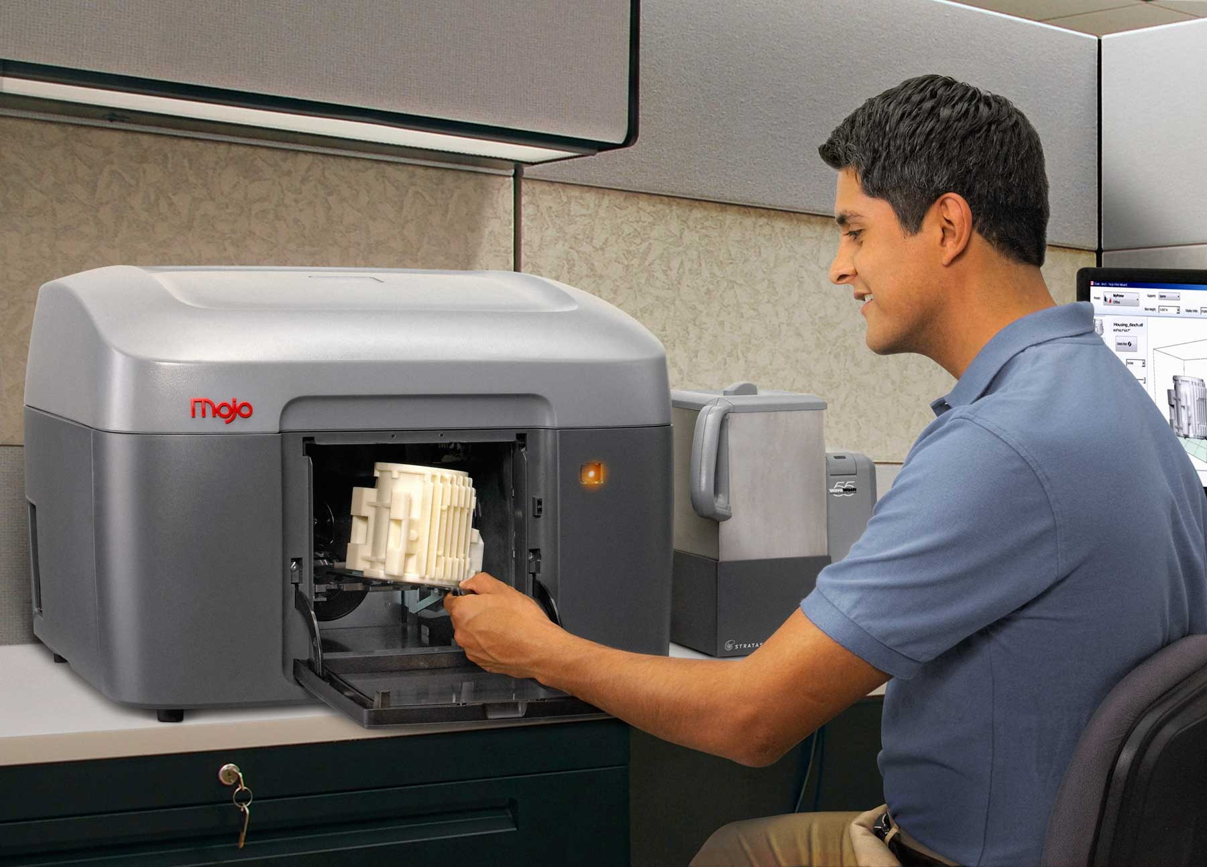
http://www.tubechop.com/watch/1134223
Starting at $1,469

Slide 47
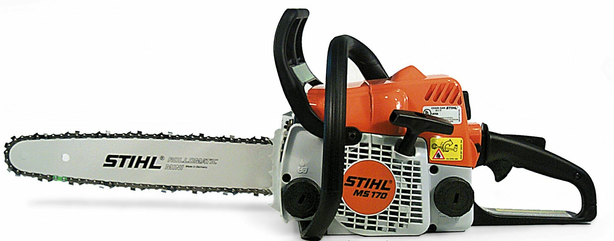
Saw Stop

Slide 48
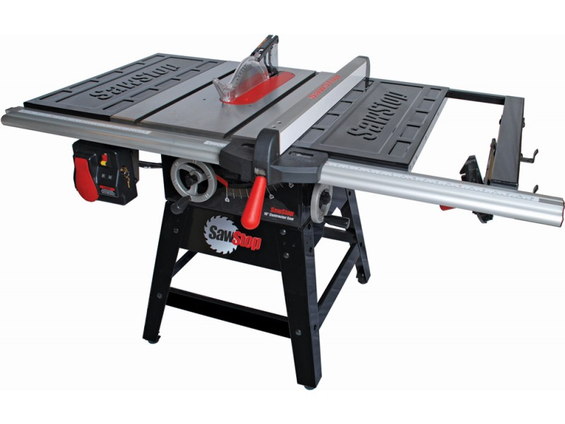
Saw Stop
60,000 table saw accidents a year, 10 fingers a day
http://www.wimp.com/amazingtechnology/
Chain saw - http://www.youtube.com/watch?v=Ah-FmYnaIWw&feature=fvwp

Slide 49
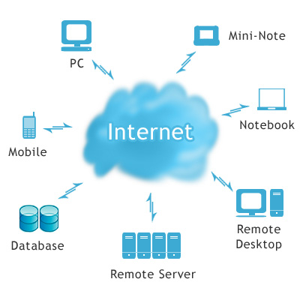
Cloud Computing

Slide 50
Shhhhh!
Cloud computing is really just another word for the Internet

Slide 51
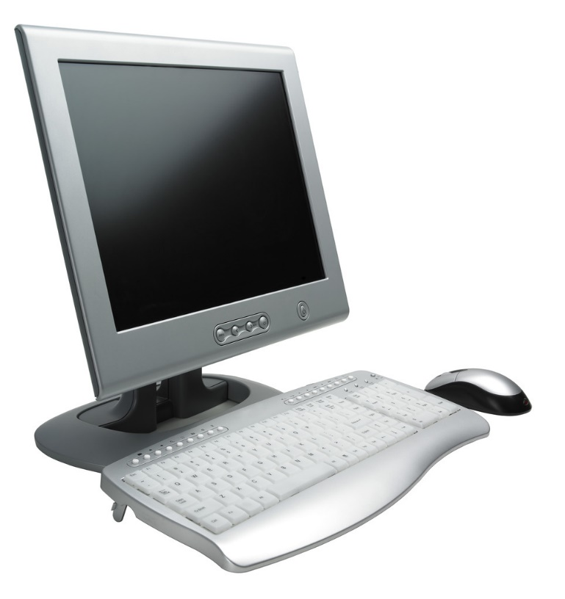
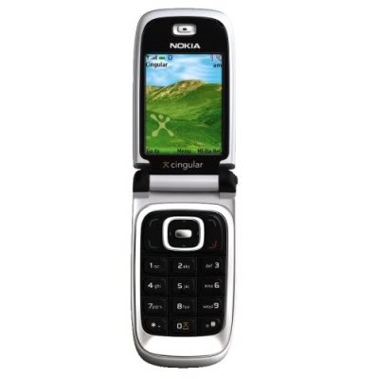
Before the Cloud
SYNC

Slide 52

After the Cloud
SYNC
SYNC

Slide 53

After the Cloud
Weather Conditions
Airport Info
Gate Changes
Driving Directions
Flight Delays
Friend Alerts
SYNC
SYNC

Slide 54
Eight Ways in which Cloud Computing is Transforming the Way We Work
Merging Real Time Data with Your Information – Your TripIt itinerary doesn’t just show you your hotel and car rental information, it shows you real time weather reports, airplane arrivals and delays, airport gates. GasBuddy shows you the gasoline prices all around you. Your maps show you the speed of the traffic ahead of you.
Easier Access - Cloud computing means that you will be able to access information from a number of devices that are connected to the Internet. All you will need to have are the login credentials in order to get to your particular area on the cloud.
Easier Storage - There is going to be much more room for information storage in a cloud. This means that there is going to be more information that can be stored on the cloud.
Back Ups For Business - Businesses are going to need backups for the information that they are holding. This is going to mean taking a good look at your systems and find out how you can restore all of that information quickly. With cloud systems, this becomes much easier.
Security - All cloud systems are becoming more and more secure. Even if you are just looking for your own personal online form of storage, then you will be happy to know that your information is going to be protected.
Convenience - Easier access is going to make for more convenience. You do not have to carry around a hard drive with you all the time if you are on the go. This is good for individuals as well as businesses.
Pricing - The price of cloud storage actually doesn't cost that much. For businesses in particular, it ends up becoming a very cost-effective form of backup. All you will need to do is rent a certain amount of space.
Flexible - Flexibility is one of the main reasons that a lot of businesses enjoy using cloud services. If they have a certain amount of space, then they can use that to store information. If more space is needed, then all you need to do is increase it and pay the increased fees. This means that you do not have to buy more space than you need. You can always get more data storage and pay for it as you need it. Again, this ties in with the overall cost-effectiveness of using a cloud system.

Slide 55
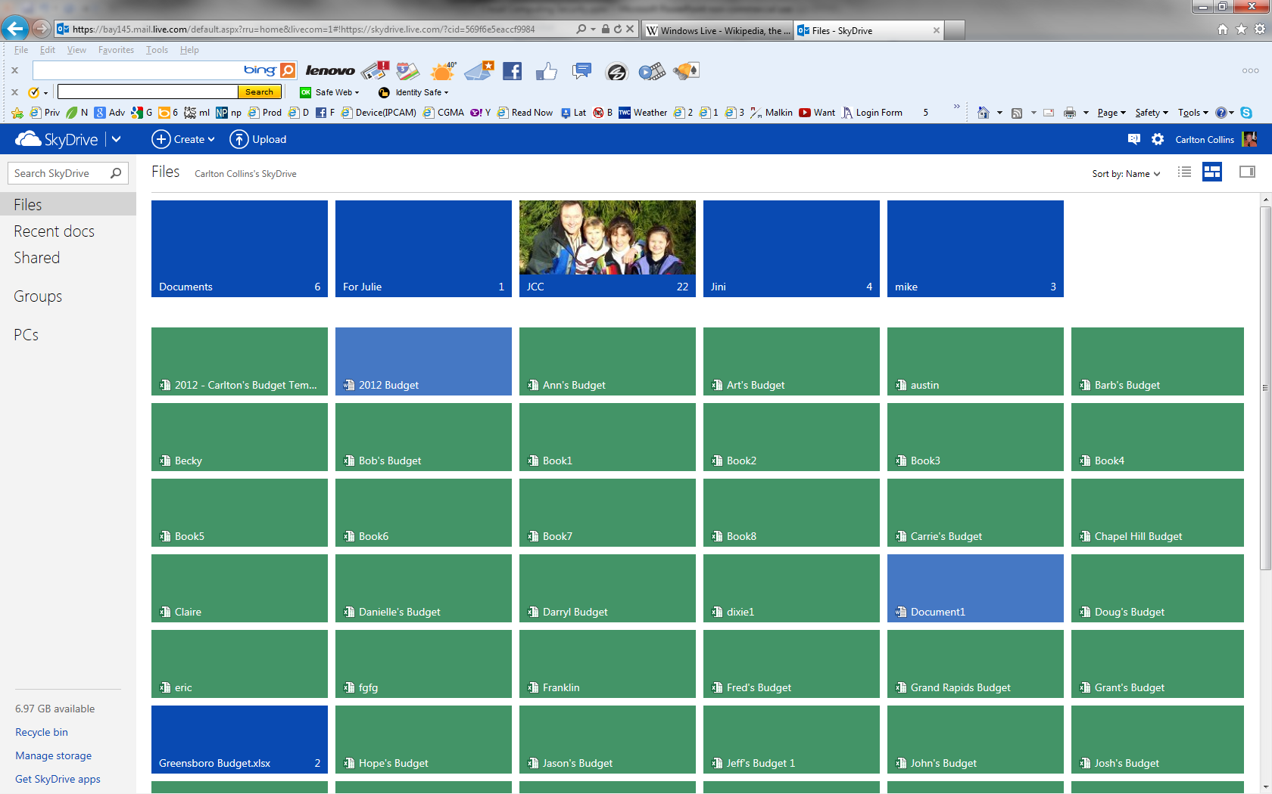
Microsoft’s Mail & SkyDrive (Formerly) Windows Live
Windows Live is a set of services and software products from Microsoft; consisting of selected Office applications, a 7 Gigabit SkyDrive, HotMail, and a services platform.

Slide 56

Google Docs
Like Windows SkyDrive, Google Docs is a free, Web-based office suite and data storage service offered by Google within its Google Drive service. It allows users to create and edit documents online while collaborating in real-time with other users. Google Docs combines the features of Writely and Spreadsheets with a presentation program incorporating technology designed by Tonic Systems. Data storage of files up to 1 GB total in size was introduced on January 13, 2010, but has since been increased to 10 GB, documents using Google Docs native formats do not count towards this quota. The largely anticipated cloud storage feature by Google is said to be replacing most of Docs' features in 2012. This extension or replacement of Google Docs called Google Drive was opened to the public on April 24, 2012.

Slide 57

DropBox
Dropbox is a file hosting service operated by Dropbox, Inc. that offers cloud storage, file synchronization, and client software. Dropbox allows users to create a special folder on each of their computers, which Dropbox then synchronizes so that it appears to be the same folder (with the same contents) regardless of the computer it is viewed on. Files placed in this folder are also accessible through a web site and mobile phone applications.

Slide 58


Slide 59
Importing to GoogleDocs & SkyDrive - http://www.youtube.com/watch?v=txCK3d90GcY
SkyDrive/Office Video - http://www.youtube.com/watch?v=D6O9J_EzmqE&feature=relmfu
Intro to SkyDrive - http://www.youtube.com/watch?v=hoTBiIpz8DI&feature=related
Intermediate SkyDrive - http://www.youtube.com/watch?v=YdhB2u2mOLM&feature=relmfu
GoogleDrive versus DropBox - www.youtube.com/watch?v=0FbjsNsfEmE&feature=related
EverNote – http://www.bing.com/videos/search?q=evernote&view=detail&mid=FC081D4B847324B6E926FC081D4B847324B6E926&first=0

Slide 60

Speech Recognition

Slide 61
Microsoft Speech Recognition Demo
Works better with 1 to 2 hours of training
Works best with 3 to 6 months of corrections

Slide 62

YouTube

Slide 63

YouTube
More content than CBS, NBC & ABC every 60 days
Upload Demo
Editing Tools
Embed Code Demo
Lila Ann Rose - https://www.youtube.com/watch?v=nwn6_qtQMN8
Maisy & Lennon, Butter - https://www.youtube.com/watch?v=7_aJHJdCHAo
Maisy & Lennon Headlock - https://www.youtube.com/watch?v=uxdUuk_l2Lk
Rachel Price - http://www.youtube.com/watch?v=sAIVlOvsMuM
Maisy & Lennon, Nashville……………………………………………………..

Slide 64
Example YouTube Clips
RFIDS - https://www.youtube.com/watch?v=_xNhL39uD7I
RFID Forklift - http://www.tubechop.com/watch/734446
ATM Scam - https://www.youtube.com/watch?v=m3qK46L2b_c
Installing Electrical Wiring - http://www.tubechop.com/watch/734456
Installing Bee Hive - http://www.tubechop.com/watch/734467
Learn the Guitar - http://www.youtube.com/watch?v=6Obf278F_00

Slide 65
YouTube:
  More content published to YouTube in a 60 day period than the three major U.S. television networks created in the past 60 years. 490 million unique users worldwide per month, who rack up an estimated 92 billion page views each month.
  YouTube is a phenomenal learning center. Carlton’s Prediction – YouTube University will be the world’s largest learning center within 5 to 10 years.
  www.tubechop.com – Crop a portion from any YouTube video
  www.mixpod.com – Combine cropped portions of YouTube clips
  www.vixey.com – Convert YouTube clips to self-running MP4s on your computer
  Uploading to YouTube is Easy (quick demonstration)
Embedding Code (Bandwidth and Codecs come from YouTube web site)

Slide 66

Ted Talks

Slide 67

Ted Talks
Who is Ted and why does he talk so much?
TED = Technology, Entertainment & Design
Average 6 to 12 minutes, not professional speakers
Creativity - http://www.tubechop.com/watch/733384
Best Thing - http://www.tubechop.com/watch/733396
Sugata Mitra shows how kids teach themselves - http://www.ted.com/talks/sugata_mitra_shows_how_kids_teach_themselves.html
Start at 7:45, or 9:37

Slide 68

Distance Learning

Slide 69

Distance Learning
No admission, No Credits (Certificate)
Harvard & MIT (EdX) 150,000 from 160 countries in 2011
Fathom (2000 Columbia & Michigan); All Learn (2003 Yale, Princeton and Stanford)
Remote Access Tools for Remote Training
  Skype

Slide 70

500 Pages of Tips

Slide 71

Carlton’s JofA Articles
www.CarltonCollins.com

Slide 72

Google
Fiber-Optics

Slide 73
Google Fiber
Google Fiber is a project to build an experimental broadband internet network using fiber-optics, 100 times faster than today’s broadband.
Austin, Texas; Kansas City, Kansas; Kansas City, Missouri; North Kansas City, Missouri and Provo, Utah.
  Three pricing options:
  Free – 5 Mbps speed
  2. $70 per month 1 Gbps (1,000 Mbps) speed, Includes 1 terabyte of Google Drive.
  3. $120 per month also includes television with 2 terabyte DVR recording up to eight live television shows simultaneously. Nexus 7 tablet acts as a remote control for the system.

Slide 74

Transparent Glass

Slide 75

Samsung’s Transparent Smart Window
Example Uses - http://www.tubechop.com/watch/732846

Slide 76
Smart Mirror
http://www.wimp.com/screentechnology/

Slide 77

The Square

Slide 78

Square, Sage Credit Card Reader
$20 device that plugs into any computer, tablet, or smartphone audio jack) in order to accept credit card payments on the go.
3,500 Girl Scout troops in Ohio used Sage credit card readers (connected to the scout’s smartphones) to accept electronic payments, boosting sales of Girl Scout cookies by 30% because the scouts were able to take orders and accept payments from cashless customers who were only able to pay using their credit card.
Video
(Cost versus transaction fee
and percentage fee should be considered)
Sage’s Credit Card Reader

Slide 79

Snipping Tool

Slide 80


Snipping Tool
Start Button, Program Files, Accessories
Higher resolution than Print Screen
Save to Different Formats
Highlighter, Eraser
Add to your Quick Launch Tool Bar
PrintScreen (resolution not as high)
Shift + PrintScreen (to capture active window/box only

Slide 81
1. Soon to be obsolete due to ultrabooks?
2. 2001 - Microsoft introduced first tablet
Laptop with touchscreen
Still had to boot up
3. Jan 2010 – Apple iPad
Basically a big iPhone, without the phone
Easier to read
No monthly subscriptions cost *
Tablets

Slide 82


Tablets
http://www.tabletpccomparison.net/
Brands

Slide 83
1. Safari Browser
2. Keyboard
3. Camera
4. Pictures (pinch, tap)
5. Photobooth
6. Video
7. Notebook
8. Maps (Peek behind)
Tablet Demonstration
9. YouTube
10. GoToMyPC
11. iBooks
12. Skype
13. Angry Birds
14. Fruit Ninja
15. Apps

Slide 84



High-End Computers

Slide 85
Rain Computers of Ringwood, NJ (raincomputers.com) produces a liquid-cooled desktop computer equipped with up to sixteen i7 core processors (two i7 cores with 8 processors each), 20 MB of core cache, Tesla companion processor, up to 96 GBs of RAM, up to six 480 GB solid state hard drives (SSD), hyper-threading, Turbo Boost, running Windows 8 64-bit, with prices starting at $2,499.
Rain also produces a laptop computer equipped with an i7 quad core processor, up to 32 GBs of RAM, dual 480 GB solid state hard drives (SSD), hyper-threading, turbo boost, running Windows 8 64-bit, priced starting at $1,299.
Rain computers are primarily targeted towards the high-end audio-visual industry, but are well suited as high-end business computers. Other high performance desktop computer manufacturers include Alienware (www.alienware.com), targeted primarily towards the gaming industry; and Maingear (www.maingear.com), targeted primarily for business professionals.

Slide 86
Gestures

Slide 87
Gestures
In this video, asks questions about using gestures “Why can’t we do the following?”
Control TV - https://www.youtube.com/watch?v=lt60r3AwuV8
Wii Bowling - https://www.youtube.com/watch?v=zwXX27U6WnI
Example of Gestures with a Smart Window:
Minority Report - http://www.tubechop.com/watch/734400

Slide 88

Robotics

Slide 89

http://www.tubechop.com/watch/1134209

Slide 90

Tiny URL

Slide 91
Tiny URL
Make a shorter URL
Avoid extra long URLs that might break in email
Hide URLs (so the reader does not know where the content is coming from)
Make a TinyURL Tool Bar Button
Bit.ly does the same thing

Slide 92

Google Map Tips

Slide 93
Google Maps
Driving Directions
Add Destinations
Ad destinations by right clicking the map
Rerouting by dragging the route
Printing Directions
Satellite or Map View
Traffic View

Slide 94

Field Monitor Pro

Slide 95
Field Monitor Pro
$275
Uses USN Port
Gives you 2 USB Ports
Daisy Chain up to 7
Number Pad

Slide 96

Google Alerts

Slide 97

Google Alerts

Slide 98

Encryption File System (EFS)

Slide 99

EFS – Encryption File System
Takes just 5 Seconds
In Pro versions of XP, Vista, 7 & 8
Not in Home versions
Encrypt a file, folder, or drive

Slide 100

Paperless

Slide 101

Paperless
Few CPAs have regrets
Large Scanner versus desktop scanners
Sheet Feeder
OCR File naming & Keyword creation

Slide 102

Wireless Technology

Slide 103


Frequency Allocation Chart
FCC reserves many frequencies and auctions off others
Higher frequencies provider greater bandwidth, lower frequencies provide greater range
License-free spectrums (amateur)
FCC restricts power output among license-fee frequencies
More WiMax info
Wireless Technology
Is WiMax Dead for Router Use?

Slide 104


Slide 105


Slide 106

Multiple Monitors

Slide 107



Slide 108

My Old Computer System

Slide 109



My New Computer System
The screens are so bright, the camera won’t take a decent picture of them
Though it does not look like it, the lights are fully on in my office

Slide 110

Ergonomics

Slide 111

Laptops are not Ergonomically Sound
Ouch
Ouch

Slide 112

Well Organized Computer System

Slide 113





Slide 114


Slide 115





Slide 116

Interactive Paper

Slide 117

http://www.diginfo.tv/v/13-0025-r-en.php
http://m.digitaltrends.com/computing/fujitsu-makes-paper-interactive-with-just-a-webcam-and-projector/

Slide 118

Instant Search

Slide 119

Instant Search (Indexed Searching)
Windows 8, 7 & Vista
Improved in Windows 8
Stacking Results
Must modify through control panel to index your data folders other than My Documents

Slide 120

Learning Thermostat

Slide 121

http://reviews.cnet.com/appliances/nest-learning-thermostat/4505-17889_7-35179222.html#reviewPage1
The Nest Learning Thermostat might be the thermostat of the future

Slide 122

Technology Steam Rolls Along
Revenue per employee to is 5 to 50 times higher per employee today than 30 years ago
Woolworths, JC Penny’s, Sears, Wal-Mart
Stage Coaches, Train Industry, Typewriters, Retail Strip Malls, Digital Cameras
Out-sourcing, In-sourcing
Keep up or get left behind???

Slide 123
Thank You

Slide 124
A Few Short
Tech Hits

Slide 125


Slide 126


Slide 127


Slide 128


Slide 129


Slide 130


Slide 131


Slide 132


Slide 133


Slide 134


Slide 135


Slide 136


Slide 137


Slide 138


Slide 139


Slide 140


Slide 141


Slide 142


Slide 143


Slide 144


Slide 145


Slide 146


Slide 147


Slide 148


Slide 149


Slide 150

http://www.youtube.com/watch?feature=player_embedded&v=8UjcqCx1Bvg

Slide 151


Slide 152


Slide 153


Slide 154


Slide 155


Slide 156


Slide 157


Slide 158


Slide 159

Lasso Slippers Pack Flat, Assemble In Seconds

Slide 160


Slide 161


Slide 162


Slide 163


Slide 164


Slide 165


Slide 166


Slide 167


